Slide 1
Support Your Media Day
101 for Participating Organizations
Part I of III: Getting Started

Slide 2
Getting Started
Learn about Razoo
Learn why your org should participate
See a giving day in action
Plan a Fundraising Strategy

Slide 3
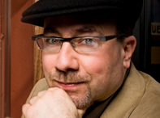
Razoo at a Glance
Launched in September 2006
More than 180,000 people around the world have donated $73 million through Razoo
Over 10,000 U.S.-registered nonprofits have received donations through Razoo
We’ve worked with community foundations (Minnesota Community Foundation), companies (Land-O-Lakes), and celebrities (Craig Newmark, founder of craigslist.org)

Slide 4
Why should your organization participate?
NEW DONORS!
87%
of nonprofits reported getting new donors on Give to the Max Day in Minnesota in 2009 and 2010.
Second Harvest Heartland reported getting 900 new donors in 2009.
Source:

Slide 5
Why should your organization participate?
It’s CHEAP. TMC is supporting the backend development of the Support Your Media Day portal, so your only investment is staff time to develop your own strategy.
Source:

Slide 6
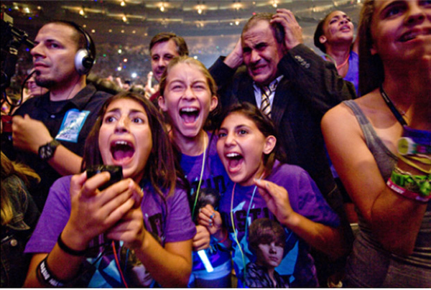
Why should your organization participate?
It’s all the rage. Seriously. Everyone will be talking about it. And not just on Twitter – actually talking to each other, face-to-face like humans do once in awhile.
Source:

Slide 7
Why should your organization participate?
You might win a PRIZE. Who doesn’t like prizes? TMC is building a pool of matching grant money that will be awarded to participating orgs throughout the day. That means more money for your organization.
Source:

Slide 8
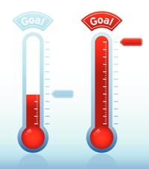
Why should your organization participate?
You will raise money. I repeat, you will raise money. Use this giving day to go out to your donors, ask your board to ask their friends to give, activate your support networks. You will raise money!
Source:
Notes:
Razoo estimates that you’ll engage 10% of your existing donor base in this day, based on other giving days. Other metrics to assist with goal-setting for the day: here are two sets for big and small media orgs organizations. You can generally count on a measure of around $0.25 cents per unique view. For those of you who are primarily
minnpost: 400 donations and 50K in the last giving day for givemn. 10K match from board. third year participating. 80K uniques: $0.62 per unique
the uptake: had 53 donors, raised $2700. average of $50 per donation. 10K uniques. $0.26 per unique.

Slide 9
How to Have a Successful Giving Day for YOUR Organization
Set a fundraising goal.
Offer a matching grant.
Get Creative!
Consider hosting a live event.
ENGAGE everyone you know to make the ask – email, facebook, Twitter.
Source:

Slide 10
Notes:
Jump out to links to GivePC pages.

Slide 11
Plan: Pre-Giving Day
Now:
Promote the event in your newsletter & explain on your website that Feb. 15, 2012 is THE day to give to support independent media, the media for the 99%.
Ask board members, top donors, or local businesses to provide a matching grant to incentivize donations on the giving day.
One month before:
Personally ask top donors to give and talk about the day in regular conversation.
Update your Facebook status with a link to the Support Your Media landing page: SupportYourMedia.Razoo.com.

Slide 12
Plan: Pre-Giving Day
Two weeks before:
E-mail supporters to remind them about the day.
Set up your organization’s matching grants on Razoo.
One week before:
Update Facebook and Twitter on a daily basis.
Send supporters a link to your organization’s Razoo page where they can donate.

Slide 13
Plan: Giving Day
Send 3 e-mails throughout the day to supporters.
Update them on fundraising progress.
Remind them of your overall goal.
Provide a reason for them to give again.
Promote your matching grant, $10 = $20, etc.
Utilize Facebook and Twitter.
Cheer on donors with status updates.
Ask questions to generate conversation & community.

Slide 14
Plan: Post-Giving Day
Send thank you e-mails to donors 1-2 days after the event
Tell them how their donation was put to good work and made a difference.
Provide updates about your organization—how much did you raise?
Make it easy for them to stay in touch.
Send physical thank you notes to top donors
Build life-long supporters and friends of your media outlet.

Slide 15
Contact
We are excited to see you succeed. Please contact us with any questions or if there is any way we can better support your fundraising efforts. We are here to help!
joellen@themediaconsortium.com
erin@themediaconsortium.com

