Slide 1
Support Your Media Day
Training for Participating Organizations
Part III of III: Strategy for your Giving Day

Slide 2
Getting the Most out of Razoo Further information is included in your checklist, available in the nonprofit toolkit [LINK TO TOOLKIT]
Create Projects and Fundraisers
Encourage Donations – be creative!
Plan a Fundraising Strategy

Slide 3
How to Have a Successful Giving Day for YOUR Organization
Set a fundraising goal.
Offer a matching grant.
Get Creative!
Consider hosting a live event.
ENGAGE everyone you know to make the ask – email, Facebook, Twitter.
Source:

Slide 4
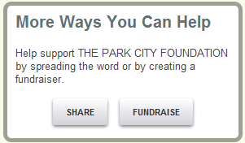
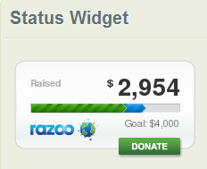
Create: Projects
From your organization’s page, click the Fundraise button on the right hand side to create a page for a specific program or event, which we call Projects.
Click Share to embed a Status Widget on your website or in your e-mail signature. The status widget updates as donations are made to your project, and is hyperlinked to your project page.

Slide 5
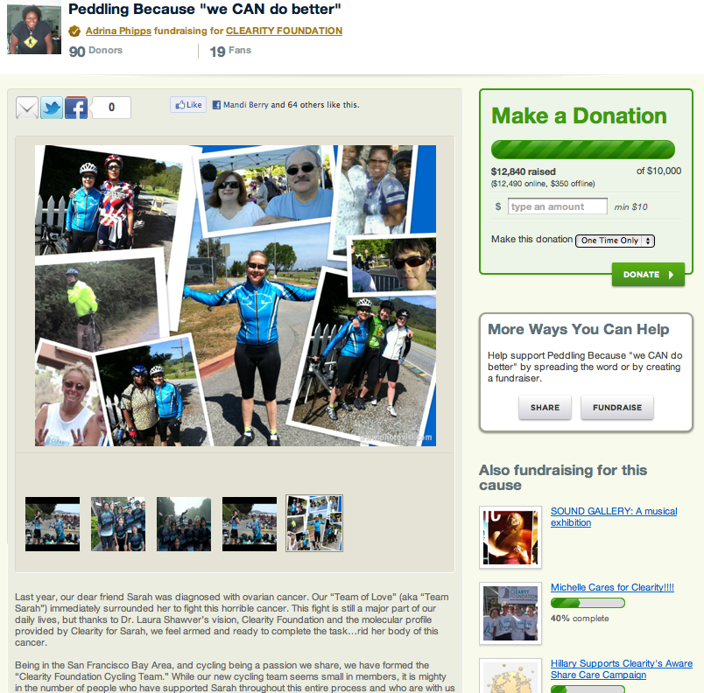
Create: Fundraisers
Direct supporters to click the Fundraise button from the right hand side of your organization’s page.
Fundraisers are customizable pages where supporters can use their own personality to raise funds on your behalf.
When individuals share why they love your nonprofit through their fundraiser, your work gains more exposure and support.

Slide 6
Encourage: Asking
Personal: Send e-mails to individuals, or call them on the phone, rather than sending mass e-mails.
Relational: Help supporters relate by telling stories about ways your nonprofit has made a difference.
Concrete: Provide examples of work your organization has done and ways that donations will bring about future good.

Slide 7
Encourage: Creativity
Associate your online fundraiser with an actual event. Have people donate to your fundraiser on a laptop, iPhone, or iPad:
host a party or happy hour
invite people into your office
start a competition
Use photos and captions to tell a story or make a video highlighting the work of your nonprofit.

Slide 8
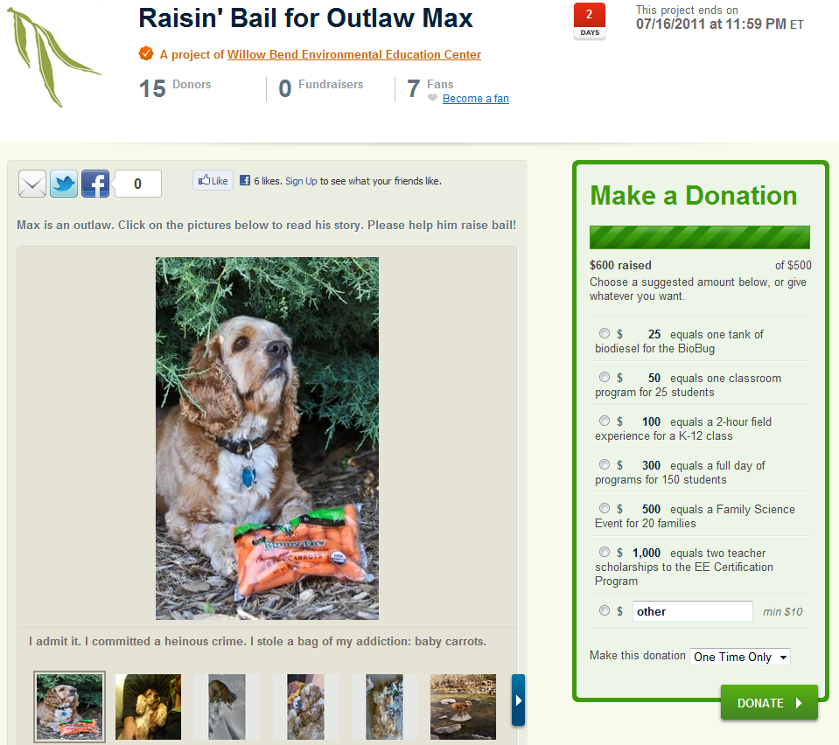
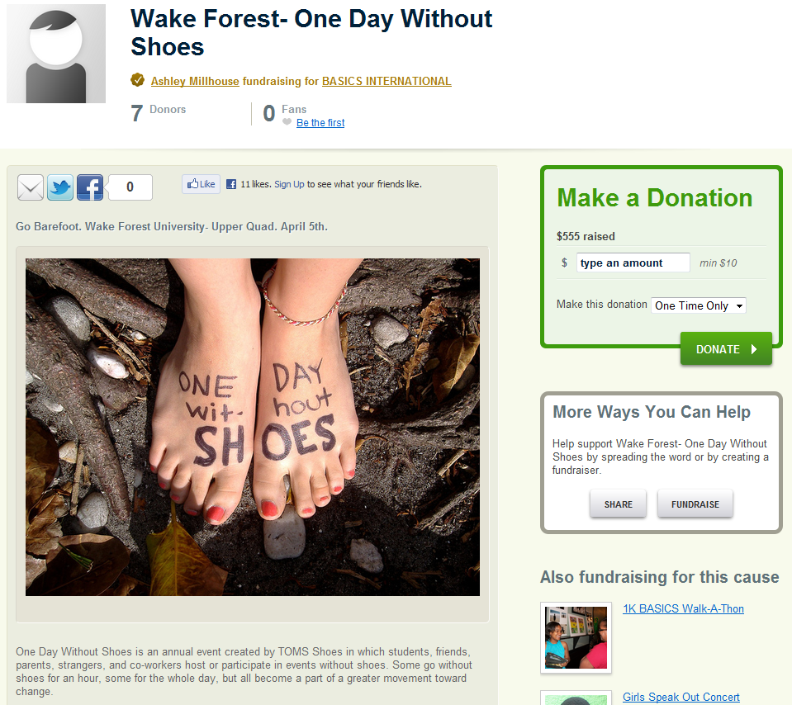
Examples of Creativity
Tell a story with images and captions. Add suggested donation amounts to express the value of a donation.
Connect your fundraiser with the actual work of your organization and help donors relate.
Notes:
Each of these images are hyperlinked. When you are in “slide show” mode, simply click to be brought to the fundraiser on Razoo.
Click through the images of “Raisin’ Bail for Outlaw Max” to read the story through images and captions.
Draw out the connection between the work that Basics International does with the idea of going barefoot for a day to raise awareness about the need, help donors sympathize with the cause, and encourage donations.

Slide 9
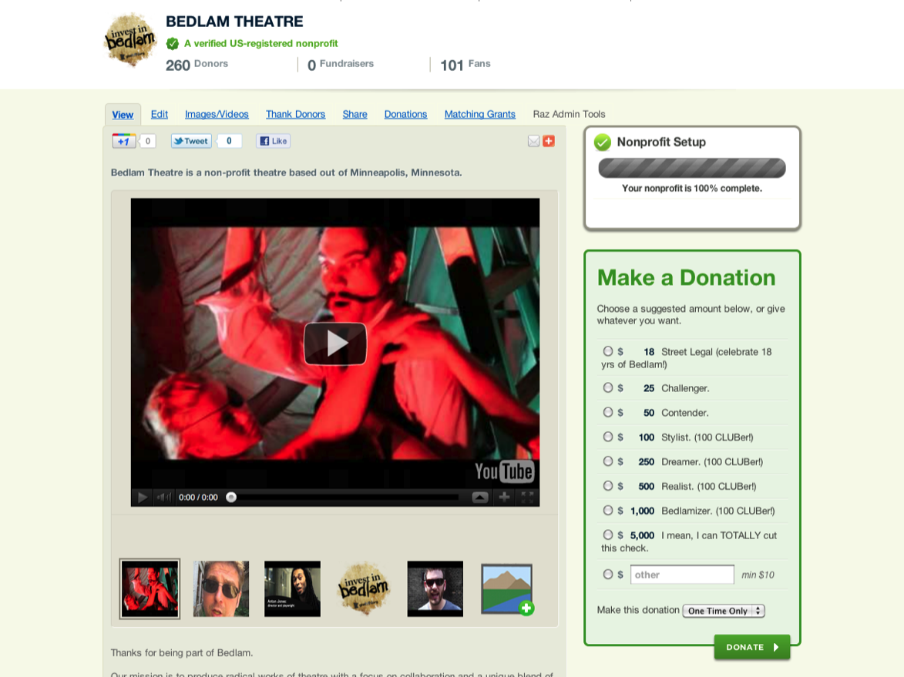
Case Study of Creativity
A Theatre in MN locked their director in a cage during Give to the Max Day.
Each donation counted toward a reward – water, food, stretch break, etc.
They raised over $6,000
Notes:
When you click the link to the fundraiser on the right, you can play the video
You can set up matching grants before the day, just select that the grant start on November 11^{7h}. It will not display until that day. At 12:00am on Nov 17th, a count down timer will appear and each time a donation is made, it will display how much of the match is still available.

Slide 10
Contact
We are excited to see you succeed. Please contact us with any questions or if there is any way we can better support your fundraising efforts. We are here to help!
Support@Razoo.com
866-437-1952
Monday-Friday, 9am-6pm EST

