Slide 1
First-Ever Independent Media Collaborative Fundraiser Live Event Sponsorship

Slide 2
The Media Consortium supports and grows the progressive independent media sector. We are the Media for the 99 percent.
On February 15, 2012, the Media Consortium will hold the first-ever collaborative fundraiser designed to increase charitable giving to progressive media. Over 40 media outlets will engage their audience of over 75 million progressive donors to participate in the fundraiser.

Slide 3
What is a Collaborative Fundraiser?
Dedicated Website
Livestream Video
Donors are directed to one website powered by Razoo.
Donors see all participating media and choose where to put their dollars
In real time, donors see how much funds are raised by each outlet.
Inspires friendly competition in game atmosphere.
12 hours of online news with participating journalists carried on FreeSpeechTV, Real News Network and The Uptake.org
Interviews with celebrity pundits including Laura Flanders and Young Turk Cenk Uygur.
Video stream will run on fundraising site and on over 35 member websites
Livestream Show will direct donors to fundraising website.

Slide 4
One-Day Collaborative Fundraiser
A day for supporters of progressive independent media to come together to raise as much money for this sector as possible
Creates fun and engaging ways for donors to learn about the real alternative to corporate media –and inspires people to give.
The first-ever collaborative fundraiser for this sector
How Can This Day Help You?
Position your company as a innovative leader committed to the 99 percent.
Bring business, marketing and foundation efforts together.
Reach new target audiences in a fun and engaging way
Increase brand loyalty

Slide 5
Media Coverage
National coverage by all 50 Media Consortium outlets.
PR Firm will reach out to business media to promote first-ever collaborative media fundraiser.
Facebook and Twitter campaigns, including a Tweetup and Tweetchat on the Fundraiser day.
YouTube promotional videos
12 hours livestream coverage on FreeSpeechTV.

Slide 6
Call to Action: Become a Sponsor!
Help engage donors and support independent media by participating in live online video coverage of this first-ever collaborative media fundraiser with an exciting news program crafted by Free Speech TV, Real News Network and the Uptake.
Gold Sponsor
$5,000
Silver Sponsor
$2,500
Bronze Sponsor
$1,000
Once-per-hour pre-recorded 30-second video commercial
Billboard at beginning and end of coverage segments that contains company logo and 10 sec message
Logo on Fundraiser website
Social Media Promotion
Up to 8 available
Billboard at beginning and end of coverage segments that contains company logo
Logo on Fundraiser website
Social Media Promotion
Up to 8 available
Logo on Fundraiser website
Social Media Promotion
Up to 10 available

Slide 7
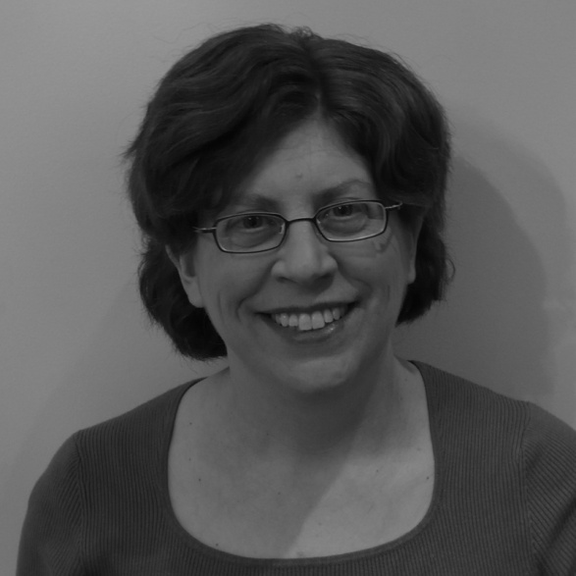
Contact Us!
Jo Ellen Green Kaiser
Executive Director
415-878-3862 (direct line)
joellen@themediaconsortium.com
www.themediaconsortium.org; Twitter: tmcmedia

