Slide 1
The Media Consortium: Collaborative Fundraising

Slide 2
Content
Introducing Razoo
Give to the Max Day Case Study
Why Participate in a Collaborative Fundraiser?

Slide 3
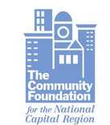
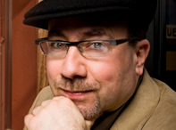
Razoo at a Glance
Launched in September 2006
More than 180,000 people around the world have donated $50 million through Razoo
Over 8,000 U.S.-registered nonprofits have received donations through Razoo
We’ve worked with community foundations (Minnesota Community Foundation), companies (Land-O-Lakes), and celebrities (Craig Newmark, founder of craigslist.org)

Slide 4
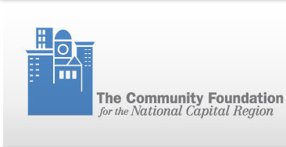
Razoo Giving Day Partners: from small cities to large states
Spring2Action Alexandria: May 5, 6, 7, 2011
Give to the Max Washington: November 9, 2011
(in collaboration with United Way and Razoo)
GiveMN Give to the Max Day: November 16, 2011
Live PC Give PC: November 11, 2011
Nevada Gives: November 17, 2011
Lexington Gives: November 18, 2011

Slide 5
Content
Introducing Razoo
Give to the Max Day Case Study
Why Participate in a Collaborative Fundraiser?

Slide 6
GiveMN’s Give to the Max Day
Goals
Build nonprofit capacity in online fundraising
Engage a new generation of online donors
Establish Minnesota Community Foundation as a philanthropic leader
Engage 4,000 nonprofits and over 40,000 donors

Slide 7
GiveMN’s Give to the Max Day 2010
Goals:
Increase giving to nonprofits across Minnesota
Get more than 40,000 people to donate
Help nonprofits attract new donors
Prizes offered:
Prize grants for nonprofits with most donations: $15,000 for 1st place, $10,000 for 2nd place and $5,000 for 3rd place
“Golden ticket”: One donation was also selected randomly every hour to receive a match of $1000 for their organization
Results at a Glance
Total Dollars Raised: $10M
Total Donors: 42,624
Average Gift Size: $188
# of Nonprofits: 3,663
Average Gifts per nonprofit: $2,741
Source: GiveMN
Notes:
Led by GiveMN, a collaboration of several Minnesota community foundations

Slide 8
Content
Introducing Razoo
Give to the Max Day Case Study
Why Participate in a Collaborative Fundraiser?

Slide 9
1. Engage New Donors
Les Voyageurs Inc.: 83 donors
75% NEW
Twin Cities Rise : 104 donors
43% NEW
Wilder Foundation: 61 donors 39% NEW
Humane Society: 1668 donors
25% NEW
Notes:
Led by GiveMN, a collaboration of several Minnesota community foundations

Slide 10
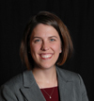
2. Rally Existing Supporters
“Students commented on the leaderboard being more exciting than Facebook – now THAT is a compliment if I have ever heard one!!”
-Kristin Bortnem, Associate Director of Annual Giving, Concordia College
“Give to the Max day is a such a benefit to a small organization…the day allows us to get our message out in a fun way that our constituents respond to…it provides…a clear motivator.”
- Laura Zabel, Executive Director, Springboard for the Arts
Notes:
Led by GiveMN, a collaboration of several Minnesota community foundations

Slide 11
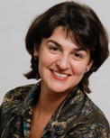
3. Introduce Supporters to Social Fundraising
“We have never seen before such an increase in individual online giving as we've seen this year through Razoo, which you [Alexandria Community Foundation] introduced us to.
Since we joined Razoo in March 16, 2011 we have raised over $17,000 from 5 unique projects and 289 online gifts. Out of these 224 are unique donors.
For a small organization like EWI, this has been transformational and has enabled us to develop stronger proposals to foundations showing matching funds and sustainable growth strategies.
Many thanks for your continued support and for sharing with us best practices in fundraising and social media, which enabled our success this year.”
- Marga Fripp, Executive Director, Empowered Women International
Notes:
Led by GiveMN, a collaboration of several Minnesota community foundations

Slide 12
3. Introduce Supporters to Social Fundraising
97%
of donors on Give to the Max Day said they will use GiveMN again
98%
of nonprofits participating in 2010 plan to participate again next year
Source: GiveMN
Notes:
Led by GiveMN, a collaboration of several Minnesota community foundations

