Slide 1
The Copenhagen News Collaborative

Slide 2
The Participants
MoJo
The UpTake
The Nation
Treehugger
Grist
OnEarth
Center for Investigative Reporting/Frontline
Pulitzer Center for Crisis Reporting
Discover.com
Content also picked up by The Atlantic & HuffPo

Slide 3
What we did
Coordinate (who’s there, what do they do)
Exchange ideas
Synergy: e.g. my writer + your videographer = awesome
Link love
Bar crawl!

Slide 4
What we got
Nearly 2 dozen reporters, videographers etc. on the ground
Better coverage
Multimedia capacity
Lots more content
Lots more eyeballs
A binding climate treaty. never mind

Slide 5
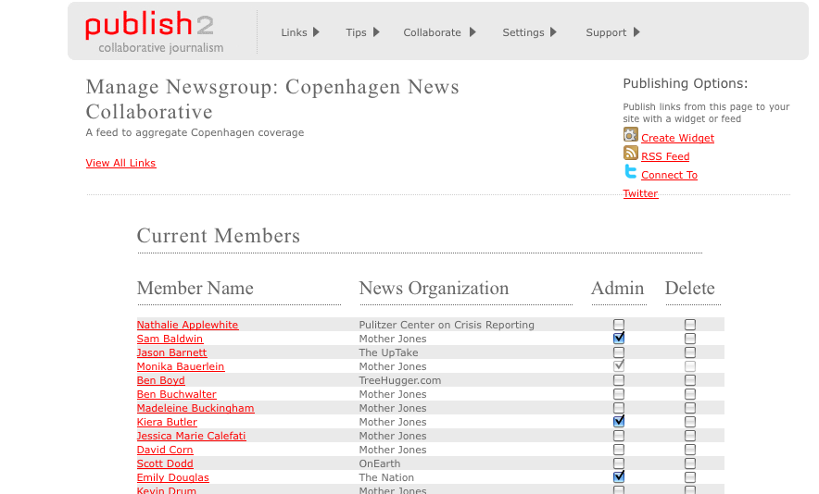
The Technology
Publish2: a journalist-only aggregation/social media tool

Slide 10
TreeHugger

Slide 11
Discover

Slide 13
Grist

