Slide 1


Transforming how users
Discover & Use
Data
CEO Diego May Diego.May@Junar.com
617.888.0465
Junar, INC.

Slide 2
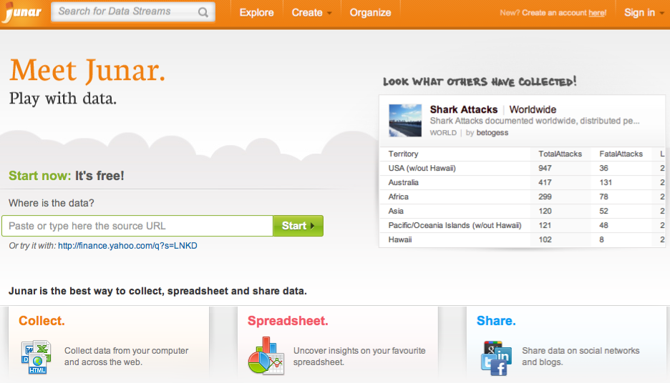

Slide 3
Lobby + elections

Slide 4
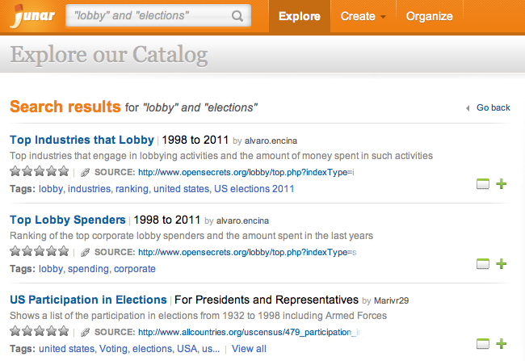

Slide 6
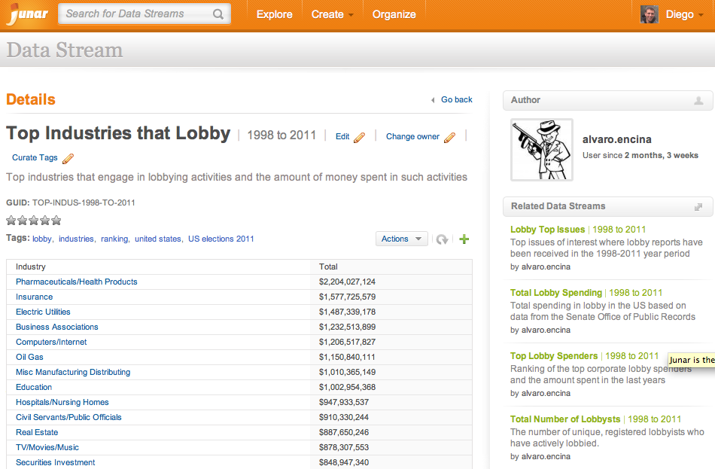

Slide 7
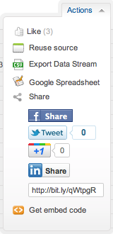

Slide 9
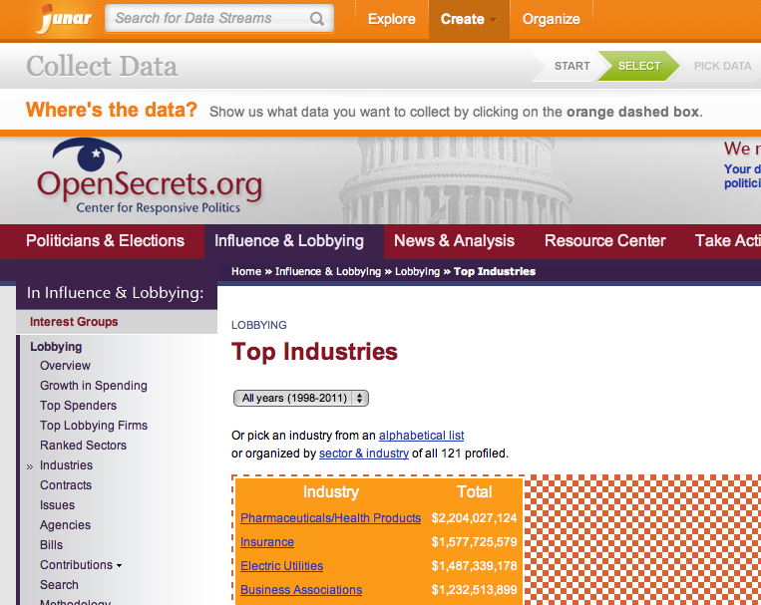

Slide 10
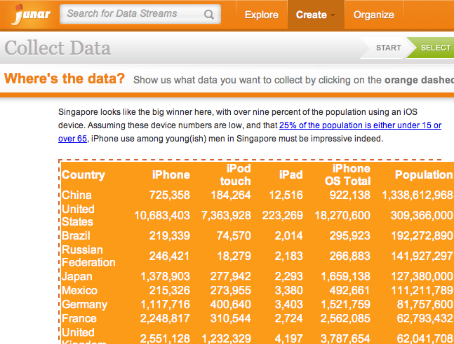
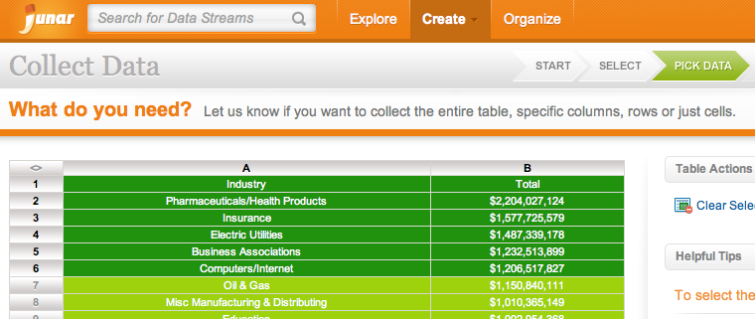
1

Slide 11
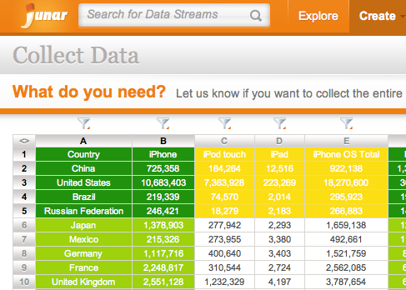
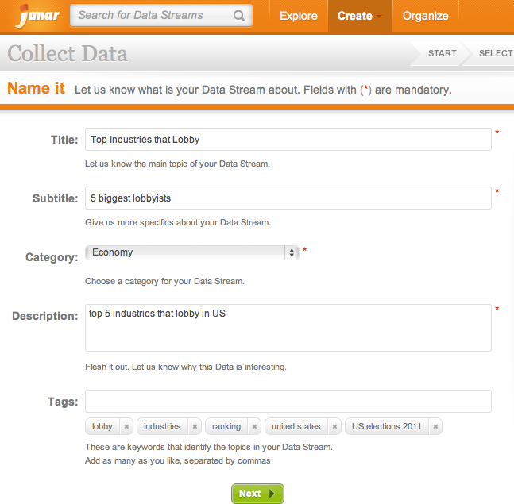
1
2

Slide 12
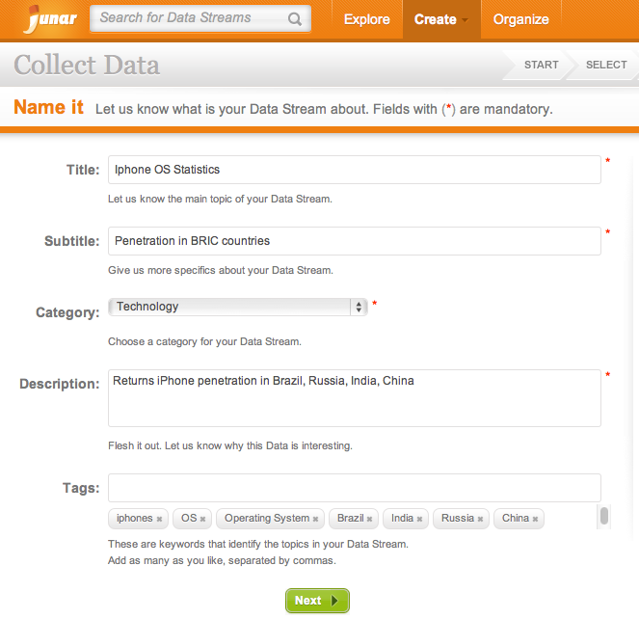
1
2
3

Slide 13
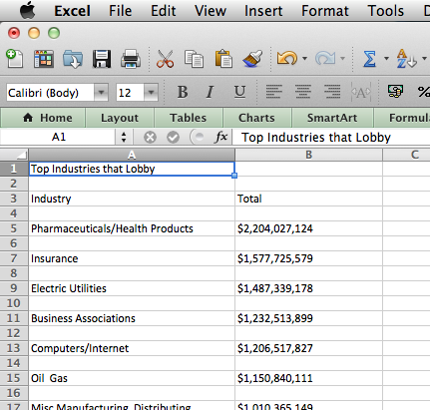

Slide 14
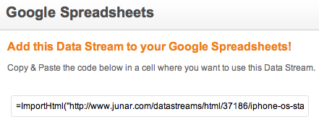
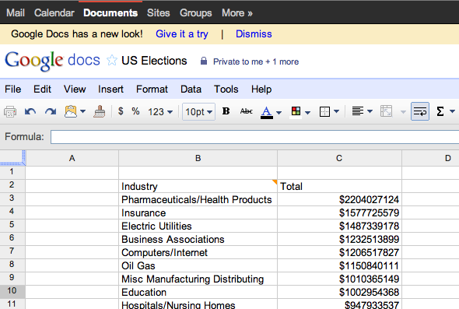

Slide 15
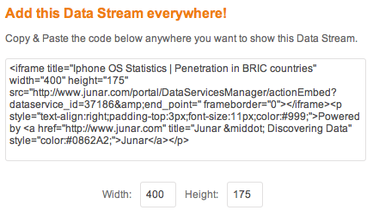
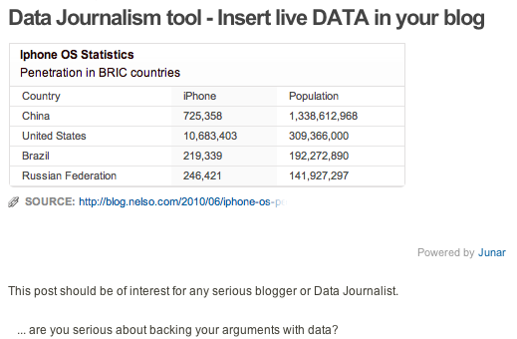

Slide 16
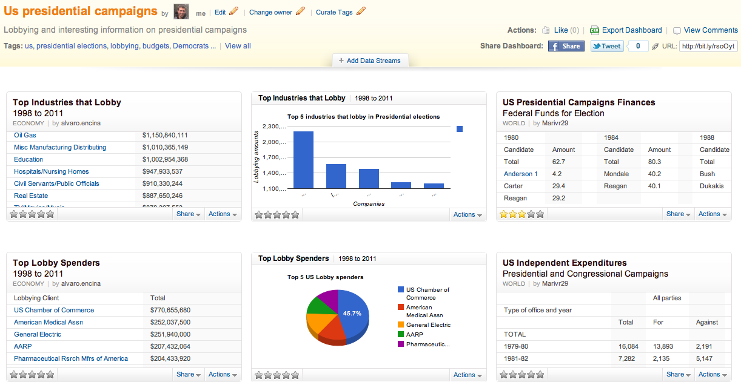
Create Dashboards
to track data

Slide 17


Slide 18
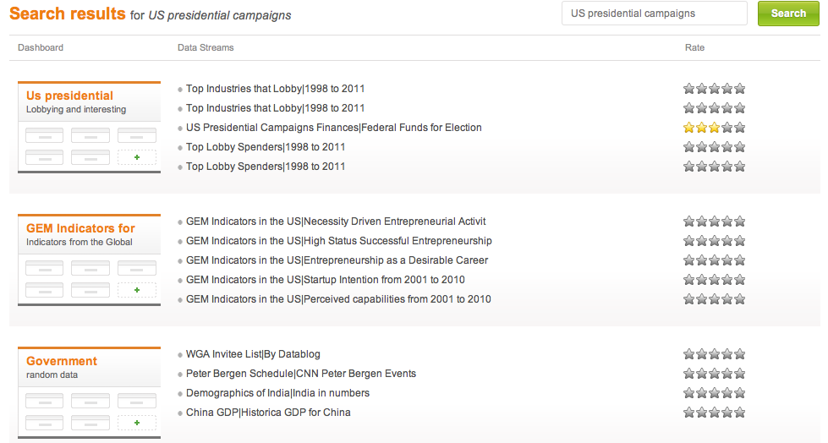

Slide 19
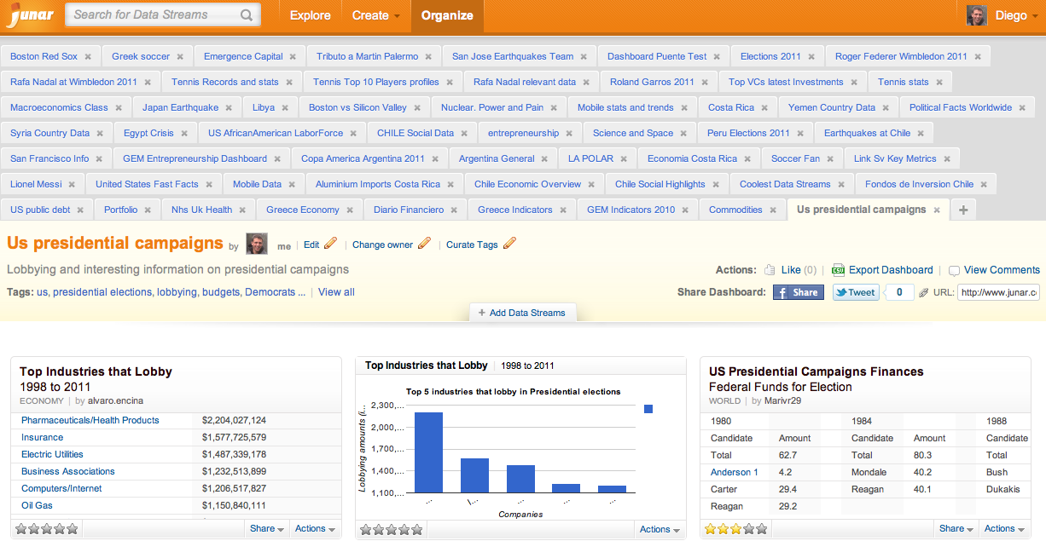

Slide 20
For mega geeks…
We have a REST/JSON API

Slide 21
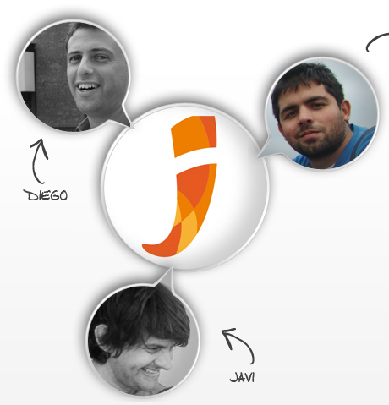
Junar team
Diego May
André Hess
Ops
Co-founder, CEO
* Biz and Sw eng studies
* Worked in P&G as PM
* Experience with Digital entertainment start-up
* Held CEO, Strategy, Sales, BD positions in corp & startups
* Worked in VC in US & Latam
* 16+ years in tech
* Engineer & MIT Sloan MBA (02´)
Pablo Bertorello
CMO
* Serial Software Entrepreneur
* Once an Intel chip geek
* 16+ years in tech
* Electrical Engineer
Javier Pajaro
Co-founder, CTO
Total Headcount -> 13
* 2 Biz / Market Dev
* 3 Operations
* 7 Engineering
* 1 Other
* Held Architect, SOA expert, & dev positions in tech companies, start-ups, banks
* Member of founding team of Start up in LAR
* 15+ years in tech
* Engineer & MBA

Slide 22
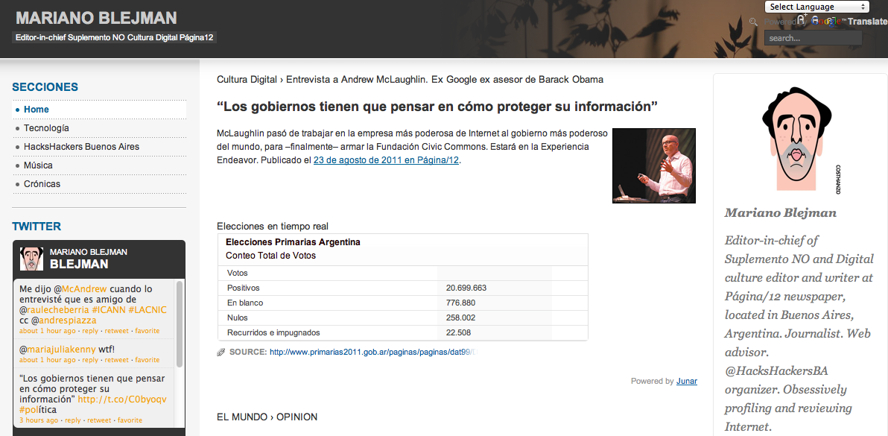
We just want to change forever…
… how people DISCOVER & USE DATA

Slide 23
Thanks!
Transforming how users
Discover & Use
Data
CEO Diego May Diego.May@Junar.com
617.888.0465
CTO Javier Pájaro Javier.Pajaro@Junar.com
CMO Pablo Bertorello Pablo.Bertorello@Junar.com
Junar, INC.

