Slide 1
Making Connections.
Building Infrastructure.
Amplifying Voices.
Notes:
Here to talk to you about concrete efforts—in terms of networking our members and projects—that TMC has taken on. A few of these projects involve shared resources and peer-to-peer trainings, some work as boosters for public perception of the sector and our members’ work. I’m going to talk through a few of our lessons learned re: building a network and how some of our projects came to be/evolved.
tangible success stories in sharing resources and capacity among MC’s journalism organizations (and challenges in getting there)

Slide 2
Who are we?
A network of 40 leading independent journalism institutions founded in 2005.
We work together to strategically
Increase independent journalism’s voice.
Navigate profound industry changes.
Notes:
We work together to strategically
Increase independent journalism’s voice in public debates around crucial political and social issues.
Navigate the profound change that’s reshaping the media business and redefining the practice of journalism.

Slide 3
Who are we?
We work with journalism-focused independent media of all kinds:
Magazines
TV Stations and Shows
Web-based (Blogs, Video, etc.)
Book Publishers
Radio
Film
Notes:
We provide networking, collaboration, and training space for our members. The media consortium makes it possible to learn and share best practices from peers.

Slide 4
Our Members Include:

Slide 5
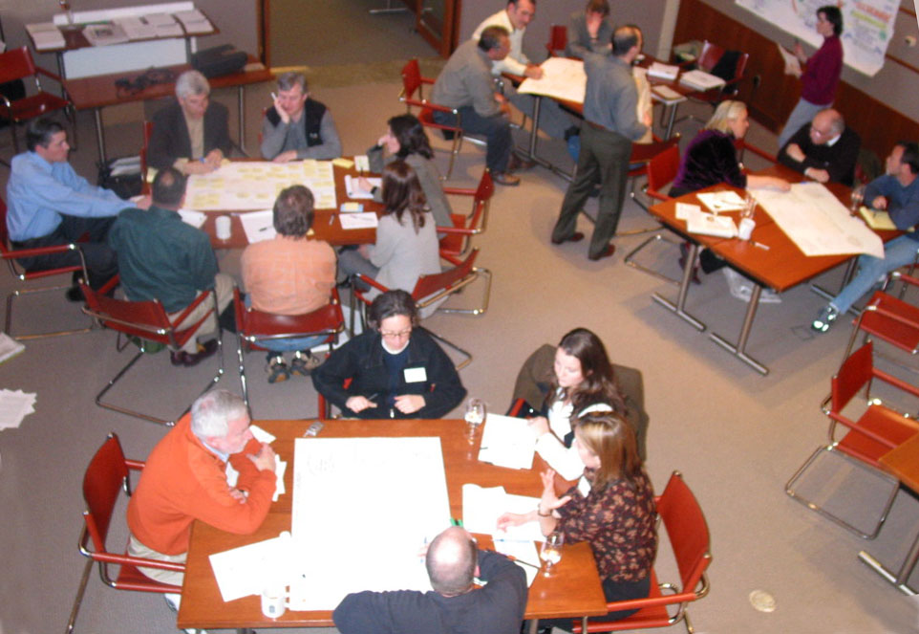
Building the Network
Where do you start?
Notes:
When TMC was in its infancy, one of the central concerns was (and in many ways, still is) “How do we build momentum for the sector and define our value to the larger public?”
This picture is from one of the first meetings of what would become the media consortium. We came to be because our founding members realized that they were facing similar challenges, yet no one was talking to one another, much less working together, be it in terms of defining audiences, coping with new technologies, or trying to diversify revenue streams.

Slide 6
Notes:
It took two meetings for people to buy into the concept of an organized network. Each meeting helped build trust among members, which in turn revealed key working areas that would help organizations across the board.
The Declaration of Independent journalism was a major turning point. It was the first time that we undertook a collective effort to not only define who we were in the public sphere, but also define our intent to support one another. We still use the language of this declaration in The Media Consortium’s mission statement.

Slide 7
Building the Network
5 points of collaboration
Date Around
Know Your Capacity—And Theirs
Involve All Staff—Not Just Top Brass
Diversity is Key
Balance Your Benefits
Notes:
We’ve come a long way since.. Before I jump into some examples of projects, I’d like to walk through a few of the things we’ve learned about coordinating a network. Each of these 5 points played vital roles in the development and implementation of TMC projects. TALK THROUGH COLLABORATION POINTS.
AT KNOW YOUR CAPACITY: The truth is, building a network of media organizations that all have different perspectives is not easy. One key lesson that we learned was that TMC could not exist as a volunteer-run organization.
At the beginning of the consortium, people said that they wanted it to be volunteer run so that members can make the decisions. That’s a great idea in theory, but the reality is. If TMC was going to be lasting or have long-term impact, we needed full time staff that could put out a sustained effort to develop strategies and programs. That’s not to say that collaborations are impossible—just that it takes a lot of legwork to put out a sustained effort.
AT BALANCE YOUR BENEFITS: We also had a few programmatic false starts. For example, in 2007, We created a progressive AP wire that fed original content to members, but it happened too early and wasn’t beneficial for all organizations. Members still hadn’t bought into the concept of aggregation and shared content, and Editorial perspectives hindered project as well. Members were also concerned that it competed with, rather than supported their existing coverage. I use this program as an example now because we’ve been able to help it evolve into something different that I’ll talk about in a little bit.

Slide 8
Our Projects
Criteria for selecting projects:
Foster Collaboration and Coordination
Build and Diversify Media Leadership
Focus on Audience Development
Bring Money and Attention into the Sector
Support Innovation in Journalism and Business Models
Notes:
I’d like to walk through a few different projects we’ve taken on at different phases in TMC’s development. One of the things that struck me is that many of our key projects are layered on top of one another.
Just as a quick side note: One major challenge to choosing projects was making sure that we balanced the benefits. We’ve developed 5 strategic principles that help us select and evaluate projects that address the many varying needs of our members. These criteria were developed by TMC’s staff and coordinating committee and are revisited annually to make sure that we are on point.
All of the following projects started out as easy, mutually beneficial, low-budget, high-impact enterprises,

Slide 9
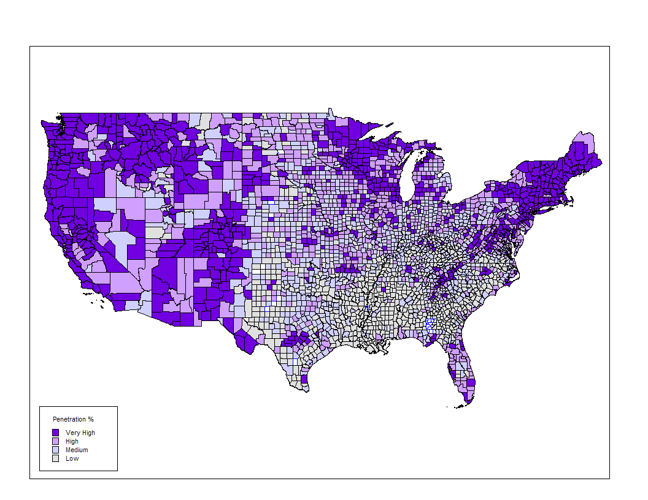
Our Projects
Demographic Research
The choir is larger and more diverse than anyone expected.
Over 2.9 confirmed million names
Only 25% of our audience is shared among TMC members.
Notes:
When we first got started, members were really questioning their reach and impact. Were they just preaching to the choir? And if so, who was in the choir and how big was it? We worked with Paradyz-Matera, a list-analysis firm, to do a merge/purge of our members’ lists. 16 organizations submitted names and addresses and the results were astonishing. This map displays the saturation of TMC members across the country in 2006.
Once duplicates were removed, there were over 2.9 million confirmed names on that list. That doesn’t include people who pick up at a library or just stumple by online. And only 25% of that audience was shared across organizations. This meant that the sector had a tremendous reach, but was also incredibly siloed.
We revisited this project last year by working with Catalist, a list-building house that provides detailed demographic profiles of registered voters. Members who put their lists in were able to cull indicators for potential new audiences. Catalist developed a model of traits that fit prospective media consumers and TMC members had access to Catalists databases to research and confirm that model. This information helps us better define the influence of our collective audience when it comes to elections, social trends, etc.

Slide 10
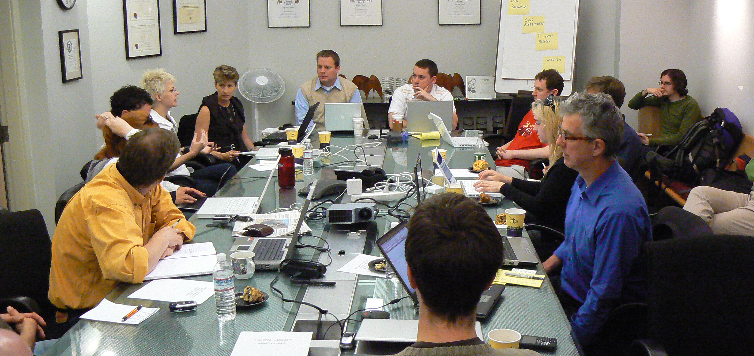
Our Projects
From Tech Camps to IILabs
“Don’t think about technology as the end of the process but as integrated into the process. …What the web is doing is not just converting news into an online experience, but it’s creating a whole new journalistic experience.”
-Vivian Schiller, CEO of NPR
Notes:
When TMC first began, the wave of technological change (AKA the Internet) was knocking many old media organizations for a loop. Revenue sources were drying up, and many organizations were still struggling with how to put content online, much less how to take advantage of “web 2.0.” In the early days, TMC convened several tech camps and built a basic listserv that connected organizations and allowed them to troubleshoot and share best practices with their peers. These “camps” helped organizations keep up with the rapidly shifting landscape.
In fall 2009, The Media Consortium completed The Big Thaw, a year-long study that was born out of a desire to change the game for media consortium members and help us become the shapers of tomorrow’s media. We’re taking the Tech Camps concept a step further today with the incubation and innovation labs, which launch this summer. It’s a two part program that combines one-on-one work/consulting and small group labs to experiment with new digital strategies, moving into mobile, journalism/community building models. TMC is providing seed money to actually implement experiments.

Slide 11
Our Projects
Advertising
Ad Barter Project
Research on Vertical Advertising Network
26 organizations surveyed
Over 6.1 million unique online users per month
55.7 million monthly pageviews
Ad Progress Network
Notes:
AD BARTER SYSTEM: In 2006, members wanted to try to increase awareness of their brand to other organizations, so they developed a swap program in which 6 organizations traded advertising space with one another. Helped breach siloed audiences and unify public perception of an independent media sector.
In Nov. 2008, TMC staff surveyed members to ascertain the viability of a vertical advertising network for independent media outlets. Survey went out, 26 organizations completed it. Here are some estimates regarding total audience: 6.1 million total Unique Users monthly (not unduplicated, clearly there would be some) and 55.7 million monthly pageviews.
Four TMC members took that info and began developing the Ad progress network.

Slide 12
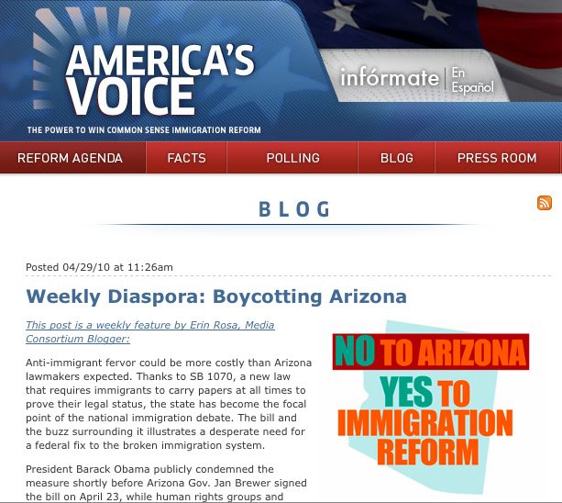
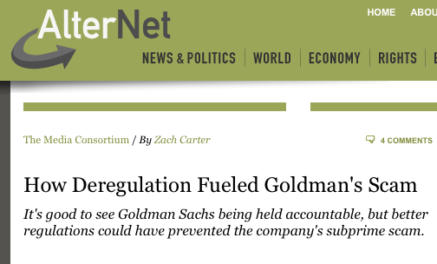
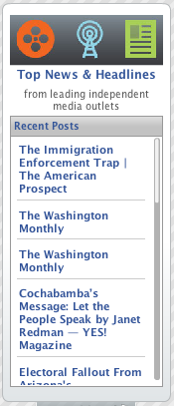
Our Projects
MediaWires
Open Source Blogs
Headline Widgets
RSS Feeds
Generates traffic to members’ content
Builds audience and momentum around key issues.
Notes:
Remember when I mentioned the progressive news wire way back in the beginning of this presentation? In 2007, we revisted the concept of providing content via a wire, but re-formatted the project to be a buzz-builder for TMC member’s content around key political issues: The Economy, The Environment, Health Care, and Immigration. We produce 4 weekly, open-source blogs that round up and contextualize the most interesting stories from TMC members, then send them out for syndication to a network of partners that includes non-profits, advocacy/activist organizations, other media outlets and more. We also offer headline widgets (SEE ABOVE) and RSS feeds for organizations to pipe into their sites.
This project is incredibly helpful as a branding tool. We use it to develop audiences and public perception of sector.

Slide 13
Recommendations/Final Thoughts
Learn your value
Start incrementally, scale up
Be realistic, but think ahead
Accountability is everything
Notes:
ADD IMAGES.
Recommendations for developing a network and undertaking collaborative projects:
1.) Make an effort to ID the public value or your sector. TMC’s demographic research has helped us recognize the political role our media plays in the
2.) Start incrementally. Many of TMCs current big projects started as small measures that tested the water. We started with simple tech trainings and working groups, then moved outward to large-scale experiments. This evolution took time and effort to bring all players on board and up to speed. One of our core functions since the beginning has been a list serv that any staff from TMC member organizations can post to and participate in. This is an extremely helpful, low cost tool to creating a community.
3.) Be realistic: Understand who can contribute and recognize that there will be conflict and growing pains. While it may take time for organizations to get on board, you also have to work on a parallel track to strategize a successful future for your sector.
4.) Accountability is everything. The Declaration of Independent media created core expectations for TMC and the organizations that participated in it. It was vital to kicking off what is now 5 years of strategic collaboration and experimentation.

Slide 14
www.themediaconsortium.org
Email Erin@themediaconsortium.com
Follow us on Twitter: @tmcmedia

