Slide 1
Making Connections.
Building Infrastructure.
Amplifying Voices.

Slide 2
Who are we?
A network of 50 leading independent journalism institutions founded in 2005.
We work together to strategically
Increase independent journalism’s voice in public debates around crucial political and social issues.
Navigate the profound change that’s reshaping the media business and redefining the practice of journalism.

Slide 3
Who are we?
We work with journalism-focused independent media of all kinds:
Magazines
TV Stations and Shows
Web-based (Blogs, Video, etc.)
Book Publishers
Radio
Film

Slide 4
Our Members Include:

Slide 5
Our Projects
Demographic Research
Our audience is politically engaged and highly active in their communities
According to 2006 research, only 25% of our audience is shared amongst MC members.
The choir is far larger and more diverse than anyone expected.
Vertical Advertising Network
You’ll hear about that shortly!
MediaWires!

Slide 6
So, What are the MediaWires?
A.) A series of topic-based aggregators around key progressive issues
B.) A system of social media tools for media, NGOs and non-profits to inform and engage their constituencies.
C.) An easy opportunity for partnership.

Slide 7
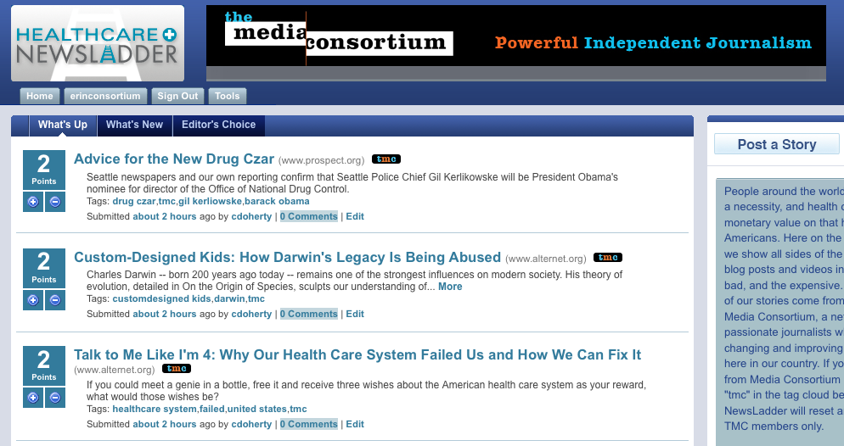
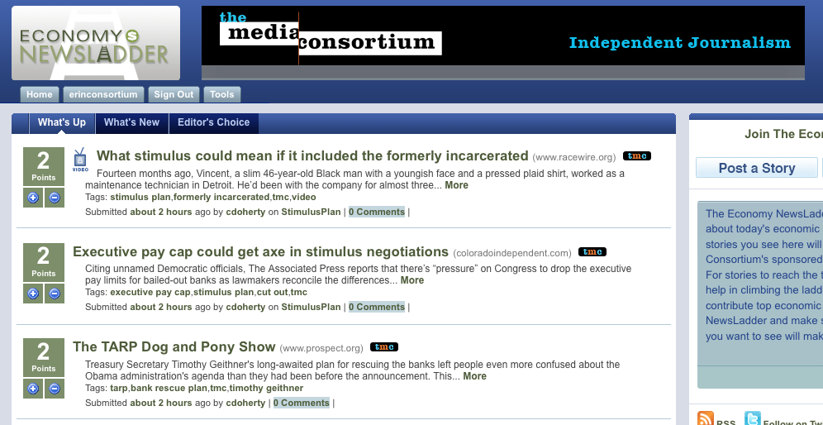
D.) All of the Above

Slide 8
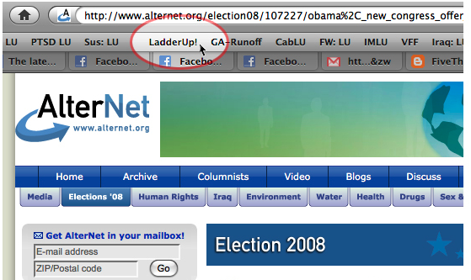
What does it do?
How does it work?
Focuses on a specific issue/personality and act as a content/news 'hub’
Aggregates and Archives relevant content
Users (like you!) can post stories, video to ladder
Submit through the site… Or…
Use Ladder Up! Toolbar tool
Forms a platform that efficiently distributes content to broader audiences

Slide 9
How is it different?
The Toolkit
We provide a FREE series of social media tools for opting in, building community around content, and informing your audience.
What’s in it?
Open Source Blogs
Headline Widgets
Facebook Apps
RSS Feeds
Twitter

Slide 10
Toolkit in action
Open Source Blogs
Weekly roundups of the best reporting on key issues.
Fully edited, delivered to your inbox in HTML code.
Schedule
Tuesdays: Economy Post by Zach Carter
Wednesdays: Healthcare Post by Lindsay Beyerstein
Thursdays: Immigration Post by Nezua
See more at ping.fm/Up7RZ

Slide 11
Toolkit in Action: Headline Widgets

Slide 12
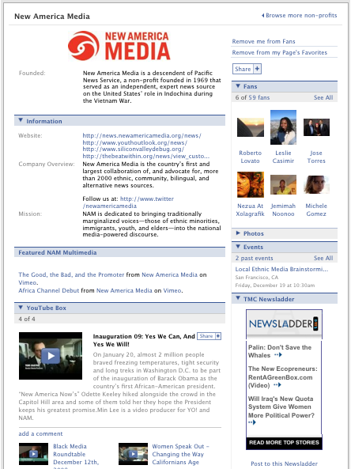
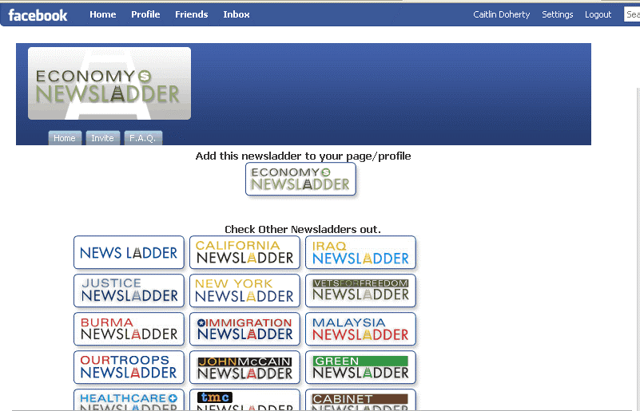
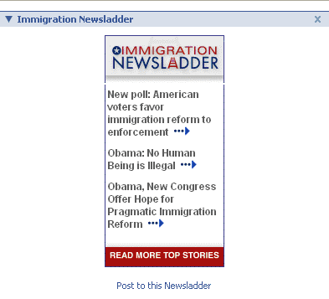
Toolkit in Action: Facebook Apps

Slide 13
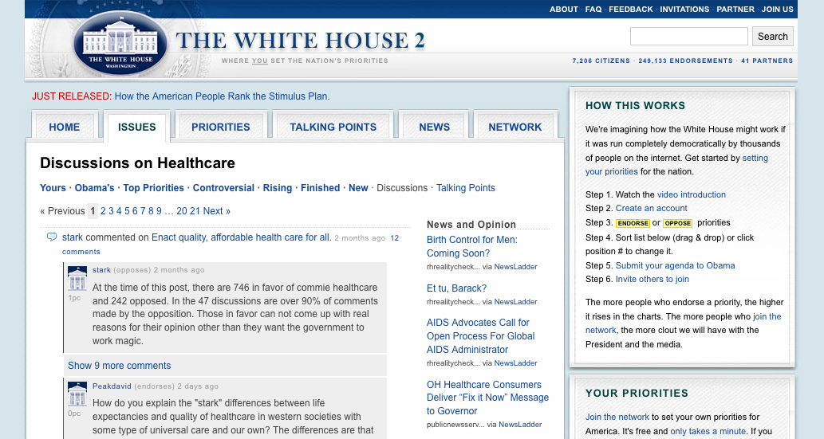
Toolkit in Action: RSS Feeds

Slide 14
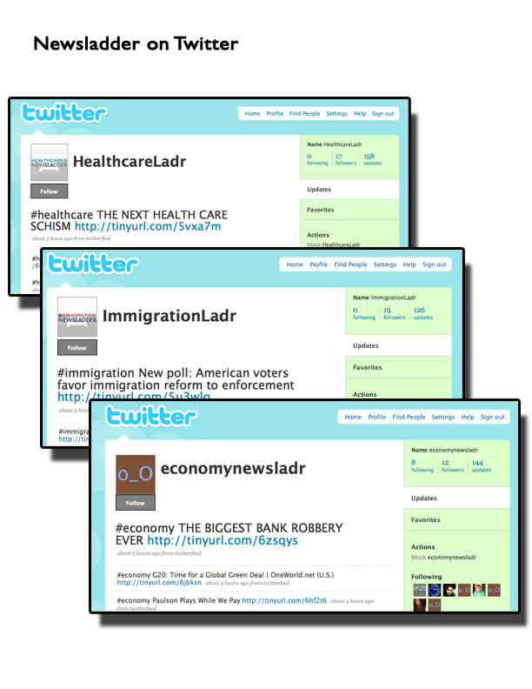
Toolkit in Action: Twitter
Healthcareladr
Immigrationladr
Economynewsladr

Slide 15
How Can You Opt In?
Visit www.themediaconsortium.org/projects
Email Erin@themediaconsortium.com
Start feeding your blogs and content into the NewsLadders!
Visit Newsladder.net to create an account.

