Slide 1
Notes:
BLANK CUE PAGE

Slide 2

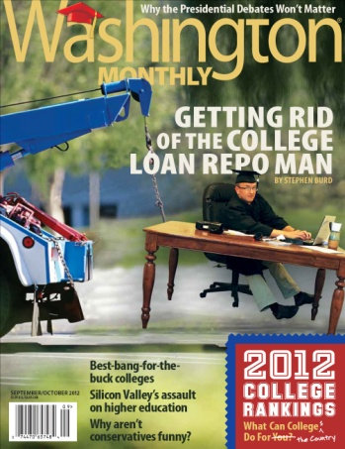
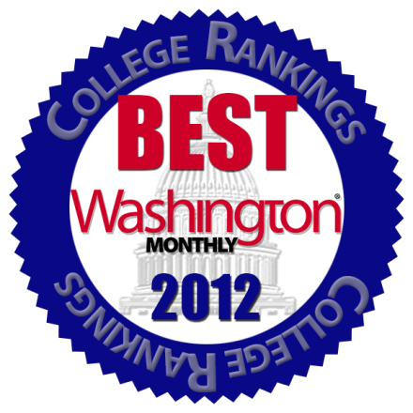
IMPACT:
The Washington Monthly Annual
College Guide & Rankings
Carl Iseli
VP, Operations & Marketing
Notes:
Title Screen
Introduction
Annual Washington Monthly College Guide & Rankings
We try to turn around “What can college do for you” to “What can colleges do for the country”

Slide 3

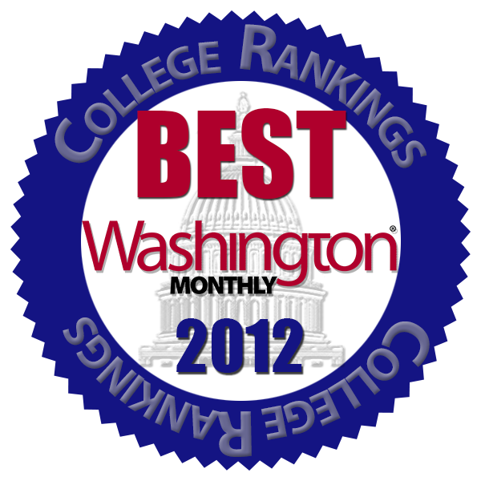
vs
Beauty Contest
Lacks Useful Measures
Biased Toward Wealthy
Underserves Working Class
Performance Based to Promote
Research
Service
Social Mobility
Notes:
Started 8 years ago as a piece designed to poke the US News rankings in the eye.
Their rankings are much like a kind of college beauty pageant:
Rating schools based on fame, highly paid professors, student selectivity, prestige, endowments, money.
WM CG ranks on multiple variables involving Research Service and Social Mobility, but always mindful of what the school can do for the country and the student. And accomplish goals economically.

Slide 4
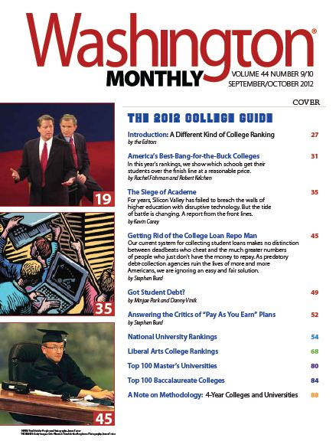

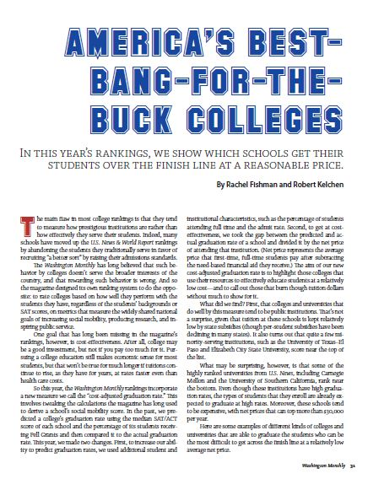
Notes:
Our College Guide is usually our highest-profile issue of the year.
In addition to the highly anticipated rankings, each issue is filled with articles by experts in higher education.
Has highest page count, the most ads, and largest circulation:
Beside regular subscribers, the hill, the White House and press corps, it higher newsstand sales, including college book stores, and it is sent to guidance counselors at schools throughout the country.

Slide 5
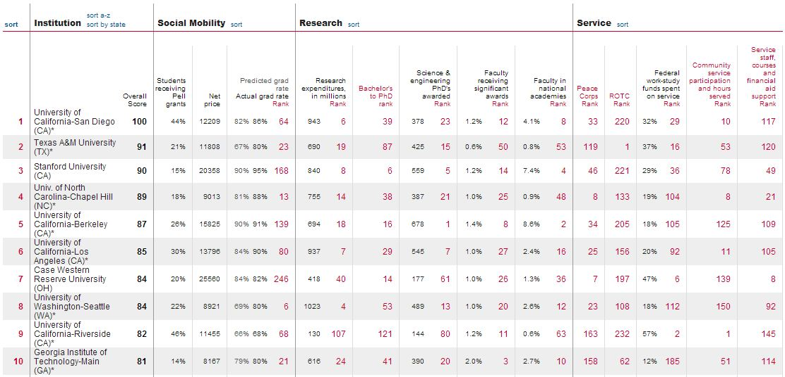
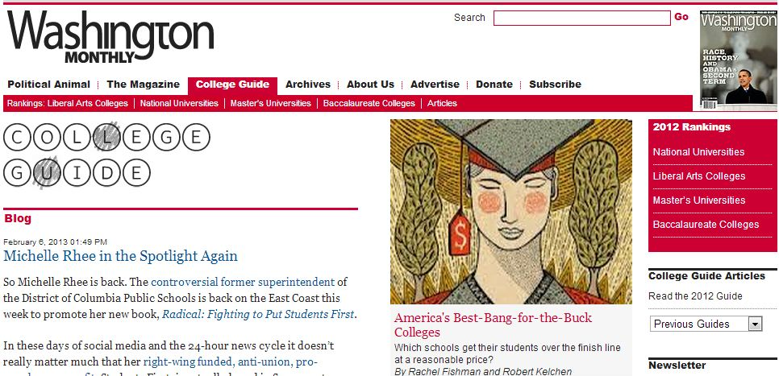
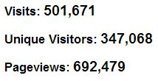
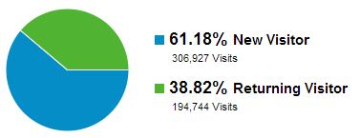
Metrics
Notes:
Within the past couple of years, thanks to a grant from Lumina Foundation, CG has become a separate section of wm.com website.
The ranks of online readers swells annually with the release of the rankings, — these figures are for the first week of the new rankings — and the high percentage of new readers attracted by the rankings contributes to our increasing year around audience.
The criteria for each of our categories — Social Mobility, Research and Service — are available for everyone to see and comment.

Slide 6
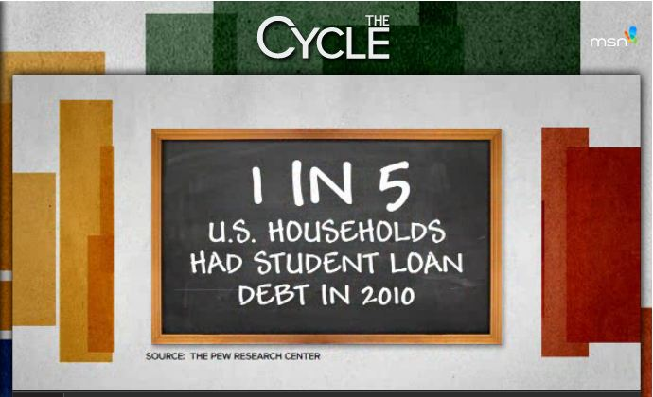
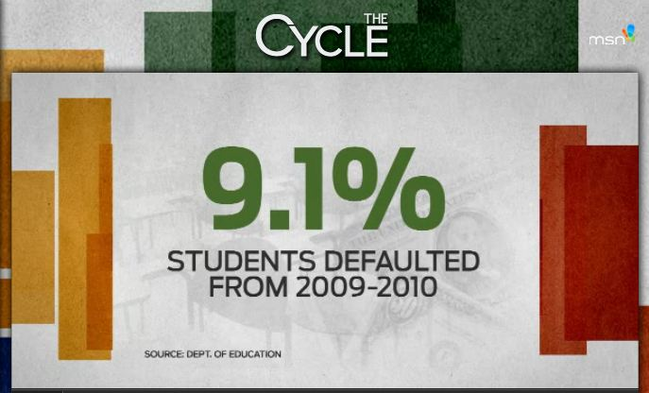
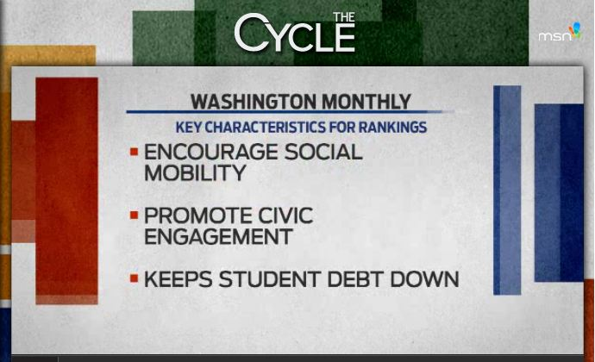
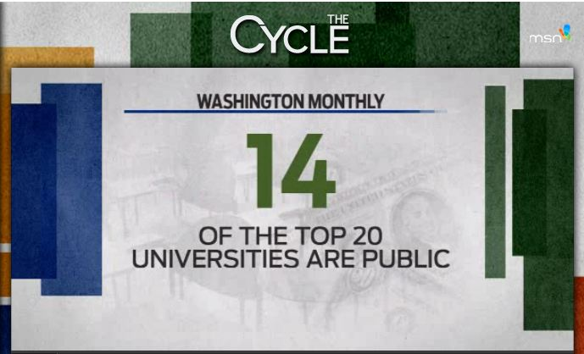
Notes:
Some of the topics from an MSNBC appearance by editor in chief Paul Glastris.

Slide 7
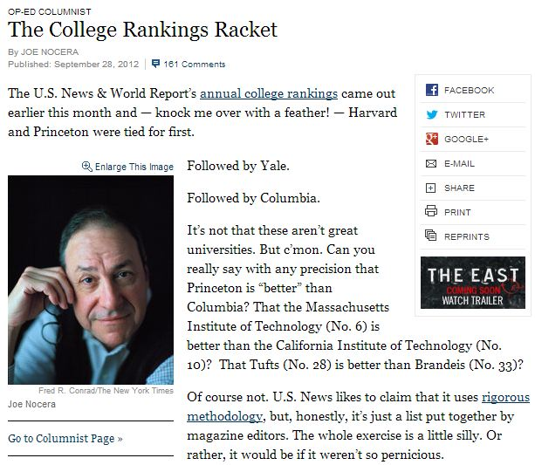




Notes:
When we started the College Guide eight years ago, few policymakers or journalists understood or agreed with our arguments that the higher education sector was in crisis—that its costs were unsustainable, and the product it was delivering was sub-standard, biased toward the wealthy to the detriment of the working class.
We’re gratified that our message has grained traction and is now covered by a wide swath of print, online and broadcast media. The best minds in journalism are generating stories excoriating the popularity contest ratings and promoting our brand of performance-based rankings.

Slide 8

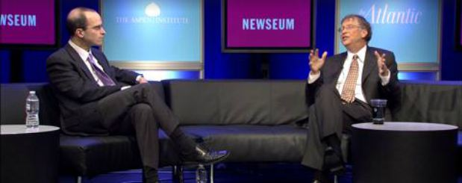
Notes:
One of the greatest indicators of the impact of our approach and persistence was Bill Gates’ talk at The Atlantic Ideas festival: It was almost a pure distillation of everything we’ve been saying in the Washington Monthly College Guide for years.

Slide 9
IMPACT:
The Washington Monthly Annual
College Guide & Rankings
Carl Iseli
VP, Operations & Marketing
Notes:
END Title Screen

