Slide 1
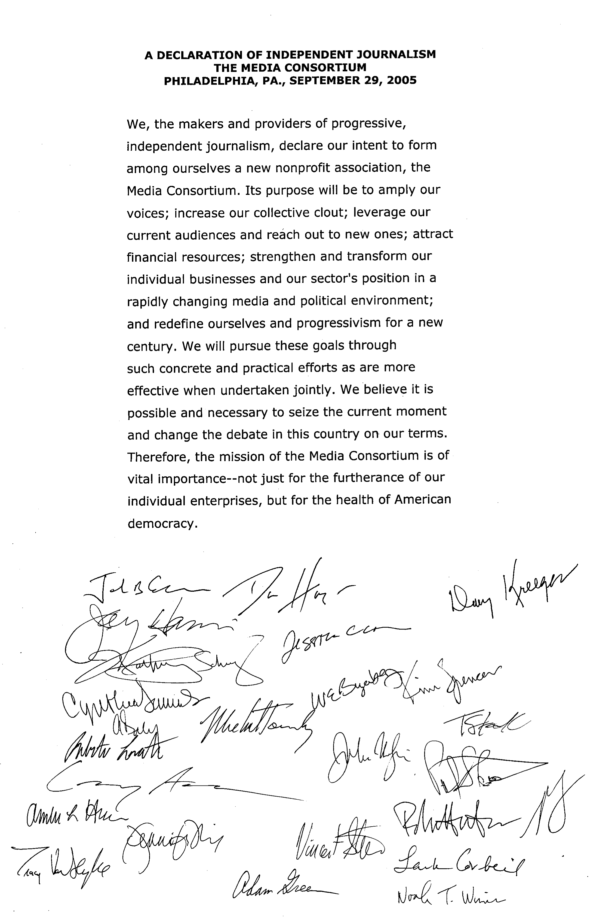
Notes:
The Media Consortium was founded as a peer network. Our founders believed that only a peer network would allow them to help each other meet the challenges of the digital revolution; build a progressive media system; and be better prepared for a future they realized would be fluid and unpredicatable.

Slide 2
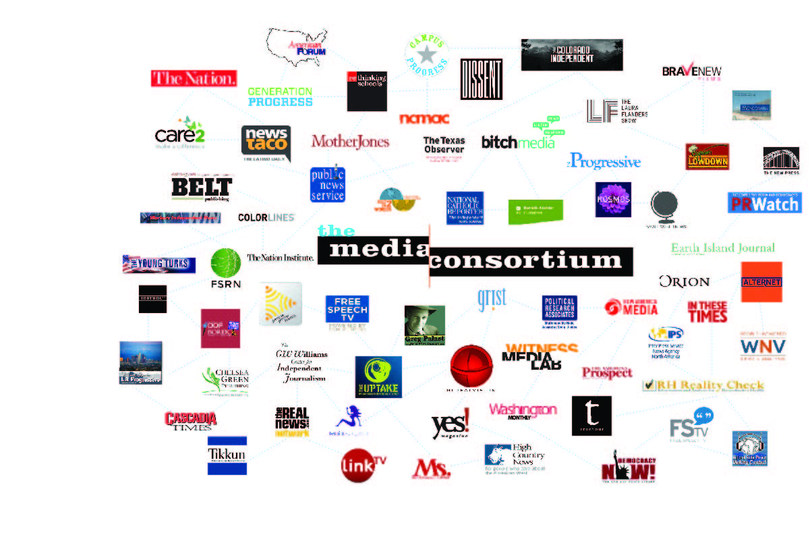
Ten Years Later
Notes:
We have built that peer network together, methodically, seeking out outlets willing to work collaboratively. The Media Consortium is now 80 independent progressive outlets strong. So now is a good time to ask—has this network succeeded in meeting the challenge of the digital revolution? Has it built a strong progressive voice in media? Is it flexible enough to support outlets in whatever comes next?

Slide 3
Three Challenges
Digital Revolution
Progressive Media Sector
Flexible Response to the New

Slide 4
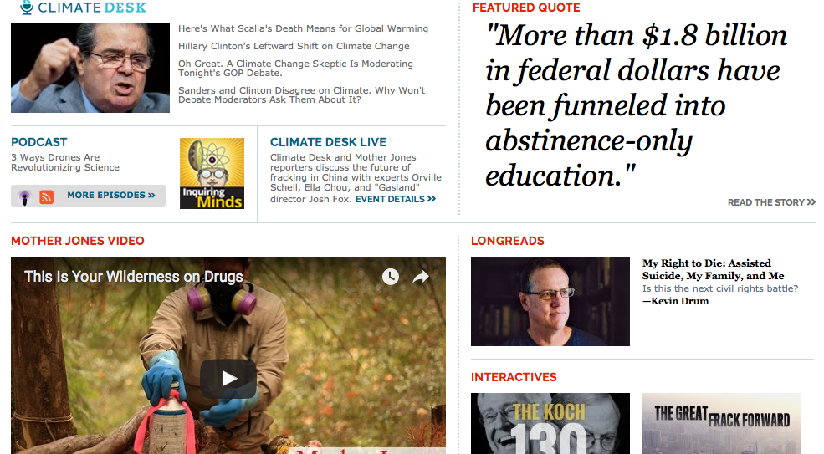
From Mother Jones:
Notes:
Have we met the digital challenge? Well, hard to say, since I don’t think the digital revolution is over. But look at our founding members. Almost all of them are still in business today. And many have grown—most notably Mother Jones, now a leader in digital adoption, with podcasts, video, longreads and interactives. What role did the Media Consortium play in this success? My predecessor, Tracy, did a lot, from hackathons to the Innovation and Incubation labs. In the past five years we have continued those labs, with deep dives into crowdfunding, longform, member databases, and impact metrics. I think, however, that the original founders had it right—our outlets continue to adapt to digital because of the strength of the peer network we have built.

Slide 5
30 Collaborations in 2015
Notes:
One way to measure the strength of our Consortium has been our success in supporting cross-Consortium partnerships. We are so proud this year that, with support from the Voqal Fund and under the guidance of TMC project director Manolia Charlotin the Media Consortium has facilitated 30 collaborations on topics ranging from reproductive health to climate change to charter schools!

Slide 6
Notes:
We never did try to build a progressive media system—Media Consortium members are too independent—and probably too progressive—for that! But when we compare the Rush Limbaugh era of 2005 to today, it’s clear that progressive media now plays a key role in the media space. These changes came about because individual members like Mother Jones and Democracy Now! have grown stronger; because outlets like In These Times and The Nation incubated the Chris Hayes’ that have gone on to dominate TV; and because new outlets like The Young Turks and feministing speak to a new generation. The Media Consortium played its role too—providing encouragement for these outlets and, bringing outlets together at key points, whether during the 2008 elections, the 2011 union uprising in Wisconsin or 2012’s Occupy May Day.

Slide 7
Photoshopped bernadette sanders
Notes:
We are the Bernadette Sanders pushing a new economic revolution. But this is part of our problem too. Like Bernie, progressive outlets have been largely staffed by white people, reaching a largely white audience. We do very well on the coasts, but do we really reach the South? Do we really reach communities of color?

Slide 8
Flip thru headlines/ stories
Notes:
Some of us do. New America Media and Colorlines were founded for this purpose, as was RPE, Feet in Two Worlds and some of the guests in this room we hope will become members like Latino Rebels and Blavity. Truthout, with its emphasis on the prison-industrial complex, has attracted a significant audience of people of color, as has feministing. Fsrn, Makoing Contact and the Real News Network. But as a consortium, we still have so much more to do to ensure that we are creating stories about people of color, by people of color, and for people of color. That’s why the theme of this conference—and of our next 5 years—is race equity. Five years from now, we want all of our outlets to be telling stories that resonate with all the people who live in North America. We know the work will be difficult. This conference was underwritten by a foundation that understands how difficult it will be—our thanks to Quixote, the foundation that understand that change only happens when we tilt at windmills!

Slide 9
Video of Beyonce
Notes:
Here’s what success will look like: Moving our progressive troops into Formation!

Slide 10
Notes:
Race equity within our current network is just the start. We also need to expand our network. We are independent, progressive, national and regional news media. To truly tell the stories of the people of the Americas, we need to be able to connect to local communities. We need to be able to find local stories that have national impact in order to fight back against the corporate power structures that want to hide those stories. And we need to make sure communities can localize national stories so they can better understand how those stories relate to their daily lives. In other words, even as we build our intra-net among our members, we have to build an inter-net between TMC members and others in the independent sector.

Slide 11
Notes:
David vs Goliath is a dangerous myth. What makes change is a community of Davids working together wrest back our society—we need to make change by working together, and that is as true for journalism as it is for activism. As we already know from our own network, we make the most impact when the impact is collective.

Slide 12
TMC in middle with link to AAN
Notes:
So over the next 5 years, as the Media Consortium works to become more racially equitable, we also will seek to network with our siblings who work in other sectors of the independent media. We have already forged a strong strategic partnership with AAN, the Association of Alternative Newsmedia, and I’m pleased Tiffany Shackelford of AAN is here with us today.

Slide 13
TMC with links to AAN and NAM and CCEM and then NFCB and ACM and ONA.
Notes:
We have already begun working with our colleagues in the ethnic media, especially New America Media and CCEM—and I’m pleased Sandy Close and Jehangir Khattak are both participating in this conference. We have begun our outreach to community media, the most grassroots media of all, and I’m so pleased that Sally Kane of NFCB and Mike Wassenaar of ACM are joining us today—and I thank Phillycam, the public access channel of Philadelphia for hosting us tonight. I’d also like to thank ONA-Philly for hosting our party Friday night, and Irving Washington of ONA who has been very helpful to me as I’ve put this conference together.

Slide 14
Notes:
Once we get our own house in order and have become more racially equitable, our Consortium will be in position to build partnerships with members of the Black, Latino,and Native American media. Our goal is to create an even larger network, a grassroots and horizontal network, bringing together existing organizations and groups into partnership so that our journalists can localize national stories and nationalize local stories.

Slide 15
Notes:
The network we will build will answer the most pressing problem journalism faces: the lack of national news. Our current national mediascape will soon be composed of a few large players—Facebook, Snapchat and Twitter providing news via social and a few entities like The New York Times, Washington Post, Wall Street Journal, Vice, Buzzfeed, and hopefully a couple of our own like Mother Jones anchoring the national newscene. We will have strong niche players including most of the media Consortium members—covering topics like environment, gender and reproductive health, and labor; large regions like the west or rust belt; or demographics like Catholics or millenials. And we will have local and hyperlocal news. What we won’t have are the newspaper dailies, metro TV stations and regional radio stations that used to provide connections between national and local news.

Slide 16
Notes:
We can build that regional network. We can build that network based on independent news. Independent news already covers local, regional and national. What is required is for us to build a network between these groups—the same kind of network we successfully built within the Media Consortium. When the Media Consortium started, people told us, it will never work. The Nation will not sit down with Mother Jones. Ms. will not sit down with Bitch. Earth Island will not sit down with Grist. These outlets are competitors, not allies. Well, this year, Ms and Bitch participated in 5 collaborations together. Grist and Earth Island participated in three. And staff at the Nation and Mother Jones talk frequently. IT can be done. We can dream big and build this national network.

Slide 17
Notes:
We build networks by starting at the grassroots. We begin by examining our own shops, ensuring that we are prepared to be good partners—and a key part of that work is race equity. Once we’ve analyzed and repaired ourselves, we approach each other in a spirit of equality and partnership. We test partnerships. We find what works. We build on success. Together, we can provide the national, regional and local news everyone in our country needs. That’s our vision for the next ten years.

