Slide 1
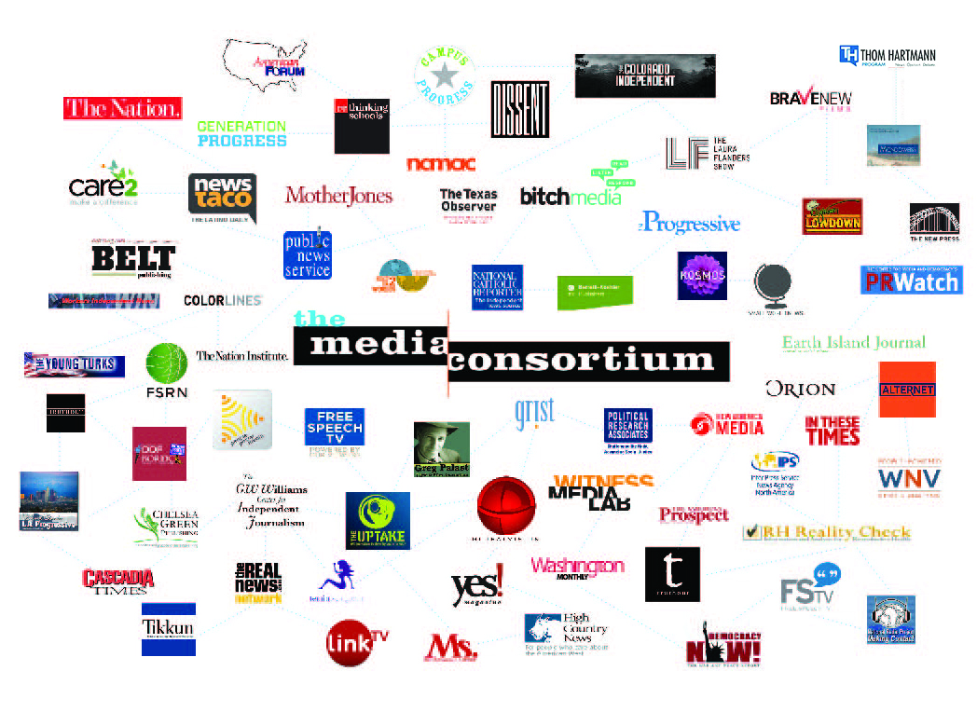
The Media Consortium
Notes:
My name is Jo Ellen Green Kaiser. I’m the Executive Director of the Media Consortium. We’re a national network of 80 independent progressive news outlets. Our mission is to support and grow the impact of the independent news sector.

Slide 2

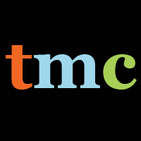
Impact
Notes:
We idealize and hope for--a massive splash that will change everything all at once (like spotlight, or mother jones' 47% video).
But it is impossible to plan for and create those kind of splashes. They are a combination of great journalism, great pr, and a lot of luck.

Slide 3

Every story produces an effect
Notes:
And while those big events make sudden changes, the progressive movement is focused on long-term change. Think about our biggest issues--climate change; economic justice; racial justice; gender justice. These issues have particular instances, like the keystone pipeline or the $15 minimum wage or keeping abortion clinics open, and all of those are important. But what we really need to do is create long-term culture change so that we don't have to have these particular fights anymore.

Slide 4
Typical “Impact” Measures
Reach—number of users
Views—number of page views (text)
Time spent—reading/listening/watching
Clicks—on ads but also content links
Social Media Shares
Notes:
But how would we measure that kind of influence? An entire field—metrics--has sprung up to measure how news media affects audiences. But most of these metrics were originally built for advertisers to measure impressions. They provide measures of quantity, but not of quality.

Slide 5

Every story produces an [a]ffect
Notes:
Metrics don’t tell us what we need to know, which is what affect we have on the end user. Culture shifts happen slowly and almost invisibly. To make change, however, we need to make these little ripples visible. We need to understand the ways that progressives--and progressive media in particular--do influence individuals and cultural thinking in order to increase that influence and bring change faster.

Slide 6





Notes:
We have always known in our guts that we influence people. But just saying so doesn’t make it so. And because our outlets are so clearly progressive, we’ve had trouble convincing even our allies that our outlets influence public conversations—that they reach beyond their own audiences. To prove these progressive outlets have real impact, we felt it necessary for the proof to come from outside the outlets themselves.

Slide 7
sen·ti·ment a·nal·y·sis
noun: sentiment analysis
the process of computationally identifying and categorizing opinions expressed in a piece of text, especially in order to determine whether the writer's attitude towards a particular topic, product, etc., is positive, negative, or neutral.
Notes:
That;s what led us to Gary King and his team at Harvard. Gary was sure he could make visible whatever influence our outlets may have on the public, and he is a highly esteemed academic with no reason to kowtow to progressive media.
You've heard about his methods before. I can review them in detail if you like--and we also have Gary on skype with us today. But let me bottom line this for you.
The project is a success. Gary's method showed that our outlets do have a measurable influence on conversations.

Slide 8
Our Experiment
=>
Proves that small outlets have a measurable influence on conversations
Notes:
Making Contact and Ms. Magazine both do great reporting and have very engaged audiences. By quantitative measures they are not that big. But clearly when they co-published content, these outlets had a measurable influence on conversations.
I can't stress enough how important this is. Your funding has made possible the first-ever proof--scientific proof--that small progressive media outlets do have a real and measurable influence on public conversations.
Also look at the reverse. We now have evidence that if progressive media did not exist, we would see a lot less conversation about the issues we care most about, from climate change to abortion to immigration reform.
But the best is yet to come. Now that we have a way to measure this influence, we can start doing the real work of growing it.

Slide 9
Notes:
We can do this kind of A/B testing now because you have created an infrastructure and a protocol for that testing.

Slide 10
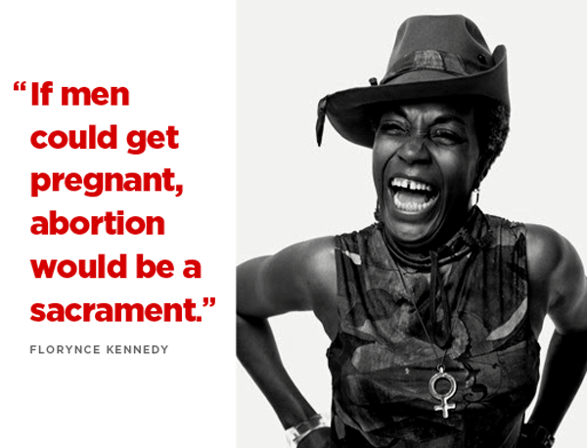
Notes:
But that chart is not easy to translate into real life, so let’s look at an example. A few years back, the Christian right decided to use the Black Lives Matter movement to attack abortion. In The Blaze, Matt Walsh argued that the war against black people is real but is not happening out on the streets, but in abortion clinics. While police killings of black men were justified, he claimed, black folks should look instead at all the potential black lives being aborted. This meme was taken up by sites like blackdignity.com, protectingblacklife.org etc.

Slide 11
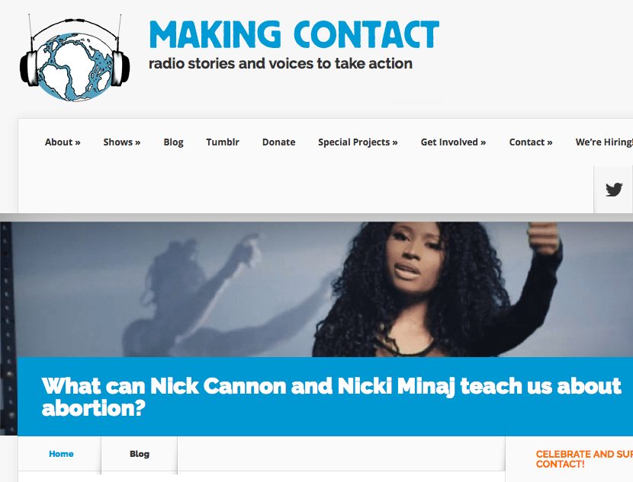
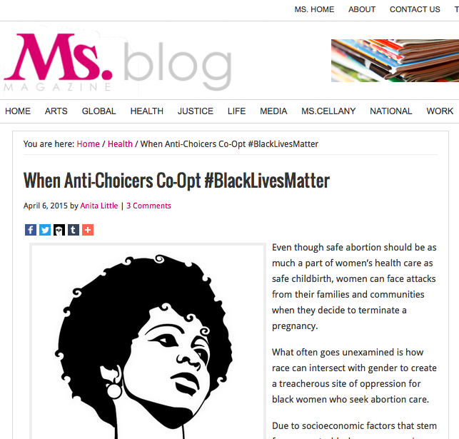
Two Davids vs. a Goliath
Notes:
Could two relatively small outlets make a difference? Could they change sentiment around abortion especially in the context of black lives? The answer was yes! On April 6, Ms. Magazine published a digital story by Anita Little titled “When Anti-Choicers Coopt #Black Lives Matter.” The same day, Making Contact Radio Project’s Jaszmin Lopez published a radio story on black singer Nicki Minaj’s song “Autobiography"

Slide 12
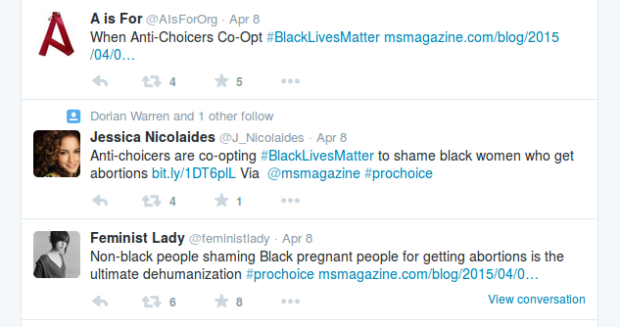
Notes:
Here are some of the tweets researchers found—these reference the Ms. magazine story directly. However the researcher’s system would have piced up the “Feminist Lady” tweet even if she hadn’t used the hashtag we were pushing or linked to the Ms. story. Juts having “black people” and “abortions” in her tweet would have been enough.

Slide 13
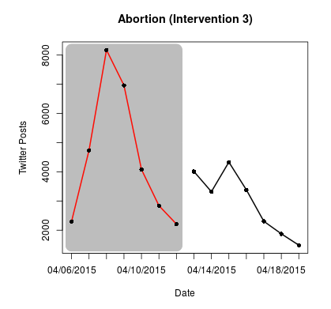
Notes:
The effect of these two stories was remarkable. The number of twitter posts that contained positive opinions on abortion almost doubled that week. People were influenced by what they read and heard.

Slide 14
Groundwork
Scientifically validated method that has shown concrete positive results
Research team willing to continue project
Baseline research on immigration completed =quick start
36 outlets trained to use the experimental protocol (plus more interested in it)
Foundation interest if we can find a funding partner
Notes:
Our member outlets asked us to put this project together at our annual meeting in February. We will do it. But here's our offer to you: if you are willing to continue to fund Gary's work and to fund the work of our project manager, we will be able to use this project to assess the best ways to grow our influence. We will be able, for example, to ask a big outlet like Mother Jones to publish a story one week, and then ask a few smaller outlets to publish on the same topic in a following week, and track which makes the more significant impact. We will be able to run a story on radio one week, and in text the next week, to see whether the platform makes a difference.

Slide 15
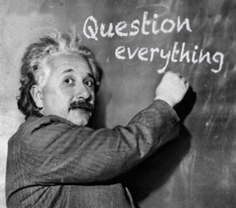
Notes:
We have so many questions we can ask. Does a group of small outlets publishing together have as much impact as one outlet with larger reach? What works better, pushing out a lot of stories all at once, a spreading stories out over time? Is video a better platform for creating influence than text? What about long-form vs. short form?
And we have tee'd up an experiment that will answer some of those questions quickly, while being very relevant for this election cycle.

Slide 16
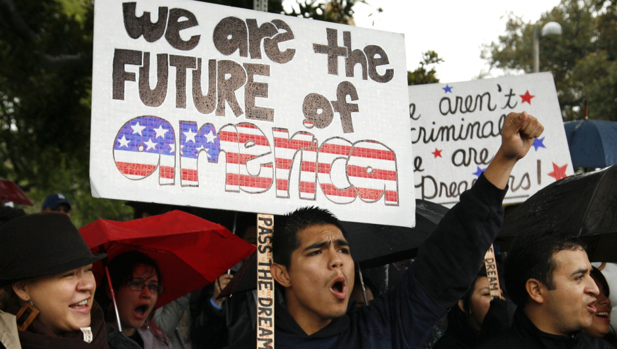
An opportunity
Notes:
Next month, the Media Consortium will launch a project on Immigrant Voter and Citizen Suppression. This project is designed to counter the nativism and xenophobia we are hearing during this electoral campaign. We need to push back with a counter narrative that will influence how Americans think about immigrants. Our focus will be on immigrants that are eligible to become citizens but face barriers to citizenship, and who are citizens but face barriers to voting. The project is designed to intersect with the Black Lives Matter movement's focus on voting rights.

Slide 17

Thank you
Notes:
Over the past twenty years, we have seen that the progressive movement can achieve real and lasting results. The gay rights movement's hard, slow work led to a culture that now embraces gay marriage. The environmental movement has a ways to go, but look at the number of electric cars on the road, and the boom in solar and wind power! The road to racial justice is long, but the Black Lives Matter movement is no sudden splash but the work of generations of civil rights' activists on the ground and in media.
Your support for this metrics project has been and continues to be critical to create the influence we seek. Thank you for your support.

Slide 18
Q & A
Notes:
End of presentation.

Slide 19
Q & A: Timeline
  Development of project; funding; recruitment of researchers and experimental subjects
  Development of project: planning the experiment; communicating w/ test subjects
  Testing the experimental protocols; communicating with test subjects
  Running the experiment (April 1, 2015 – April 1, 2016)
  Communicating about experiment; starting targeted 6 month experiments to answer specific questions.

Slide 20
Q & A: Similar Projects
Harmony Institute
  Measure social change via social media sentiment, polling, press coverage of key terms, and political discourse via the Congressional Record
  Objects measured: documentary films
Participant Index
  Measure social change via social media keyword volume changes, audience opinion data (survey), and viewership information
  Objects measured: video and film
Media Impact Project
  Combines data from social, email, web, membership and event activity to create before/after measurements for individual stories, for stories from the same outlet, and between stories from different outlets
  Objects measured: news stories on all platforms

Slide 21
35 Experiments
Topic Areas:
Reproductive health (5)
Education (4) Immigration (6)
Racial Justice (7)
Economic Inequality (6)
Climate Justice (7)
Notes:
The experimental areas where chosen largely to reflect what outlets were already doing. The twist was that outlets had to agree to co-publish their content on a date chosen by the research group. That was not an easy ask to make. We actually set up 42 experiments, but in 7 cases the outlets could not keep to the reseearchers’ protocol.

Slide 22
36 Outlets Involved
Alternet, American Prospect, Berrett-Koehler, Bitch, Cascadia Times, Care2, Chicago Reporter, City Limits, Colorado Independent, Colorlines, Defending Dissent, Dissent, Earth Island Journal, feministing, Feetin2worlds, FSRN, Generation Progress, Grist, High Country News, In These Times, LA Progressive, Making Contact, Ms. Magazine, The Nation, National Catholic Reporter, New America Media, PeoplePowerMedia, The Progressive, PR Watch, Public News Service, Reimagine, Rethinking Schools, Rewire, Tikkun, Truthout, Yes! magazine
Notes:
We are proud that 36 of our outlets participated. Kudos are due to our Director of Special Projects Manolia Charlotin who was able to convince these outlets to work together. So what did we find?

Slide 23

400 MILLION Tweets/day
Notes:
For our experiment, Prof. King measured whether sentiment on Twitter about a particular topic changed after a set of stories ran. We used Twitter as our social media base in part in part because Twitter users are fairly similar to consumers of progressive news media, but also because Prof. King had access to the entire Twitter firehose of 400 million tweets/day. For each experimental instance, Prof. King would measure sentiment on Twitter about immigrants before we ran a set of stories, published on a random date picked by researchers, and then after we ran a set of stories.

Slide 24
Q & A: Our Assumptions
“Impact” is used here to mean how much a particular news story influences an individual’s thoughts and actions
Sentiment analysis is the best way to measure influence
The twitter audience offers an accurate representation of digital news audiences
Smaller outlets have the most influence when the work together (the theory of collective impact)

Slide 25

Notes:
As we went about setting up this project, we worried that the ripples from our outlets would be present, but too small to measure. But, using the theory of collective impact, we theorized that multiple small outlets publishing simultaneously would create an effect greater than the sum of their parts. So we set up our experiment to measure the change in sentiment when multiple small outlets worked collectively to co-publish one or more stories.

Slide 26
Questions we’d like to test:
Our theory of collective impact.
What is the relationship between influence and conventional metrics like audience size?
Do smaller outlets working together have as much influence as one bigger outlet?
Which is more effective: collaborative storytelling (journalists working together) or collective storytelling (journalists working apart but publishing together)?

Slide 27
Questions we’d like to ask:
Can we expand the influence we have by changing how we distribute stories?
Video, radio, digital, mobile—does the platform make a difference?
Can we better increase influence if we publish many stories over a long period of time or a burst of stories in a short period of time?

