Slide 1
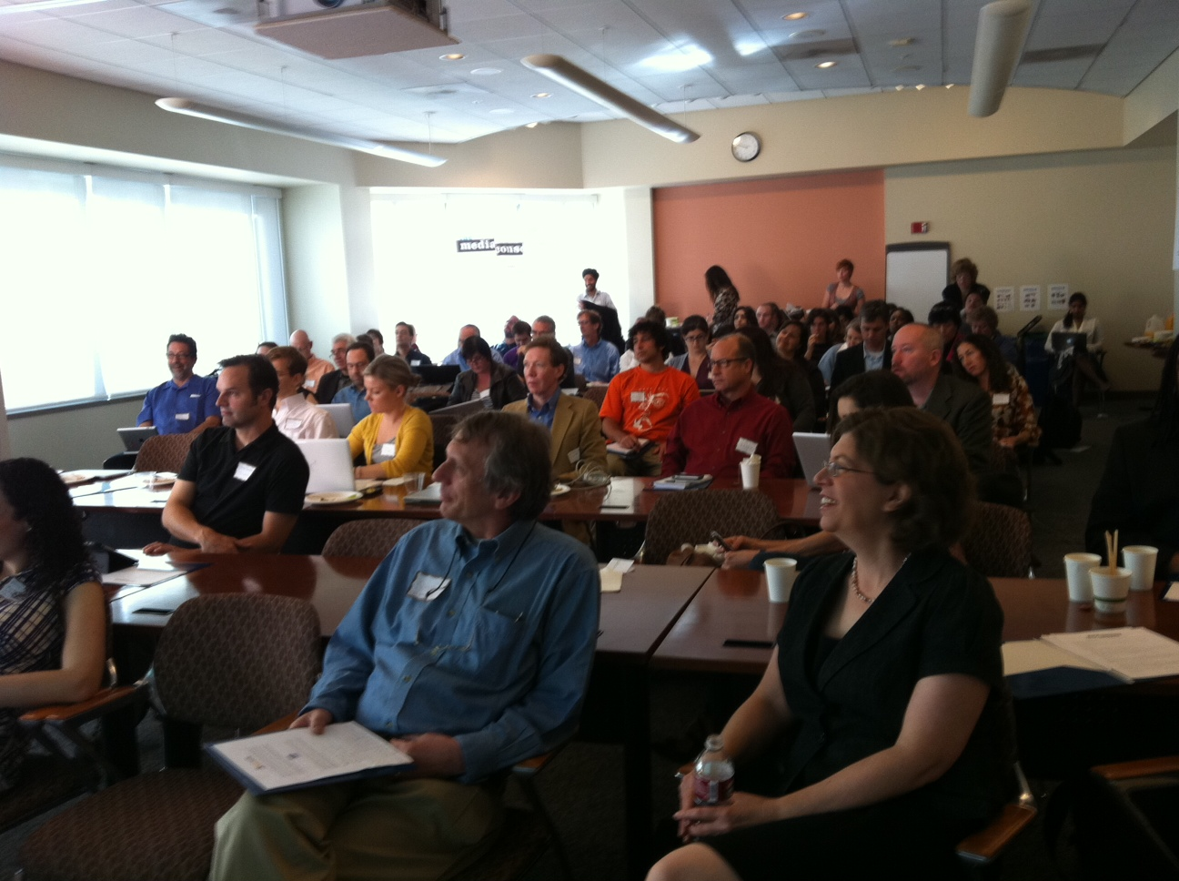
Harnessing Our Collective Power
Notes:
Yesterday, we experienced the strength of our consortium as we learned and planned together for our individual futures. Today, I want to talk about how we can strengthen the Consortium itself. I am going to talk about our future plans, and, yes, about how we can pay for those plans. I want you to understand what the Consortium really does, and how we really work.

Slide 2
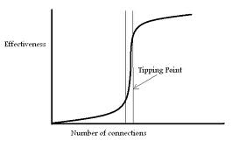
We are at a Tipping Point
Social tipping points, though they may appear to occur spontaneously, do not happen by accident.
--Gary Horvitz, FourYearsGo
Notes:
After six years and a tremendous amount of work, the Consortium has created the possibility of a self-sustaining, high quality, high visibility, high impact independent media sector. You have evolved to meet the challenges of the digital revolution. Collaboration has become one of our favorite terms. But we are by no means where we need to be—and we know it. We know we don’t yet have the influence of mainstream media or the sheer brawn of the right-wing echo chamber. This is a critical moment. Because if we don’t go up,

Slide 3
Tipping Point or Stasis?
Notes:
…we will be hard pressed to stay where we are. The media field is changing too fast to stay still. And our funders and supporters look for us to be ahead of change, rather than behind.
We should not fear this moment. On the contrary, this is why the Media Consortium exists. We know how to innovate. We know how to meet challenges. We can make the leap to the next level. But to do so, we will have to harness our collective power. That’s why we are meeting today.

Slide 4
TMC Supports and Grows the Independent Media Sector
Support =
Innovation Labs
Webinars
Listserv/Newsletter
Meetings
Grow =
Editorial Collaborations
Social Media Promotion
Networking with Allies
Notes:
So let’s start digging into the details. How do we attain the kind of success we seek? How do we fulfill our highest vision? To start answering that, let’s go back to basics and talk about what we do. Simply put, we support and grow the independent media sector.

Slide 5
We Support the Sector through Innovation and Incubation Labs
Metrics Experiment
We look forward to working with John Schwartz and Gary King on this Consortium-wide experiment to measure the power of our collaborations.
Visual Journalism: Spring 2012
Led by Erin Polgreen, this lab will place visual journalists with participating member outlets. We are seeking funding now.
Mobile II: Fall 2012
Working with partners at University-based labs, we will pair graduate students with member outlets to create mobile apps you can actually use.
Notes:
Over the next year, we will continue to support the Consortium. We are planning three Innovation and Incubation labs—working with partners in each case to defray the cost to the Consortium.

Slide 6
And Monthly Webinars
Teresa Stack, The Nation, “Why and How to Respond to Post Office Cutbacks”
Michelle Minkoff, AP Interactive Producer, “Visual Journalism HTML Open Source Modules ”
Rajat Paharia, Bunchball, “Gamifying Comments”
TBA, New America Media, “The Shadow Economy: Connecting with Ethnic Media Reporters”
Notes:
We plan to implement monthly webinars to fill the gaps between labs. TMC staff act as your curators to keep track of trends in the media space and connect the dots for how they will impact members. And of course, we will start planning now for our next annual meeting.

Slide 7
We GROW the Sector through Collaborations
National Coverage: Wisconsin
National Meme: #campaigncash
National Allies: media policy
Notes:
Supporting our sector is core to our mission. The key to achieving that tipping point, however, will likely come through our collaborations. In the past year, the independent media sector has moved into the national spotlight when we collaborated with each other and allies on editorial projects.

Slide 8
We create an External Network
TMC
Media Policy NGOs
Media Partners
Ethnic Press
Advocacy NGOs
Notes:
To deepen our reach, TMC staff work with the ethnic press. To strengthen our services, we work with partner organizations like ONA and AAN. To amplify our voices and increase our impact, we work with Media Policy and Advocacy NGOs. This external network amplifies our voices and is critical to harnessing our collective power.

Slide 9
What is the Key to Successful Collaborations?
  A Willingness to Collaborate
  Trust between Collaborators
  A Topic of Mutual Interest
  Infrastructure!
Notes:
Here’s what we have learned about creating a successful collaboration , whether that’s within the TMC network or with our allies. It takes a willingness to collaborate first of all. It takes trust that your partner is committed to collaborating, rather than simply sharing content. It takes a topic of mutual interest, like Occupy NY. But we’ve discovered that alone is not enough. A successful collaboration takes infrastructure.

Slide 10
What is a Collaborative Infrastructure?
Notes:
A successful collaboration requires four different types of infrastructure: networking, content-provision, marketing, and evaluation, with TMC staffers keeping the community going.

Slide 11
Networking Infrastructure
Networking Infrastructure
Dedicated Listserv
Regular Conference Calls
Shared Editorial Calendars
Notes:
For each of our collaborations, TMC staff have pulled together a dedicated google group, regular conference calls between collaborators, and a google doc through which we can share editorial calendars. Timing is critical to a collaboration that creates impact.

Slide 12
Content-Provision Infrastructure
Content-Provision
Webinars w/experts
Multiplatforming
Seed money for reporting
Notes:
We support your collaborations through raising seed money for your reporting. We help you diversify your content by linking members with different platforms together, so you can run rich, highquality text, podcast and video. When we have time—when the story is not breaking—we create webinars with experts to provide you with sources and background for your reporting.

Slide 13
Marketing Infrastructure
Marketing
Social Media listserv
TMC social media curator
TMC Tumblr
Topic-driven URL
Professional publicist
Networking with allies
Notes:
Content creation is not enough. For impact, stories must be marketed. TMC has been creating a marketing infrastructure by assembling a google group listserv for staffers at your outlets who tweet and fb for you. We’ve hired a social media curator to push out your stories on our facebook and twitter pages. We’ve begun creating tumblrs for each collaboration, and placing the tumblr under a topic-driven Url for better SEO. When we obtain funding, we hire a professional publicist to get your journalists those mainstream media interviews. And we network with our advocacy allies to tie your stories to their campaigns.

Slide 14
Evaluation Infrastructure
Evaluation
Pixel Ping w/stories
Social Media Dashboard
Publicists keep interview file
Qualitative surveys
Notes:
Finally, we aspire to do better each time. So we keep a social media dashboard to track our social media work. We plan to begin placing pixel pings in collaborative content so we can track those metrics. And after each collaboration, we ask you to evaluate what went well and what we can do better.

Slide 15
TMC Staff
Notes:
In short, editorial collaborations take a significant amount of work to be successful. Right now, that infrastructure has been created by TMC. When collaborations are going, she is working full-time pulling these different pieces together to create success. So when we ask, how can we strengthen the Consortium, we not only mean, how can we strengthen our individual members, but how can we support staff like Erin, to make sure that infrastructure work gets done?

Slide 16
It’s time to look at ….
the Numbers
Notes:
If you’ve been in business—any kind of business—for any length of time, you know that the story of an organization lies in its numbers. A budget tells you what an organization values and how it functions. A budget creates a blueprint for success or failure. So if we want to strengthen the Consortium, we have to look at the numbers…

Slide 17
How do we pay for all this?
Notes:
We rely heavily on foundations to fund Consortium activities. We have the highest ratio of foundation to external revenue funding of any of our comparable organizations.

Slide 18
What Are Our Costs?
General Operations
Total Personnel | 152,000
Total Non-Personnel Administrative | 14,500
Total General Operations Expense | 166,500
Project Expense (exclusive of staff time)
TMC Annual Meeting | 10,000
Social Media Blogger/MediaWires | 20,000
Media Policy Reporting and Education Program | 84,750
Campaign Cash Collaboration | 45,250
Metrics Experiment | 111,150
Visual Journalism Lab | 21,750
Collaborative Fundraiser | 20,000
Total Project Expense (Direct Costs) | 312,900
Total Expenses | 479,400
Notes:
Sixty-five percent of our dollars are going directly into programs. That means providing members with dollars for reporting, providing experts to work with you on labs, and paying marketing/pr folk to promote your material.

Slide 19
How is 2012 Looking?
The budget I just showed had expenses of $480,000.
We expect to receive foundation funding at a max of $300,000.
And that is not a worst-case scenario…
Notes:
But we constantly are scrambling to make ends meet.

Slide 20
Where’s the Dough?
We are more ambitious today than we were yesterday—our expenses are higher.
The economy is recessionary, and we’re back in a bear stock market.
TMC is 6 years old—we no longer are the cute nonprofit on the block.
Notes:
Editorial collabs take more $$ and staff time than tech labs.
Most philanthropists give interest on their nut; they have less to give.
Philanthropists expect us to cover our general operating expenses.

Slide 21

Let’s Innovate and Incubate
Stephanie Cashteen
Wikimedia commons
Notes:
What we’re doing is totally amazing. This is not the time to cut back. It’s the time to push forward.

Slide 22
Let’s Create a New Biz Model
Grant Income= Project Expenses
Earned Income= General Operations Expenses
Notes:
Foundations will always give grants for one-time projects. What’s difficult is getting general support. If we don’t get general support, we have to take it out of project funding, and that leaves less for what we actually want to do. So what if we could raise enough money for staff and overhead in some other way?

Slide 23
The Payoff
TMC no longer competes with members for grant dollars (grant $ all goes back to members).
TMC is sustainable for the long term.
TMC becomes independent of funders as well as corporations and government.
Huzzah!

Slide 24
Let’s Talk Numbers Again
In today’s model, earned income = $25,000
x 5
_________
In tomorrow’s model $125,000
(Staffing currently costs $175,000, so this still imagines some grant money to cover staff , but a much smaller amount)
Notes:
To achieve this new model, we’d have to multiply our current earned income by 5. That’s pretty steep. It really does mean thinking outside the box.

Slide 25
Can we find this Earned Income? Yes!

Slide 26
And I Will Help Too
Continue to bring in grant money
Raise money from corporate sponsors for non-editorial projects (like this meeting)
Look for programs that could be opened to non-members in order to bring in extra revenue (like the media trainings)
Keep our overhead costs low

Slide 27
It’s Up to All of Us
We are a Consortium, a network of partners, working together to strengthen each other.
We know when we work together, we all become stronger.
Let’s move the Consortium to a more sustainable place, together!
Notes:
I am going to turn the conversation over to Jamie, who will facilitate a discussion about how we can strengthen our Consortium. Thank you.

