Slide 1


Slide 2
who is this guy?

Slide 3
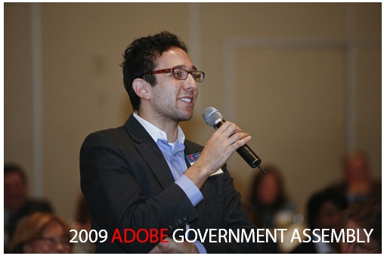
Notes:
Isn't this all the cred I need?

Slide 4
multimedia
content
producer
video - audio - stills - text
Notes:
a dollar if you catch the tron reference
the more I look at this term the more I think it's increasingly redundant
who is familar with Sunlight?

Slide 5


Slide 6
Should you move into mobile?

Slide 7
YES.
Notes:
CNNvv

Slide 8
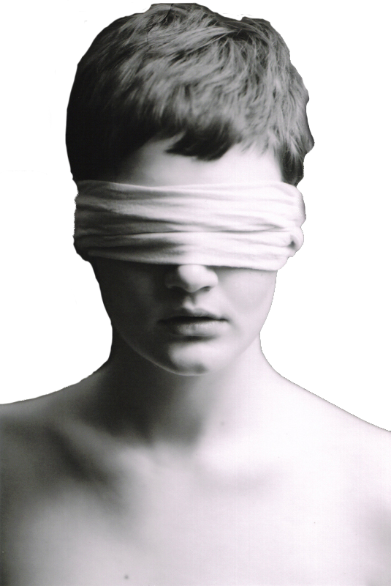
Vision?
Notes:
What is your vision?

Slide 9

Do not clone yourself.
Notes:
Trust me, no one wants to see that.

Slide 10



Notes:
All just basic mirrors of the mobile site.

Slide 11

Notes:
First pitfall is CNN, how many of you have visited their mobile site on iPhone or Android? How many have your paid app?

Slide 12
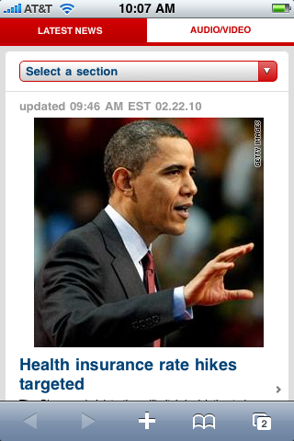
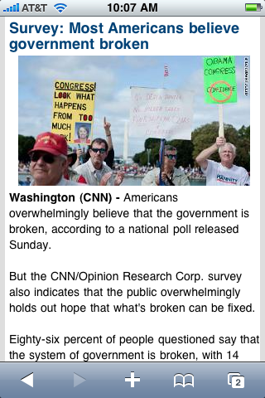

Slide 13
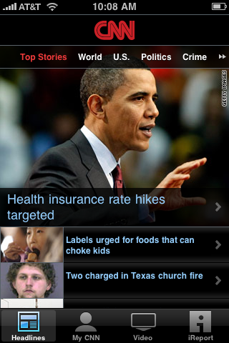

Slide 14
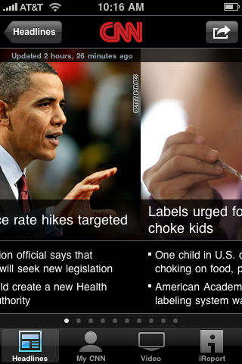
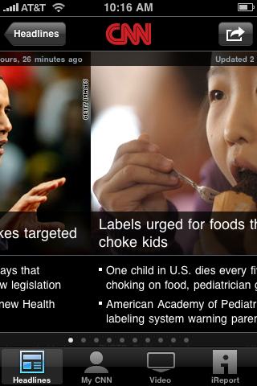
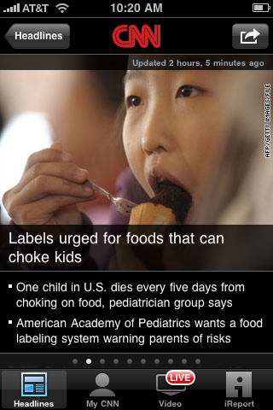

Slide 15
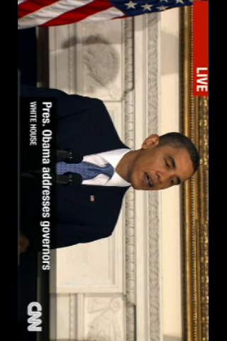

Slide 16



Notes:
MOVIE ON NEXT SLIDE

Slide 17
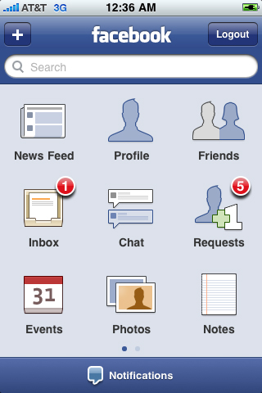
Notes:
A companion to Sunlight’s work – not a carbon copy. What can you offer that’s head and shoulders above the competition?

Slide 18


Slide 19
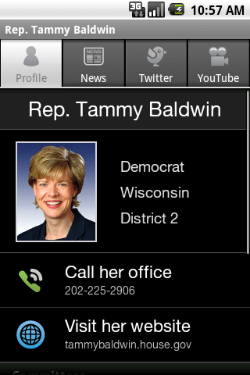
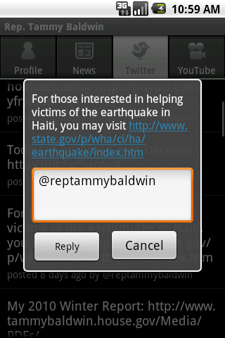
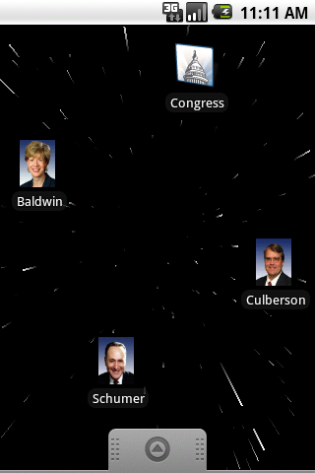
Notes:
A companion to Sunlight’s work – not a carbon copy. What can you offer that’s head and shoulders above the competition?

Slide 20
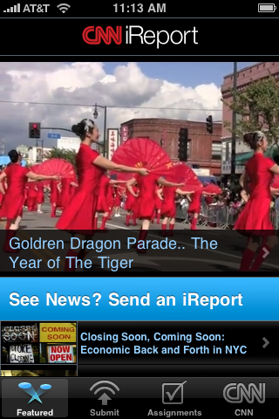
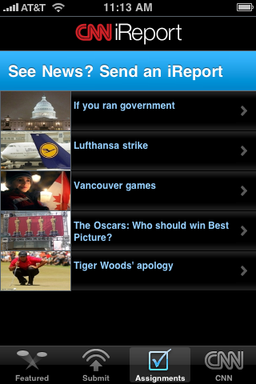

Slide 21
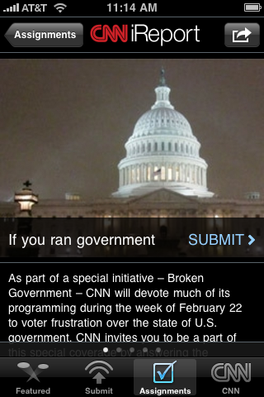
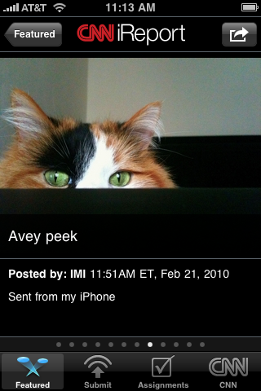

Slide 22
Thanks!
Questions?

