Slide 1


Progressive Media Wire Project
Impact, Evaluation, Next Steps
February 10, 2009

Slide 2
Agenda
Overview of Project
Current Activity / Initiatives
Success to Date
What’s Next?
Questions / Feedback
Notes:
Going to review the agenda quickly, then we’ll be off and running.
II. What are the Media Wires/Project overview
-Review goals and strategy of project, -Give overview of newsladder platform and project benefits
III. Current Activity and Initiatives-Blogs, Social Media, Ads and more
IV. Success to Date.
We’ll also look at a traffic snapshot for January and go over projections through June.
V. What’s Next? Goals for next 6 months and how you can opt in
VI. Questions/Feedback and ideas for next steps.
Make sure people know they can jump in and ask questions

Slide 3
Agenda
Overview of Project
Current Activity / Initiatives
Success to Date
What’s Next?
Questions / Feedback

Slide 4
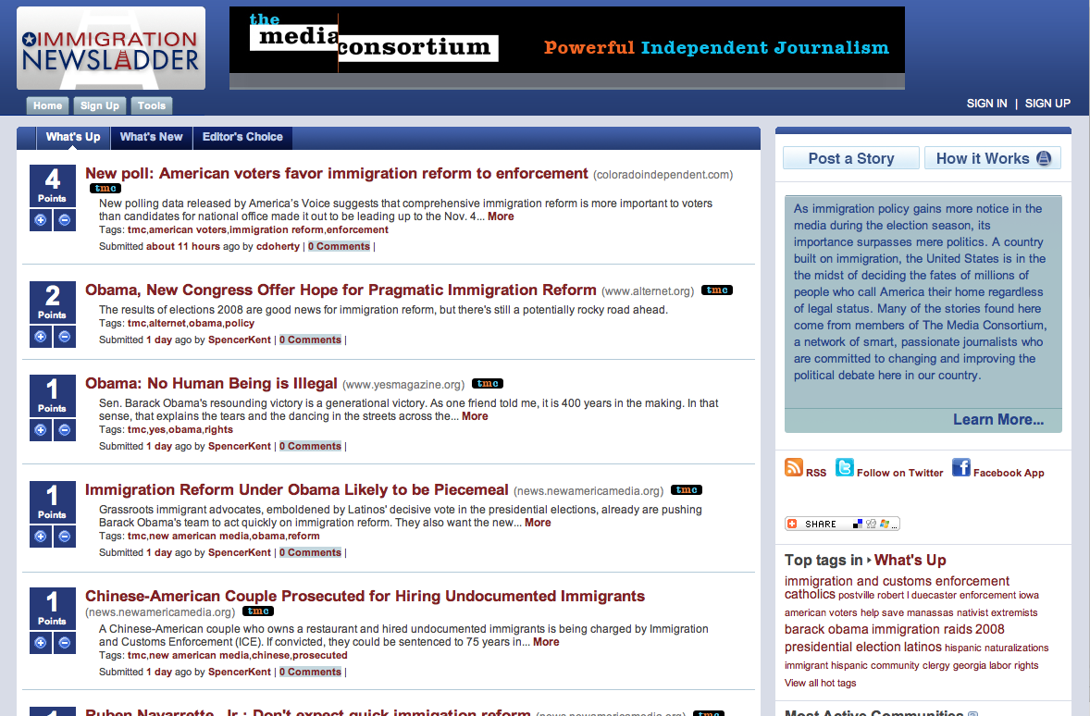




Goals
The MediaWire project is made up of two strategies:
1) Aggregation by issue at NewsLadder.net
2) Content round up and distribution through new media tools
The goal? Build a unique distribution platform that will:
  Increase awareness and influence of your content and the progressive media sector
  Drive traffic to member sites
  Facilitate sharing and cross-linking of your content to new audiences using new media tools
  Archive your content around key issues
Notes:
Some of the slides you’ll see today have been adapted and updated from a presentation that we gave to over two dozen members in november/december.
The driving inspiration for the media wires project was find a way to support YOUR WORK and distribute it to new and untapped audiences.
Two strategies:
1.) aggregate your content via newsladder.net
2.) provide round ups promoting that content using new media distribution tools such as blogs and social networking platforms to push it out
This project’s ultimate goal is to provide a platform that:
(again, increases awareness and influence of YOUR content and the progressive media sector, drive traffic to your sites, move your content to new audiences and archive your content around key issues.) We’re working to frame this project as a sort of progressive digg—where content is organized by topic.

Slide 5
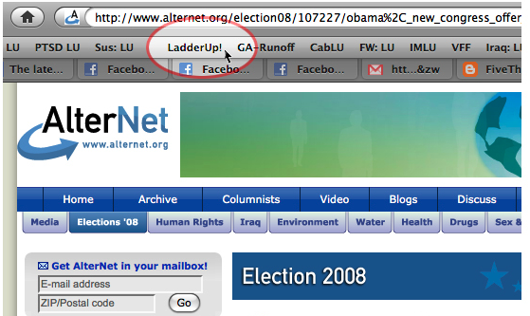
Platform
How does a NewsLadder work?
  Focus on a specific issue/personality and act as a content/news 'hub’
  Aggregates and Archives all relevant TMC Member content
  Users (like you!) can post stories, video to ladder
    Submit through the site… Or…
    Use Ladder Up! Toolbar tool
  Forms a platform that efficiently distributes content to broader audiences
NewsLadder team posts TMC member content
  Aggregated across TMC sites (RSS feeds, Yahoo! Pipes, daily site review)
  Team reviews against 501c3 guidelines
  Content is also posted to other, non-TMC NewsLadders
    Cabinet, OurTroops, Iraq, Justice, etc.
Notes:
So, to tell you a little bit more about the NewLadder: Each ladder acts as a hub for content, but functions as a mechanism to distribute more efficiently outward. This isn’t about competing – but about a platform for distribution…
Users can post stories
You can post content
Newsladder team aggregates and posts TMC member content EVERY DAY.
Aggregated across TMC sites (RSS feeds, Yahoo! Pipes, daily site review) Content team reviews against 501c3 guidelines (If needed: the 501c3 guidelines stipulate that since this project is sponsored by a non-profit entity, it cannot provide specific endorsements of political parties or members, nor can it advocate or lobby causes. These wires are journalistic in intent for legal reasons.
Content team posts to appropriate / relevant NewsLadder Site—including non-TMC NewsLadders like OurTroops, Iraq, Justice, etc.

Slide 6







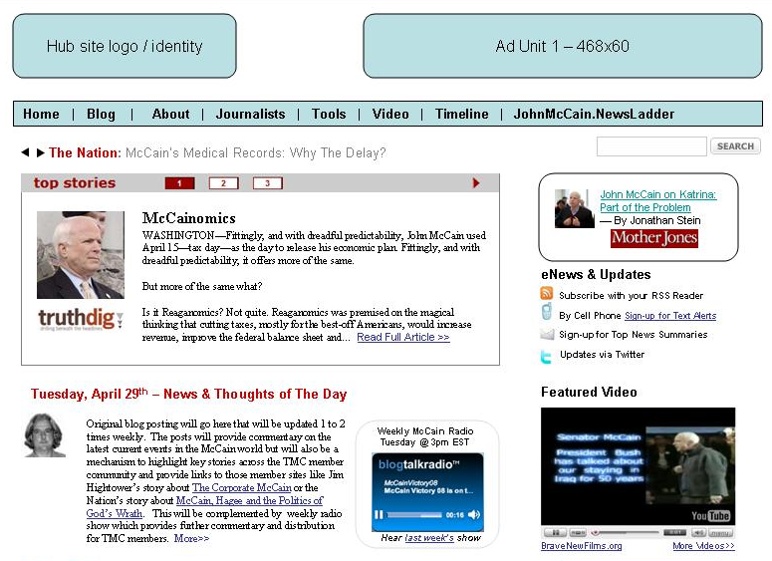












Visual: How It Works
Blog Outreach /
Cross-posting
Audience
Social Networks
Advertising
Audience
Media Wire Sites
Topic-specific
A Hub of News
Multi-Media
SEO-friendly
Audience
Media Tools
content
content
NewsLadders
Content
Audience
Audience
Audience
content
content
RSS, Twitter
Audience
Mobile Updates
Audience
Search
Audience
Email Alerts
Widgets
Notes:
Here’s a little animation that sums up how the project works. This third point also includes some potential distribution growth areas, such as mobile updates and larger advertising campaigns.

Slide 7
Key Benefits
The MediaWire sites create a strong distribution platform that:
  Builds TMC member influence by extending content to new and targeted audiences
  Facilitates content and audience sharing among TMC members
  Increases traffic and incremental readership via:
    Focused content: Wires function as ‘the’ journalistic hub on key issues
    Natural search
    Efficient distribution of content (new media tools, outreach, social networks, strategic partnerships)
  Requires almost no TMC member effort for maximum benefit
    We Leverage & Extend Your Existing Content
Notes:
READ SLIDE.

Slide 8
Agenda
Overview of Project
Current Activity / Initiatives
Success to Date
What’s Next?
Questions / Feedback

Slide 9
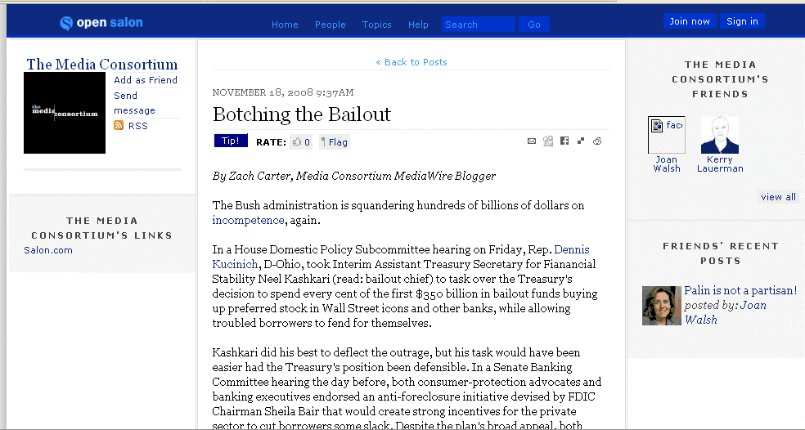
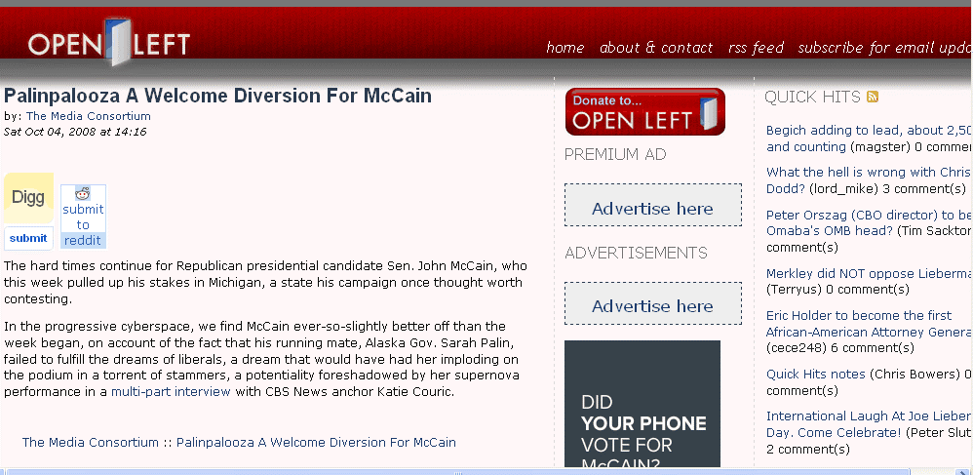
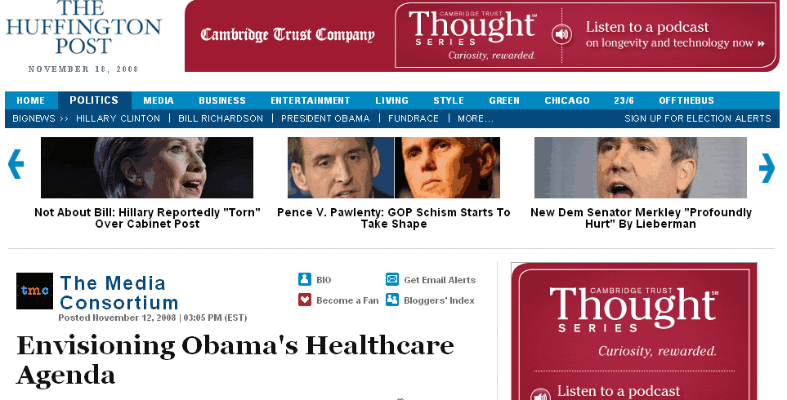
Blog Outreach
Top Stories Blog Post Schedule
  Tuesdays: Economy Post by Zach Carter
  Wednesdays: Healthcare Post by Lindsay Beyerstein
  Thursdays: Immigration Post by Nezua
Blogs posted on Huffpo, DailyKos, Firedoglake, MyDD, Open Salon & More:
TMC is working on one-on-one partnerships with immigration, healthcare and economy focused blogs, orgs, and think tanks to pick up and distribute blog posts.
Notes:
Intro Zach and Lindsay
These purpose of these blogs is to curate and contextualize your content--while also cultivating new audiences, We’re providing snappy, easy to read directories of topics that people want to know more about. Our bloggers are all very knowledgeable of their fields and are doing a great job contextualizing your work as part of a powerful progressive media movement. As an extra aid, you’ll find 3 short “roundups” of potential stories, trends and resources that our bloggers put together for each beat.
We’ve developed relationships with leading progressive websites (like Huffington Post) and are publishing these roundups across the blogosphere. You can pick up the blog posts from the MC listserv Tues-Thurs, where we publish them in HTML—so you can just copy and paste from your email. You can also get these posts from the new MC website. We’ll talk more about that and the one-on-one partnerships we’re building with non-profit organizations and thinktanks later on.

Slide 10
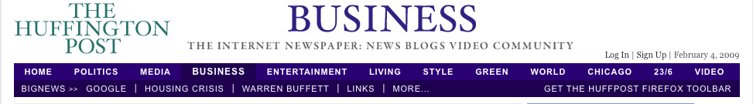
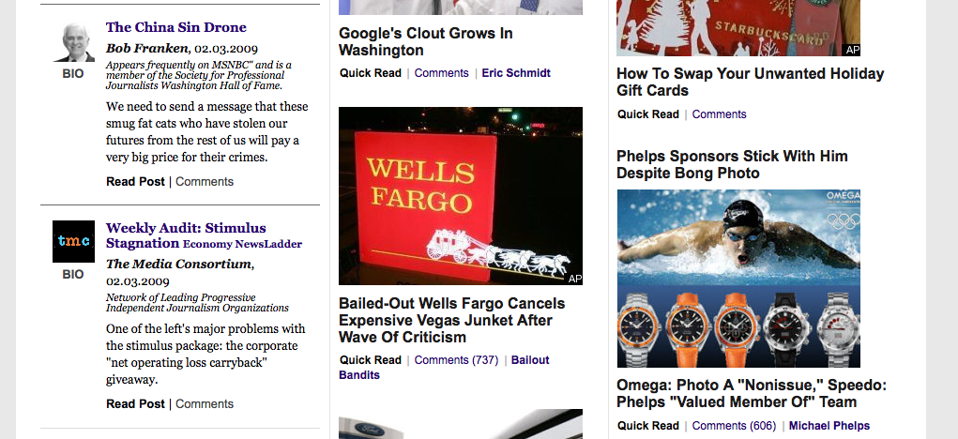
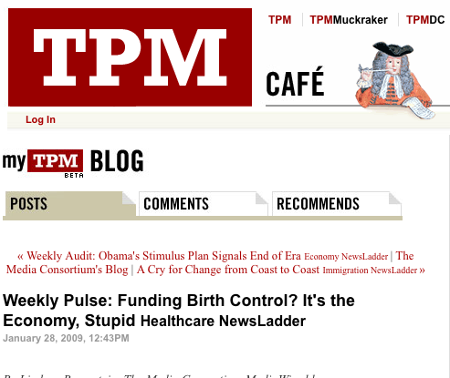
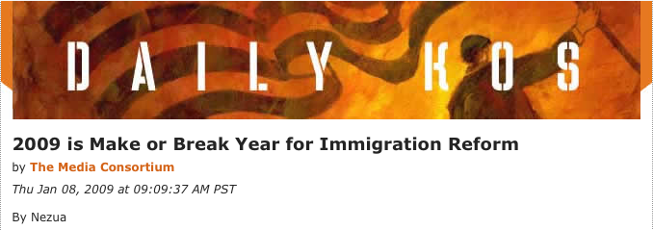
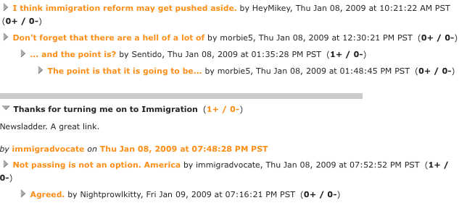
Blog Outreach
So how are we doing?
Notes:
While we’re still working on making tracking more efficient, here’s what we do know:
Huffington Post: Content is regularly featured on Business and Media Sites. John McCain content was featured on election page.
TPM Café: One of their top 20 cafe blogs. The Media Consortium’s posts got almost 1800 unique pageviews in January
DailyKos: Commenters are active and definitely paying attention to our work.
We’re working to figure out how to track pageviews for blogs on separate sites and should have a solution in the next few weeks.

Slide 11
Partnerships
Who’s on board?
Twin Cities Daily Planet
U.S. Women’s Chamber of Commerce
In Motion Magazine
Campaign for America’s Future
Young People For
OneAmerica
Student-Farmworker Alliance
National Council on Research for Women
WhiteHouse2.org
Center for Health and Gender Equity
…and many more to come!
Notes:
As I said earlier, we’re also working on one-on-one partnerships with immigration, healthcare, economic-focused blogs, orgs, and think tanks to pick up and distribute blog posts. These listed organizations are interested in implementing this project, or already have. All of these contacts were generated by MC members. It’s an organizing process—lots of phone calls and follow up. Over all feeling is that people are very interested and excited by this project. It’s a tremendous way for our sector to engage likeminded partners. Pick up has been slow due to the election/inauguration—apparently people were busy then? Did you all know about this? But now that things are evening out, folks are starting to implement.
Here are some of the commitments we’ve gotten so far: TCDP, USWSS, In Motion are all working on implementing the widgets.
CAF is interest in hosting the blogs.
Young People For is going to in hosting the blogs and widgets across the board.
OneAmerica plans to begin hosting the blogs and Immigration widgets.
The Student-Farmworker Alliance is hosting the widgets and blogs and is also helping promote immigration wire via facebook.
The National Council for Research on Women is currently hosting the widgets, and we’re working on a strategy to roll these tools out to their network of more than 100 U.S.-based research, advocacy, and policy centers.
WhiteHouse2 is featuring RSS feeds from the NewsLadders on its discussion pages. You’ll see a screenshot in a moment.
Center for Health and Gender Equity is interested in helping build a reproductive health subladder—but we’ll talk more about that later.
Groups that we reached out to in Dec and early Jan are also starting to respond, so expect more good news to come.

Slide 12
Tools of the trade
How else are we increasing your content’s reach?

Slide 13
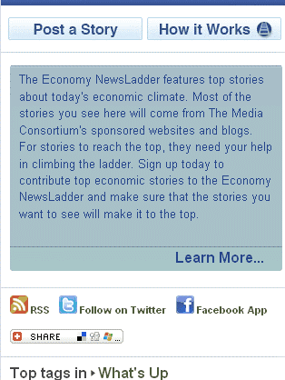
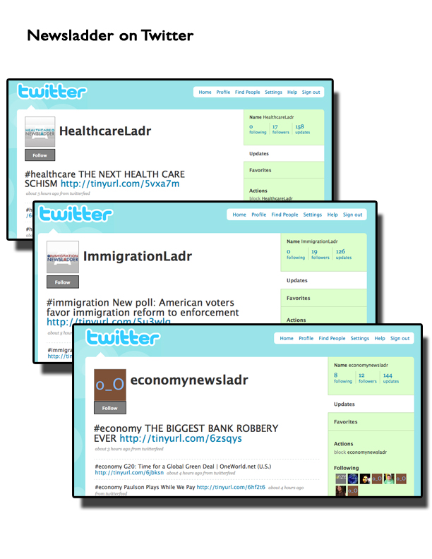
Tools of the trade
How else are we increasing your content’s reach?
13
Notes:
Twitter
Follow the Media Wires on Twitter
Twitter feeds are available for every Media Wire
Re-Tweet when a blog post goes up.
Twitter followers are growing—we’re at approximately 250 followers now for our sponsored ladders, and it’s growing by 30-40 people a month.

Slide 14
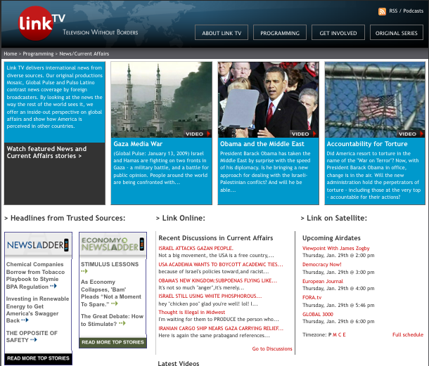
Tools of the trade
How else are we increasing your content’s reach?
Notes:
WIDGETS!
Here’s an example of the Widgets at work on LinkTV’s current event’s site.
We’ve just launched an improved tracking system for widgets and should have a good snapshot on this content next month.
Widgets are easy to implement and available in flash and java, in multiple sizes. They are very popular among our non-profit partners, who see them as the perfect way to help inform their audiences. Of our non-profit partners, several have referred to these widgets as a perfect compliments to their own sites and work.

Slide 15
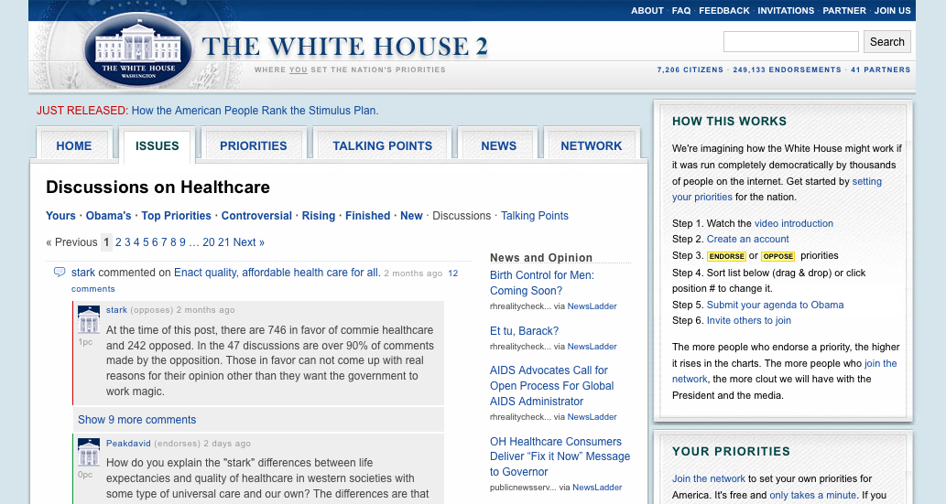
Tools of the trade
How else are we increasing your content’s reach?
Notes:
RSS!
We also have RSS feeds that can be fed into your site to fit your design specs. Tracking on these links is also up and running. Here’s a visual of how WhiteHouse2 is working with the feeds.

Slide 16
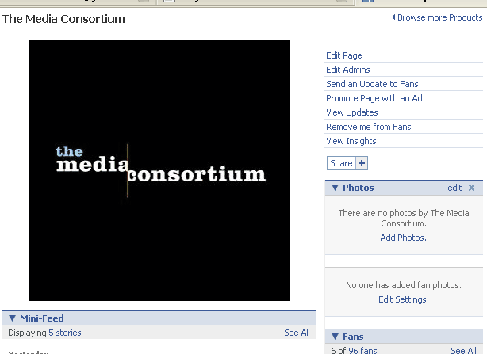
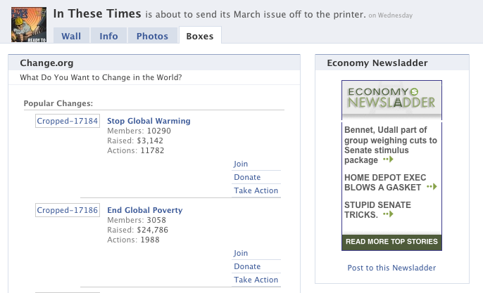
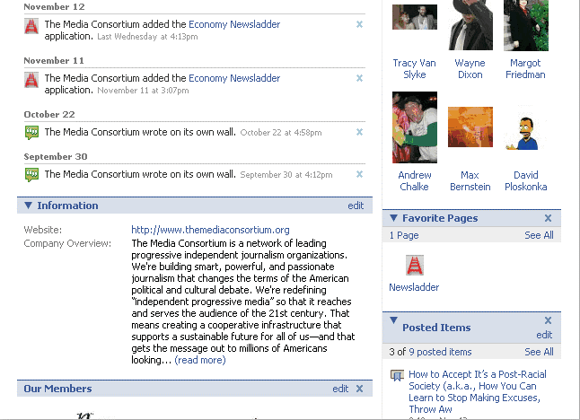
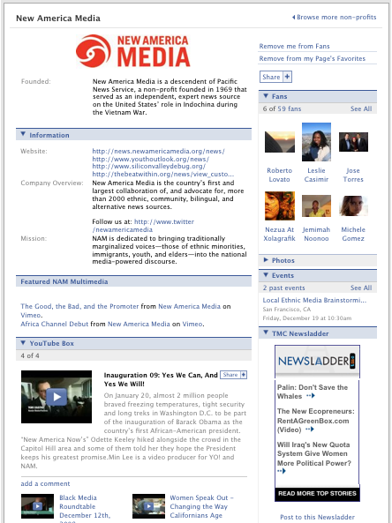
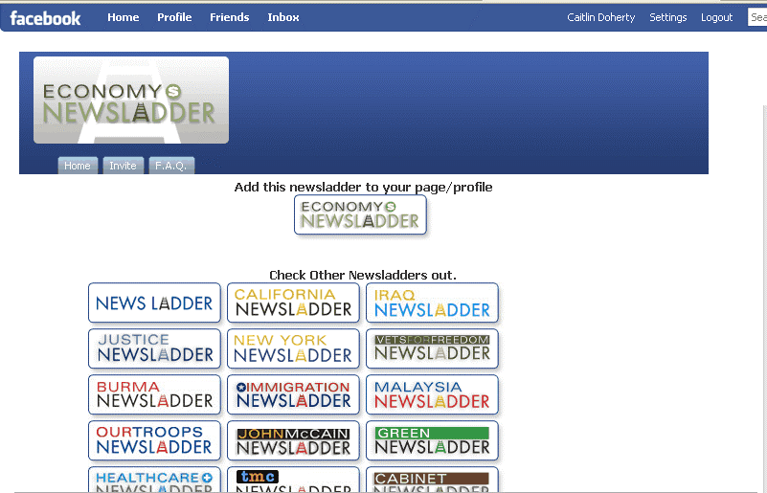
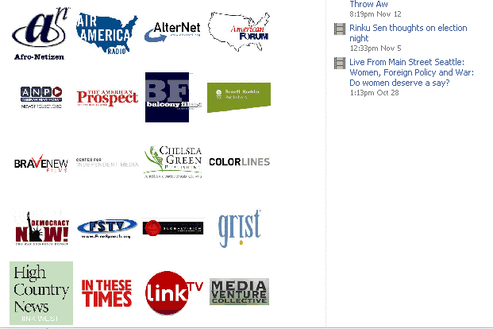
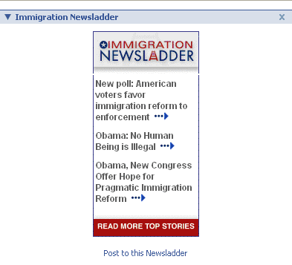
Facebook – Page & Applications
Notes:
Our FaceBook page and applications are helping connect your content to new audiences.
Current App users:
Economy - 54
Immigration - 63
Healthcare - 26
ALL TMC - 23
Fans: 238
The applications are by far the easiest way to participate in this project: adding them to a page or profile is just a matter of clicks. You can see them in action on the right hand side of this slide.
You can work with these tools to self promote:
Facebook
Become a fan
Become an Admin
Post your content
- Events
- YouTube clips
Send a message
Add the Facebook application to your profile for your friends to see and use.

Slide 17



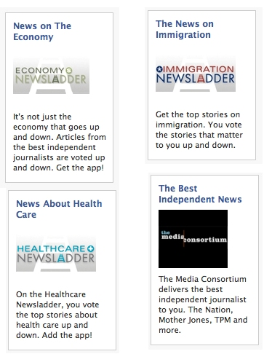

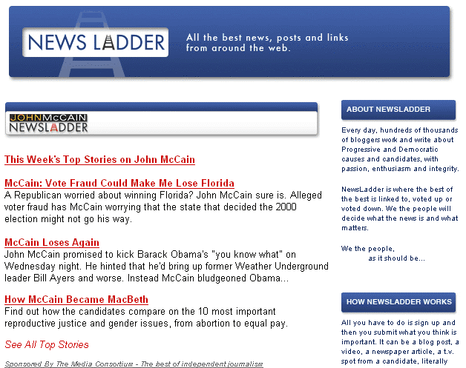
Other Promotions
Paid Search
Efficient advertising
$0.16 CPC
Highly targeted audience
Low-cost exposure
Weekly Emails
TMC Member content is included in other NewsLadder Top Stories emails that
go out on a weekly basis
Notes:
These other efforts make up a smaller percentage of our overall strategy, but are helping cultivate an audience and reputation for this content.
Paid Search,
We’re investing smartly in paid search to help boost the awareness and audience of this product for people that are already looking for this information
We’re also in the process of applying for a google grant for 10,000 of advertising a month, which could exponentially boost our traffic and the project’s reach. We should know about this by March.
Enewsletter Promotions
While small, these lists are growing, and are encouraging repeat visits to the ladders—and TMC content by extention. And even though this is a small list, the CTRs and open rates are strong.

Slide 18
Agenda
Overview of Project
Current Activity / Initiatives
Success to Date
What’s Next?
Questions / Feedback

Slide 19
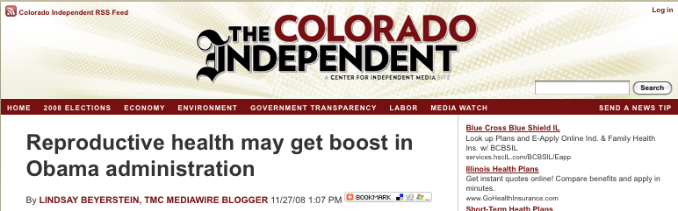
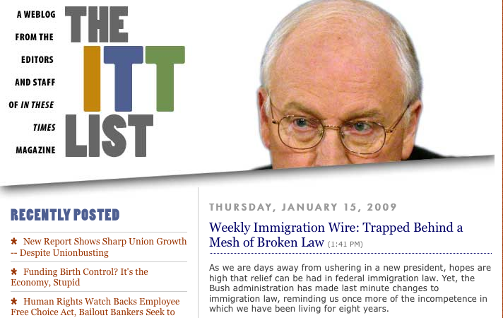
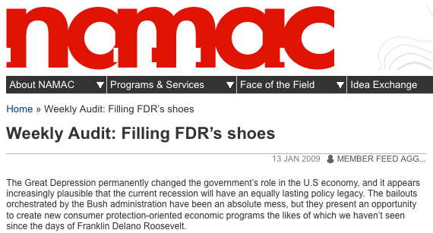
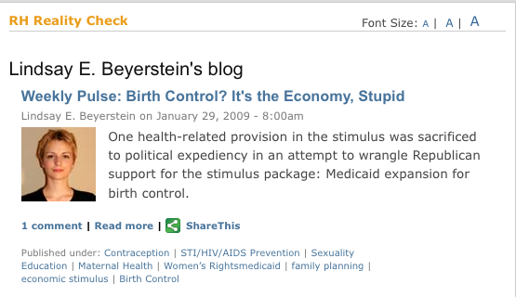
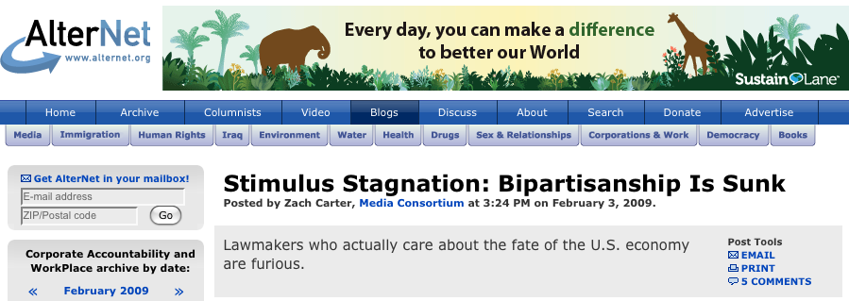
What Is Success?
4 Key Factors
  We are presenting TMC members as experts on key issues online
  Distribution of member content to build awareness, influence and readership
  Generating traffic and pulling in new readers to your sites
Member Participation
Notes:
Read through slide.
And the 4th factor? Member participation. We need your help to make sure that this project has an impact. The success of this project hinges on collaboration amongst MC members and the resulting cross-pollination of audiences. We’ll talk more about how you can opt in later on.
The more you host widgets and publish blogs, the bigger this project becomes. We need your investment to help this project take off!

Slide 20



Recap
What’s working so far?
  Blogs are well-received and growing in popularity.
  Non-profit partners view this project as a tremendous resource for their constituencies.
  Wires are a valuable archive for your content that can be mixed and mashed in a variety of ways.
  People are excited about working with progressive media to enhance their own sites.
Current NewsLadders

Slide 21
Challenges
Accurately tracking traffic.
January Snapshot (missing data from blogs, widgets, Facebook apps, RSS)
  15,000 page views for TMC-sponsored ladders:
  Clicks to TMC member stories: ~ 3,500
  Approximate value of traffic to member sites ~ $1750
Solutions
Redirect in place. Preliminary results suggest that member clicks are actually double what we were able to track.
Continue to Push out Blogs/Widgets to partners and MC members.
Aggressively pursue Google Grants, which could boost traffic by 8-10K per month.
Implement Facebook Connect
Notes:
We’ve been struggling to accurately map the impact and traffic for this project and implemented new measurement tools that will track blog pageviews and clicks, rss, facebook and widget clicks as well. January also marked a recovery from the holidays and the downswing of McCain related traffic. This is part of a process and we are confident that numbers will perk up beginning this month.
Each month, we’re analyzing what does and doesn’t work in our promotional approaches to this project.
While we are still solidifying our tracking abilities (we just recently launched a redirect that will make it easier to see what stories are most popular on the blogs and widgets), we do know that traffic is growing and will continue to do so as more and more organizations and individuals use the widgets and rss feeds.
Based on our growth from Dec-Jan (Post John McCain Dropoff), we’re hoping to incrementally increase member clicks across the existing newsladders by 1670/month at bare minimum.

Slide 22
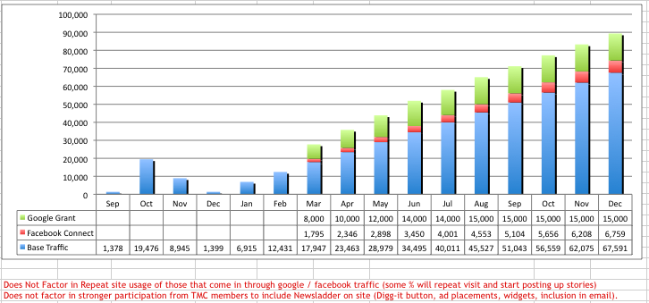
2009 Traffic Forecast
Notes:
Looking at traffic for media consortium newsladders hitting around 90K in dec—but numbers don’t account for XXXXXX.

Slide 23
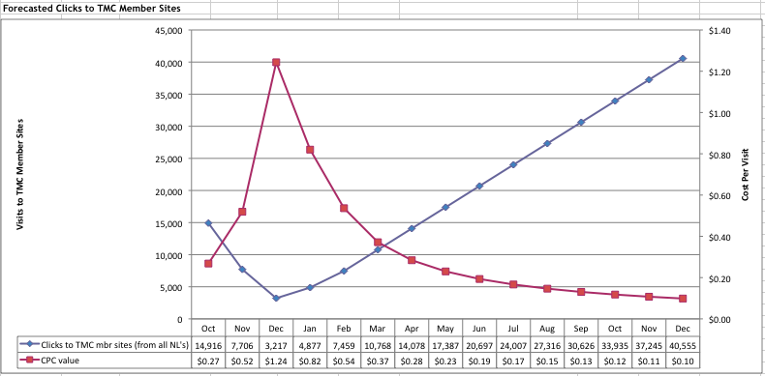
2009 Forecasted Member Clicks
Notes:
Looking to hit 40,000 clicks by Dec, with a CPC of about 10 cents. This is pretty good return on our monthly fee—clicks are usually valued at around 50 cents.

Slide 24
Agenda
Overview of Project
Current Activity / Initiatives
Success to Date
What’s Next?
Questions / Feedback

Slide 25
Goals for Next 6 Months
Ramp up traffic via multi-pronged approach
Continue to build partnerships with like-minded organizations
Develop and launch new wire
Facebook Connect
Ladder Up! Button
But wait! There’s more…
Notes:
Multi-pronged approach: blogs, widgets, exchange ads, google grants, radio, etc.
-New wires. Sustain is ours and one more is budgeted for launch. We’ve had suggestions of a media focused wire—just to brainstorm quickly, what are your thoughts? We’re looking for areas that MC members are planning great content that we can leverage. We’ve got a sheet on the wall-make sure to write your suggestions down!
-FaceBook Connect will add another layer of linking to your content and make joining the newsladder community easier. LOOKING TO LAUNCH WHEN. This tool will publish a notice to your facebook feed anytime you publish an item to the ladders or vote on content. Your FB friends will be able to click on that feed to access TMC member content. It’s another easy way to funnel links to your content to new audiences.
-The Ladder up button can be implemented to fit on your site with other social media buttons. It will allow readers to push your content out to the ladders and vote on it, increasing the playing power of this platform.

Slide 26
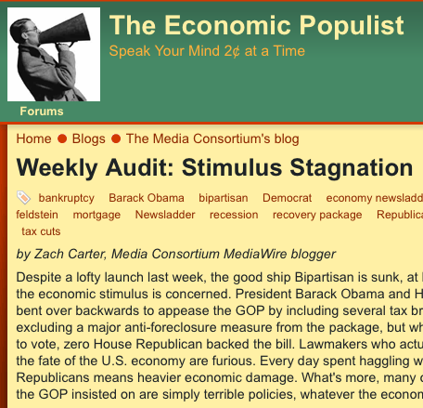
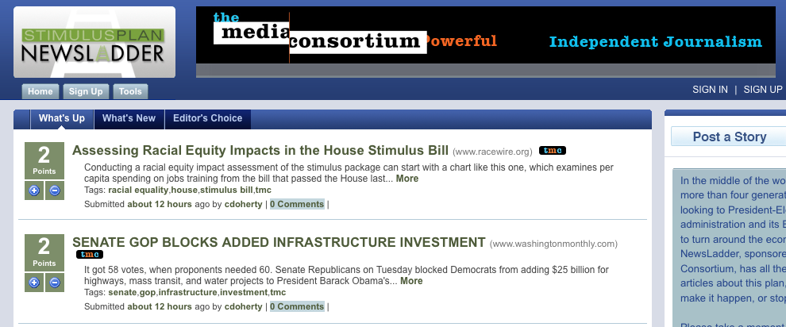
Flash Ladders
How do they work?
Leverage news to catch the height of public interest in topic.
Strong push of marketing activities, paid search, blogs expand reach of ladder
John McCain: 18,661 visits in October, ~77% went on to visit a TMC member site
StimulusPlan.NewsLadder.Net
Notes:
Flash newsladders are short term ladders that capitalize on a specific news item as it goes viral. NewsLadder has tested this platform before with Cabinet.NewsLadder.net and Zimbabwe.NewsLadder.Net
Our first ladder functioned in this manner. During it’s peak month, John McCain,newsladder.net brought in 18,661 visits, around 77% of which were redirected to you. These numbers do not include blog traffic.
We launched StimulusPlan.newsladder.net on Jan 5. It also functions as a subladder for Economy.newsladder.net. We’re currently ramping up on traffic efforts, and a strong blog outreach is in place as you can see by this screenshot from the economic populist—as the stimulus plan continues to make news, we’ll be generating traffic for your sites.

Slide 27

Video
REFORMAT AND INSERT NEZUA’s VIDEO HERE
Notes:
So, we also wanted to give you all a little taste of where else this project could go. Keep in mind this is just an idea….
PLAY VID
So, quickly, what did you all think? Any immediate comments or suggestions?
We’re looking for partners to help us produce and distribute. Will keep you all apprised of developments.

Slide 28






Exchange Ads
Promote Media Wires with your unused advertising inventory
  Multiple Ad sizes to choose from
Mention the Media Wire in your weekly or monthly emails
28
Notes:
Part of building out the impact of this project and this sector means that we have to work together. By re-posting using remnant ad space to serve ads for the wires, we are representing ourselves as a powerful network that shares information and expertise on key issues. Your support and participation in this project increases our collective clout and our overall value to new viewers.
All of the widgets and ads are available in IAB standard sizes, so they should fit very easily into your site’s architecture.
Mention in enewsletters—we would be more than happy to provide links and text for you to do this. Just ask.

Slide 29
Opting In
Facebook
Twitter
RSS
Blogs
Ads
Widgets
Help Promote
29
Notes:
So, just a reminder, these are all of the ways your organization can participate. Please feel free to talk to me during lunch tomorrow about how you can implement!
Facebook Become an Admin, promote/post your content, add the app
Twitter, Twitter feeds are available for every Media Wire. You can follow them or Re-Tweet when a blog post goes up.
RSS Feeds are available for every MediaWire. You can import them to your own site.
Host ads on your site to help promote
Widgets You can host a widget on your site
Help promote! We are looking to take this project to many other groups and would love your recommendations and contacts!

Slide 30
Any questions or feedback?
For more information, please contact:
Erin
erin@themediaconsortium.com
312.841.0553
Or go to: http://www.themediaconsortium.org/projects/mediawires

