Slide 1
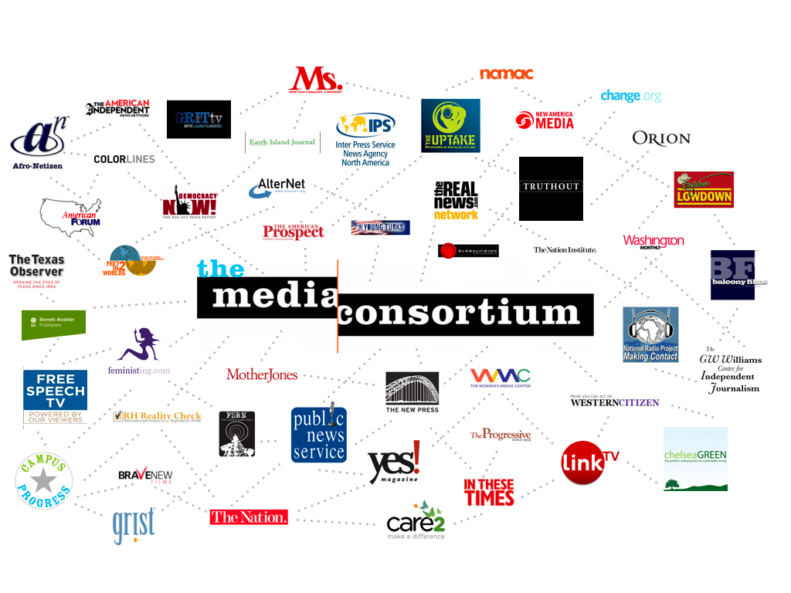

Slide 3
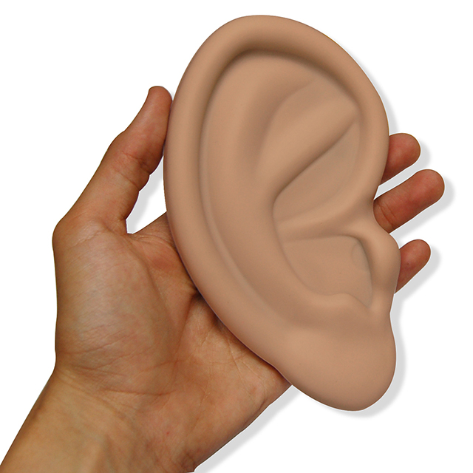
Impact Study
Stage 1: Listen to Conversations
Recruit Member Outlets
Stage 3: Create Collaborations
Measure Impact
Areas of Study
Abortion
Reproductive Health Immigration
ACA/Obamacare
Military Conflict
Fracking/Extreme Energy Education: School Choice
Education: Unions
Stage 2: Set a Baseline
#FF @AltWeeklies @QuixoteTilts
@rhrealitycheck @rhtporg @mmfa for supporting journalism collab http://www.whereisyourplanb.com #whereismyplanb

Slide 4
