Slide 1
H C O

Slide 2
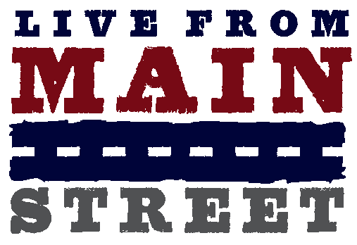

Slide 3
Live From Main Street’s goal is to develop new ways for independent media to collaboratively inform and support the democratic process while bringing truth and the voices of everyday Americans to the current national election conversation.
Your Streets. Your Stories.

Slide 4
A celebration of independent media- our strength, our sources, our impact. Five events in five months, in five key states between now and the election. Each event will spotlight an important national issue and dive into how that issue is impacting the local community and what everyday people and independent media are doing confront it.

Slide 5
Live From….
Getting Heard: What Stands Between the Public and a True Story? Minneapolis, June 8 at the close of the National Conference for Media Reform
Magic City, Hard Times: Miami Facing the Economic Crisis and Working Toward a Sustainable Future? Miami, July 12
New Territory, New Faces: The Democratic Party of 2008 Denver, late August during the DNC
Voting Rights, Voter Engagement Columbus, mid-September
Women on Real National Security, Seattle, mid-October

Slide 6
Live From Main Street is….
A 90 minute televised town hall event hosted by Laura Flanders and a local personality
An in-depth conversation and exploration about the issues that matter to real people this election season
Local organizations in partnership with independent media working to create a new framework to engage with key issues
Featuring…
Leaders
Activists
Independent media
Grassroots organizations

Slide 7
Live From Main Street Format
Tradeshow meets town hall.
Roll call of local participants.
Spotlight on the local.
Engaging hosts talking with…
Leaders, local activists and everyday people.
Sharing…
Information, inspiration, strategy for success.
A networking, promotional and newsmaker opportunity.

Slide 8
Media Consortium on Main Street
Report on how national issues are playing out in local communities
Cover the town halls events
Cover stories related to town hall events
Connect LFMS with your current initiatives
Collaborate with one another

Slide 9
Wow! What a great PR opportunity for my organization…
LFMS events will be an opportunity to connect with your current audience and extend your reach
•Invite subscribers to the event though pre-event outreach
•Work to build your audience by having a presence on location at the town halls and distributing copies of your publication
•Reach an even larger audience by making sure your name and work is highlighted in town hall content that gets distributed far and wide
•Sponsor LFMS events

Slide 10
A New Echo Chamber
Let’s turn this inside out…
Media Consortium members can distribute content from the town hall tour. Reporting in text, video and audio format created from these events will be available to all members to distribute through your individual platforms.
LiveFromMainStreet.org- content distribution hub
Already we are working closely with the National Radio Project, Link TV, Balcony Films, AlterNet, The Nation.
Let’s make all this coverage bubble-up to tell a different story that you won’t get in the mainstream media-
the main street story.
Remember LFMS Participation forms
The mainstream echo chamber:

