Slide 1
ADAPTIVE SEMANTICS
Sentiment analysis for UGC

Slide 2
Overview
Adaptive Semantics leverages research in computational linguistics and sentiment analysis, to develop applications that bring intelligence to user-generated content.
Our first product is JuLiA (Just a Linguistic Algorithm), an automated system for moderation, reporting, and community analytics.
Notes:
2/24/10
2

Slide 3
About Adaptive Semantics
Adaptive Semantics: Past and present
May 2009: The Huffington Post makes a small investment in Adaptive Semantics and puts JuLiA into production
June-August 2009: Product development yields improved accuracy and additional features
October-December 2009: CNN.com, Post-Newsweek local sites added as clients through third-party commenting system, Disqus
January 2010: Upcoming service contracts with several top tier publishers

Slide 4
UGC and Community
User Generated Content (UGC) is becoming as important as editorial content
Promises
Increases traffic and engagement
Provides an immediate opinion barometer for your content
Encourages word-of-mouth and sharing behavior
Attracts advertisers
Pitfalls
Determines your image as a publication (for good or ill)
Presents a significant management problem
Attracts trolls

Slide 5
Introducing JuLiA
JuLiA (Just a Linguistic Algorithm) is an automated community moderation and management system for publishers. The system is a solution for a number of common community moderation challenges such as:
Managing trolling behavior in the comments section
Eliminating backlogged and pending comments
Profiling and grouping members by their opinions and expertise
Discovering worthwhile contributions such as positive reviews or heated and intelligent debates
Tracking criticisms of the publication within the flow of member conversations
Flagging violent threats towards public figures or other members for analysis
Notes:
2/24/10
5

Slide 6
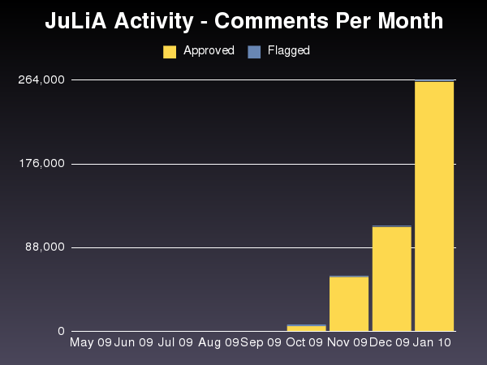
JuLiA’s Impact for Publishers
Combined with third-party commenting systems driving traffic:
17 million comments moderated in total since May 2009
Impact for first major client:
Comment traffic grew by 87% over nine months
Moderation costs reduced by 28%
Represents annualized savings of over $125,000
850,000 abusive comments discovered and removed
Expected 2010 Impact:
44% reduction in moderation costs as percent of comments by year-end
Represents annualized savings of over $500,000

Slide 7
Cultivating Your Community
Quarantine your trolls, not your community
Be as specific as possible with your guidelines
Drive traffic and engagement with a flexible commenting system
Integrate social media
Maximize the productivity of your human moderators by using smart tools
Implement rewards / reputation system

