Slide 1
Change.org
Media Advocacy

Slide 2
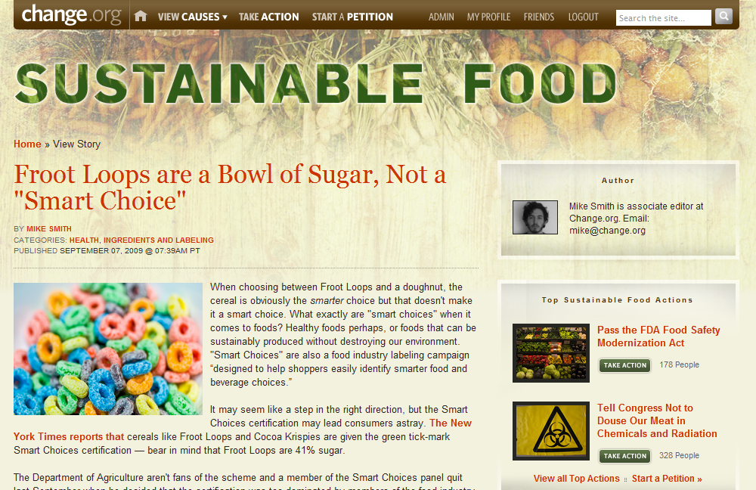

Slide 3
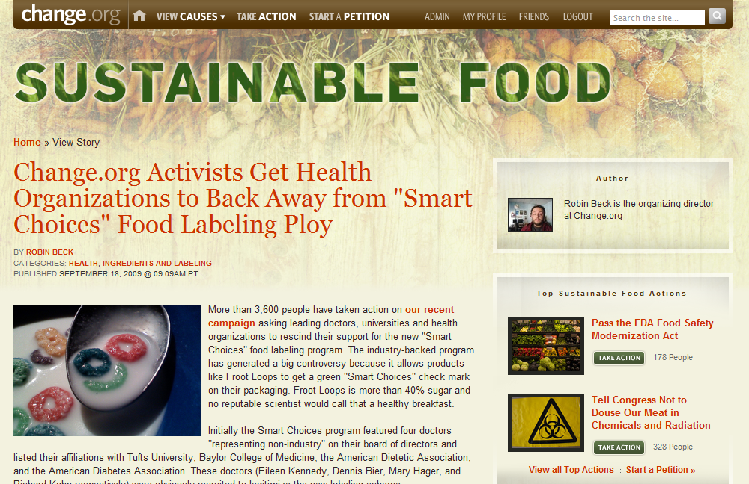

Slide 4
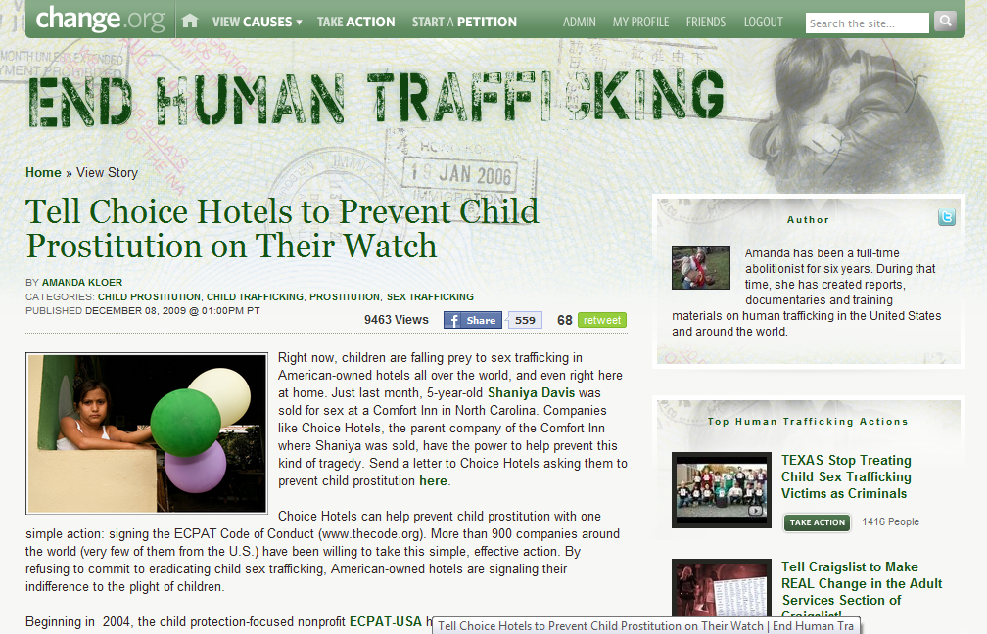

Slide 5
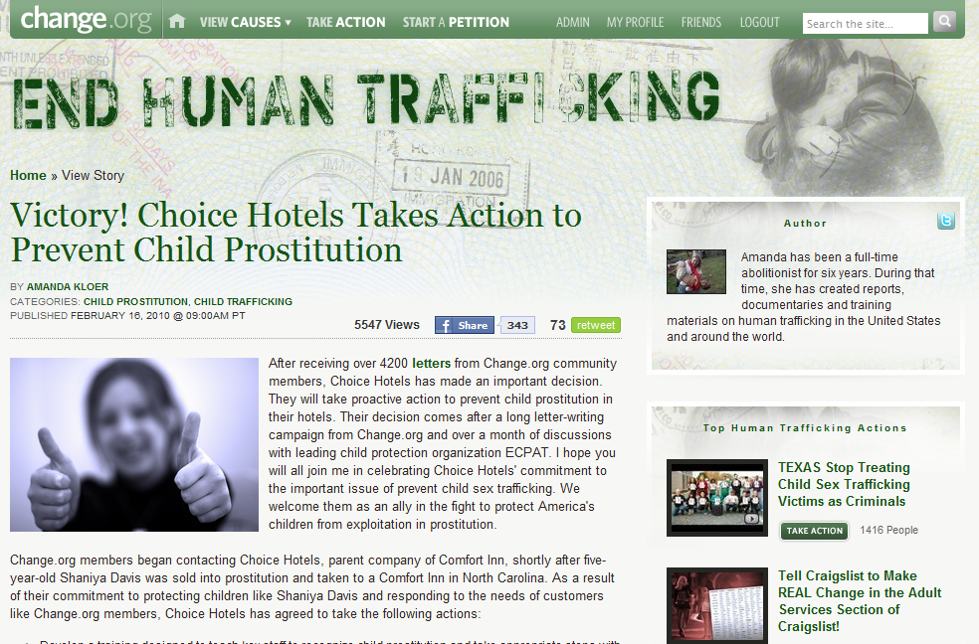

Slide 6
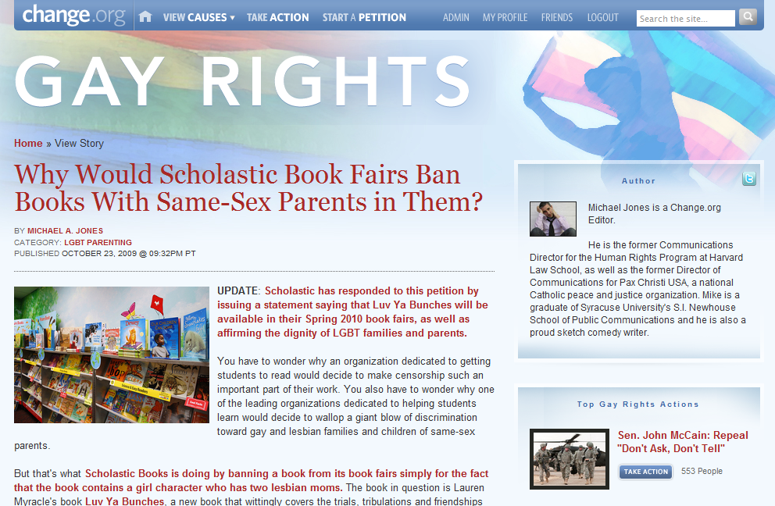

Slide 7
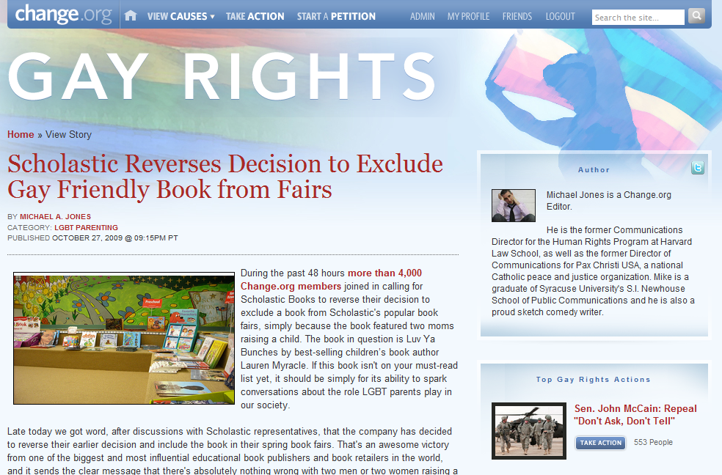

Slide 8
Kim Crump says:
As a social justice, peace, pride, labor, and feminist activist, this list has made my year.
Gay Edelman says:
This fills my heart more deeply than I can say.
Ronna Sommers says:
Thank you for giving me another reason to awaken every morning-
Ashleigh Jackson says:
I get tingles reading this. Let’s kick ass this new year and make the world a more positive and humane place to live.
Lori O'Donnell says:
I have no idea how I got this email, but I’m grateful I did!! You guys are doing AWESOME work. How do I get involved? I want to help!!

Slide 9
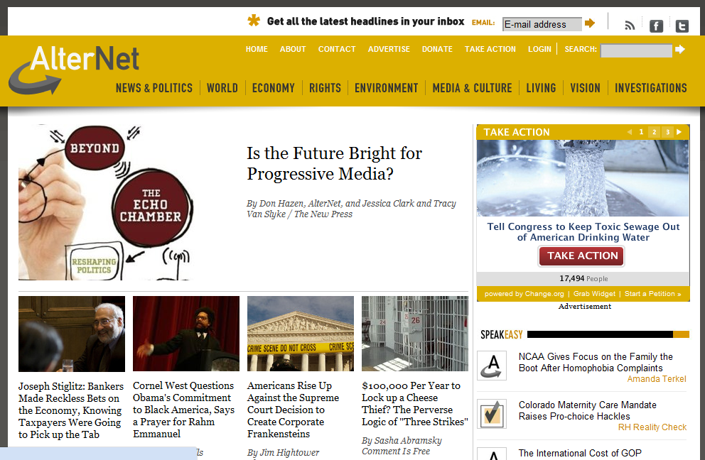

Slide 10
