Slide 1
Colorlines.com
2012 Impact Report
Presenter | Tiffany Bradley
Online Marketing Associate, Applied Research Center
@tiffanymarket
Media Consortium Annual Meeting
February 7, 2013

Slide 2
About arc/colorlines.com
Applied Research Center (ARC) is a 30-year-old, national organization committed to racial justice. ARC’s mission is to build awareness, solutions and leadership for racial justice by generating transformative ideas, information and experiences.
Colorlines.com is an award-winning, daily news site where race matters, reporting breaking news, offering insightful analysis and developing in-depth investigations.

Slide 3
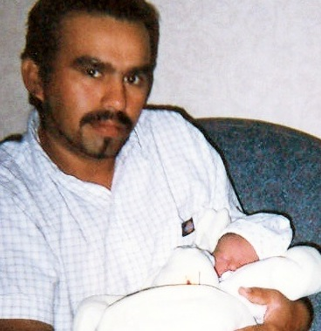
Shattered Families
Broke the story of Felipe Montes, a deported father who lost his children to foster care.
Humanized immigration policy concerns outlined in ARC’s research report “Shattered Families.”
Colorlines partnered with Presente.org on a petition calling for the reunification of Felipe and his children. Over 20K readers signed the petition.

Slide 4
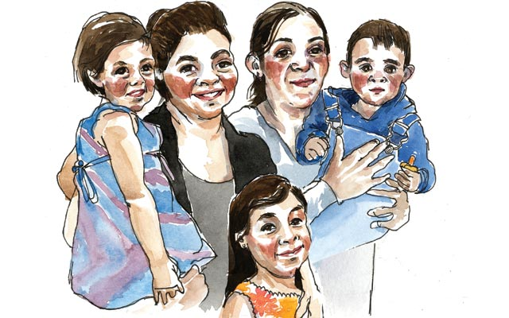
Shattered Families
Other press outlets covered the story, including the AP, LA Times, and NPR.
ICE granted Montes a rare humanitarian parole so that he could return to the US and attend court hearings.
In the end, a judge made the momentous decision to reunify Felipe and his sons.

Slide 5

Drop the i-word
DTIW campaign outlines the reasons that people should not be described as “illegal.”
Campaign encourages journalists to drop the coded language of “illegal immigrant.”
ARC held targeted discussions with journalists and media outlets encouraging them to update their stylebooks.

Slide 6
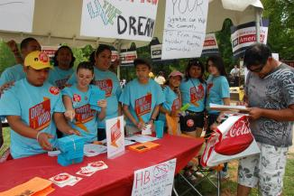
Drop the i-word
The Miami Herald, The San Antonio Express-News, Fox News Latino, ABC News and The Huffington Post have dropped the i-word.
The 7,800-member Society of Professional Journalists (SPJ) passed a resolution in 2011 to discontinue use of the term "illegal alien."
The DTIW campaign has also been endorsed by the national UNITY alliance of over 10,000 members.

Slide 7
ARC/Colorlines coverage
Reframes the discussion on immigration to centralize those impacted.
Highlights that inhumane language and policies affect actual people.

Slide 8
For more information
Contact Kai Wright
Email: kwright@arc.org
Twitter: @Kai_Wright
Web: colorlines.com | arc.org

