Slide 1
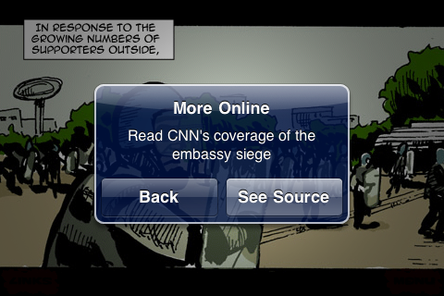
Comics journalism
Dan Archer
www.archcomix.com

Slide 2
What it isn’t…

Slide 3
And What it is…

Slide 4
Why comics?

Slide 6
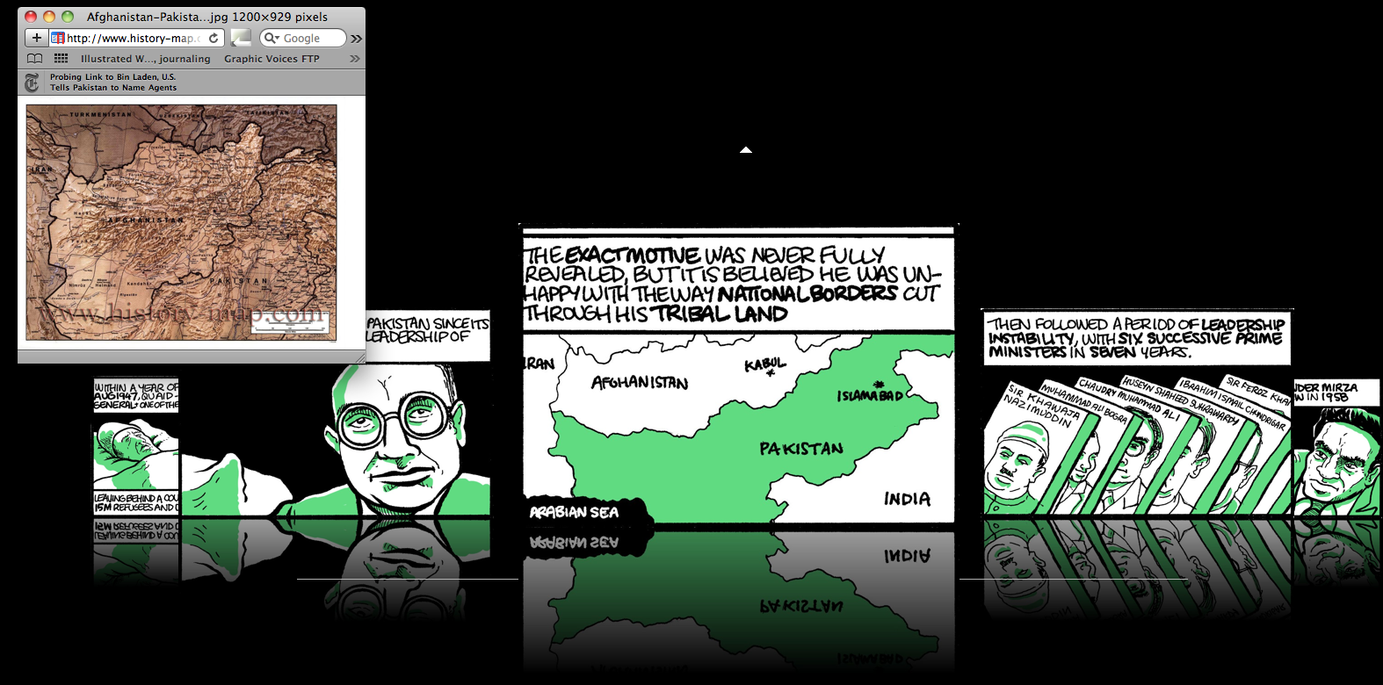
Why now?

Slide 9
archer@stanford.edu
www.archcomix.com
www.newspanels.com

