Slide 1
News in Our Digital Lives
Amy Mitchell Acting Director
Pew research center, PEJ
www.journalism.org
amitchell@pewresearch.org

Slide 2
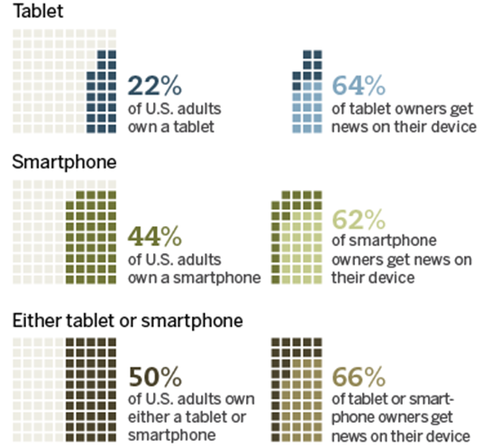
The Growing Mobile Landscape

Slide 3
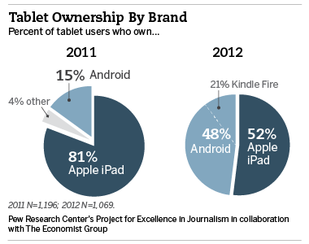
Tablet Market Opens to New Players

Slide 4
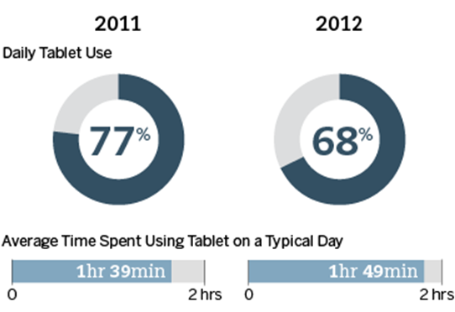
Daily Use of Tablet Remains High

Slide 5
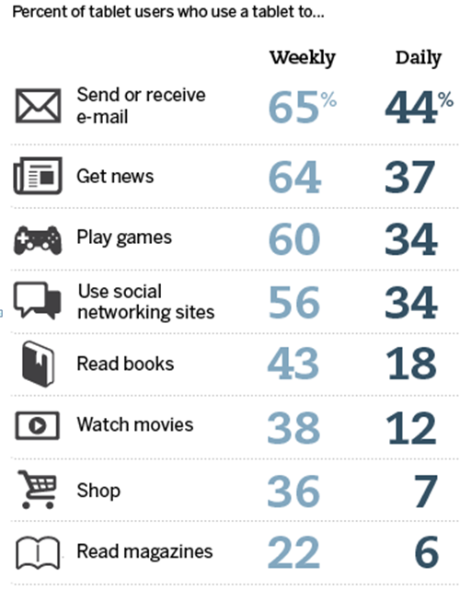
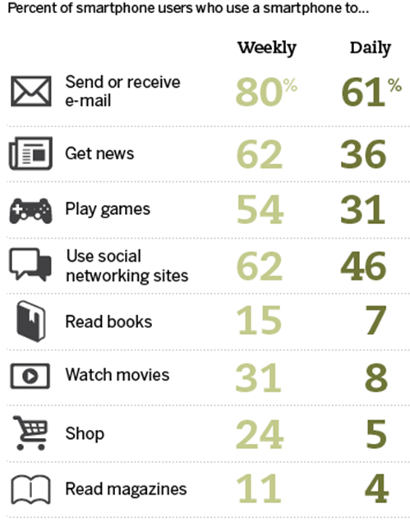
News Remains a Top Activity on Mobile Devices

Slide 6
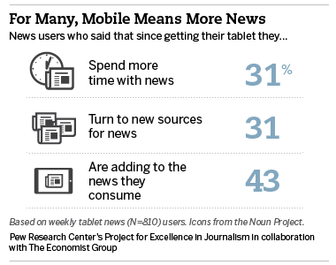
The Broader Population Continues to Add News Time

Slide 7
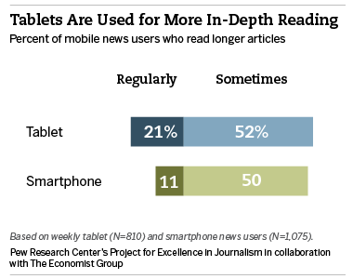
Tablets Used More for Long-form Reading

Slide 8
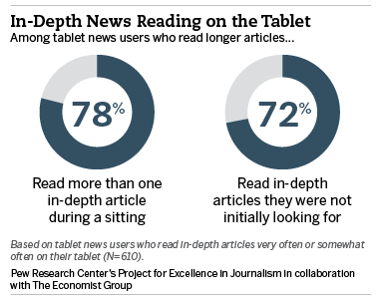
Incidental Reading Revived on Tablets

Slide 9
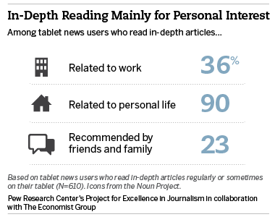
Personal Interest Ranks High

Slide 10
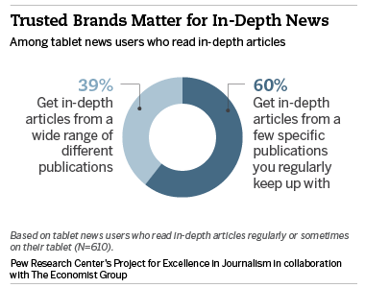
Brands Are Important
Notes:
Note in Talk: and tends to be at home & at somewhat traditional news times – (Graphics 7, 9, 10—might make a slide of a few numbers there)

Slide 11
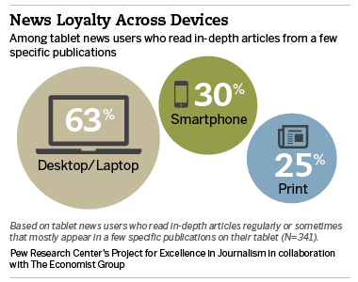
And Often Followed on Multiple Platforms
Notes:
Note in Talk: and tends to be at home & at somewhat traditional news times – (Graphics 7, 9, 10—might make a slide of a few numbers there)

Slide 12
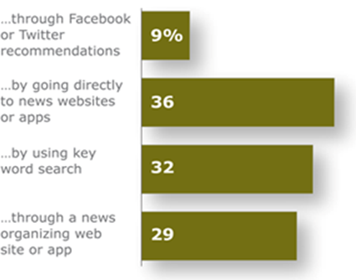
The Influence of Social Networks
Social Media is Not an Overwhelming Driver of News (Yet)
Percent of U.S. Adults who Get News on any Digital Device Very Often …

Slide 13
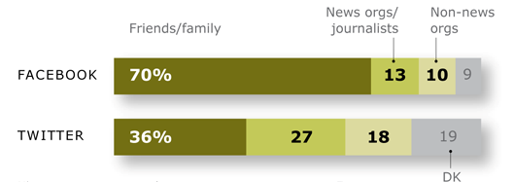
Twitter & Facebook Use Differs
Where Social Media Links Come From
Percent who get most of their news links from …
Notes:
35% of U.S. adults own a smart phone

Slide 14
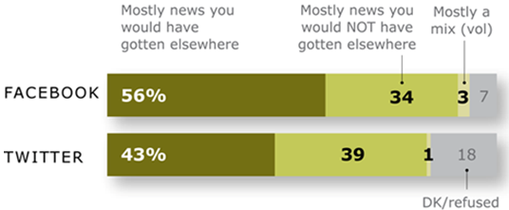
Twitter & Facebook Use Differs
Twitter News is Viewed as More Unique
Percent who say the news they get on each platform is …
Notes:
35% of U.S. adults own a smart phone

Slide 15
YouTube and News
Creation is a Shared Process
Produced by both news organizations and citizens
Posted by citizens and news organizations
A mix of raw footage and edited video
A variety of lengths

Slide 16
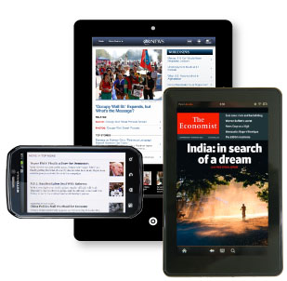
Mobile News Users Who Carry Special Appeal
Notes:
Note in Talk: and tends to be at home & at somewhat traditional news times – (Graphics 7, 9, 10—might make a slide of a few numbers there)

Slide 17
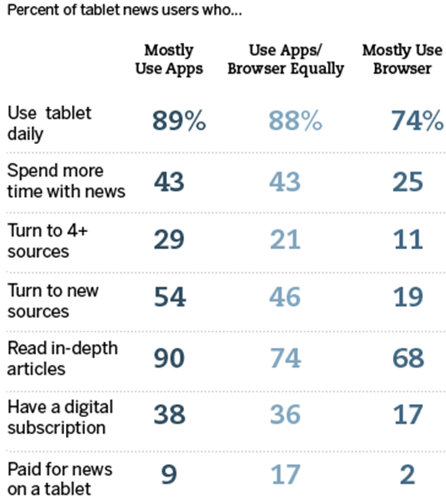
App Users Stand Out
Notes:
Note in Talk: and tends to be at home & at somewhat traditional news times – (Graphics 7, 9, 10—might make a slide of a few numbers there)

Slide 18
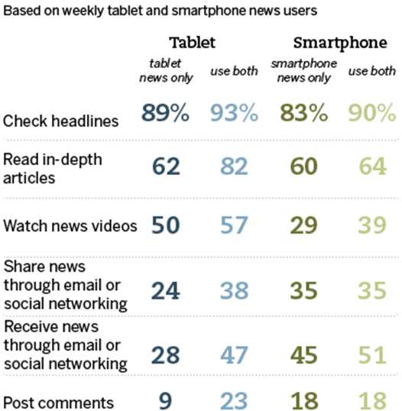
As Do Dual Device Users

Slide 19
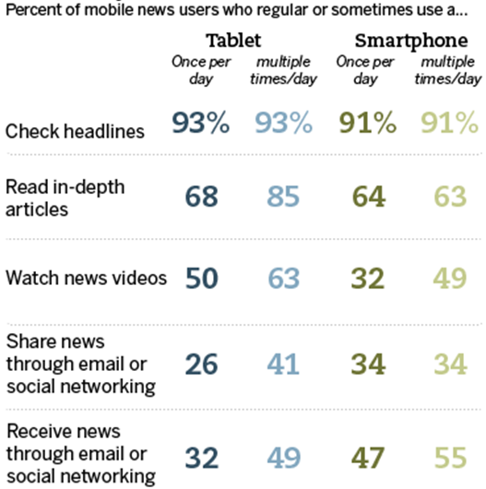
And Those Who Get News Multiple Times a Day

Slide 20
What This Means
New opportunities:
IF……
News organizations, other content providers & advertisers do a better job of understanding and creatively reaching digital mobile news users.

Slide 21
News in Our Digital Lives
Amy Mitchell Acting Director
Pew research center, PEJ
www.journalism.org
amitchell@pewresearch.org

