Slide 1
Community Media = Community News
Jo Ellen Green Kaiser
@jgksf

Slide 2
“By 2016 we will have one-half the number of journalists working as we did 16 years ago” –Ken Doctor, Nieman Lab
Image: NiemanLabs
Notes:
American Society of News Editors 2015 News Census: http://asne.org/content.asp?admin=Y&contentid=121
Ken Doctor, Newseconomics: http://www.niemanlab.org/2015/07/newsonomics-the-halving-of-americas-daily-newsrooms/
http://newspaperdeathwatch.com/

Slide 3
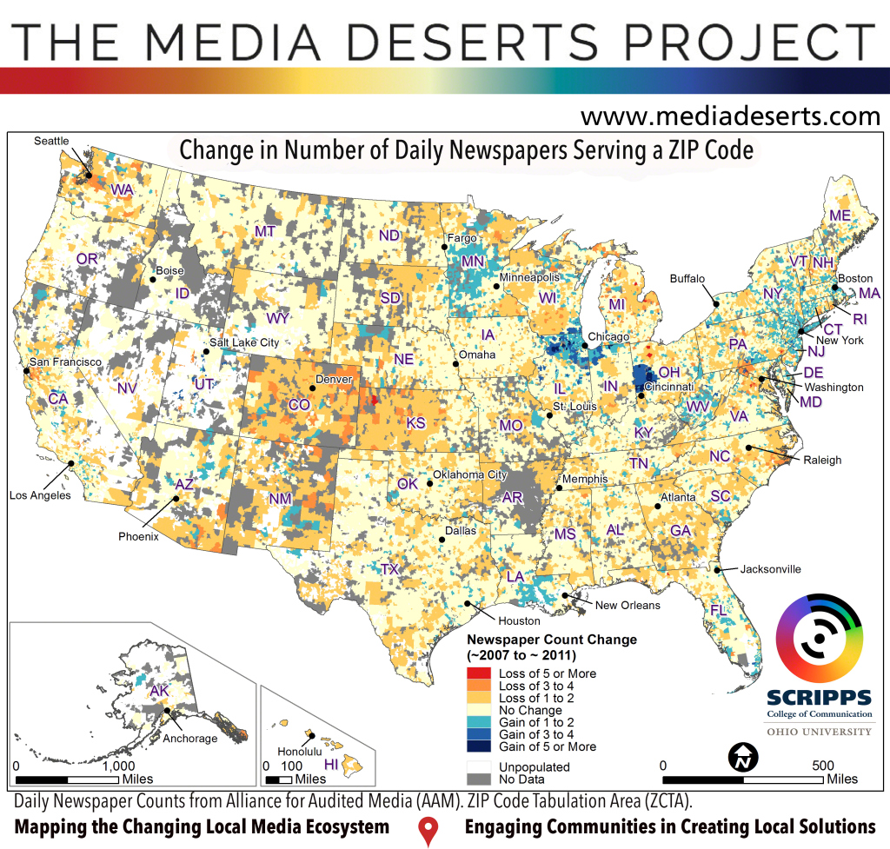
Notes:
Dr. Michelle Ferrier: https://mediadeserts.wordpress.com/about/
http://www.cjr.org/analysis/new_jersey_media_desert.php
http://www.businessnewsdaily.com/2848-american-information-needs-unmet.html

Slide 4
Ferguson Video Christopher Gagne
Notes:
28:30-28:45
Argus August 10, 2014, Christopher Gagne
Christopher Gagne was a music executive who, after shooting Ferguson video, became news desk head at Argus, a relatively young company providing online services for St. Louis newspapers.

Slide 5
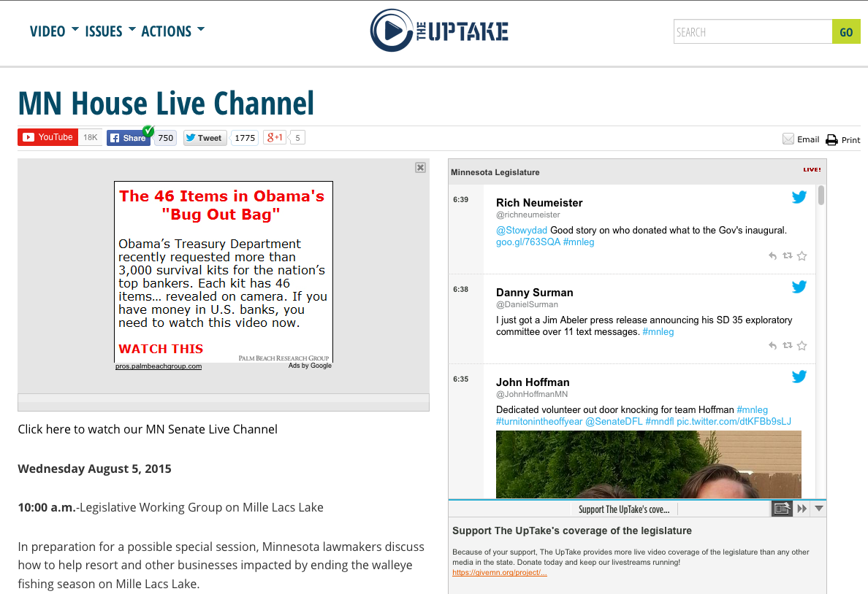
Notes:
Government Access: Online. This is not a PEG—it’s funded by individual donors and foundations! Imagine what a government access channel could do online!

Slide 6
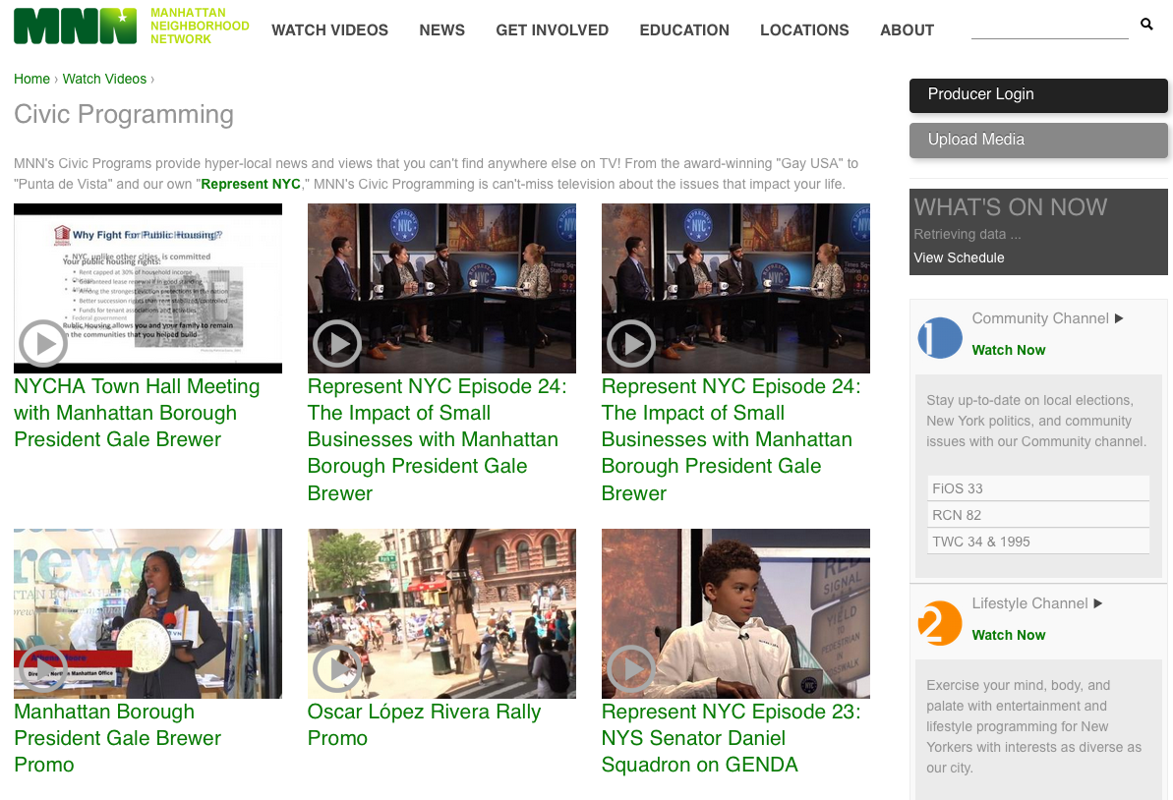
Notes:
Here is one of your own, the Manhattan Neighborhood Network. This public access channel offers training in mobile storytelling and has created digital civic programming that includes rallies and other news footage.

Slide 7
We Need You
Provide training
Provide a digital platform
Share content
Diversify the news
Notes:
Provide training for community journalists
Provide a digital platform for community journalism
Share content with community radio and hyperlocal websites
With voices of your community

Slide 8
