Slide 1
The Power of the Independent Media Sector
Yana Kunichoff
Miles Kampf-Lassin
Jo Ellen Green Kaiser

Slide 3
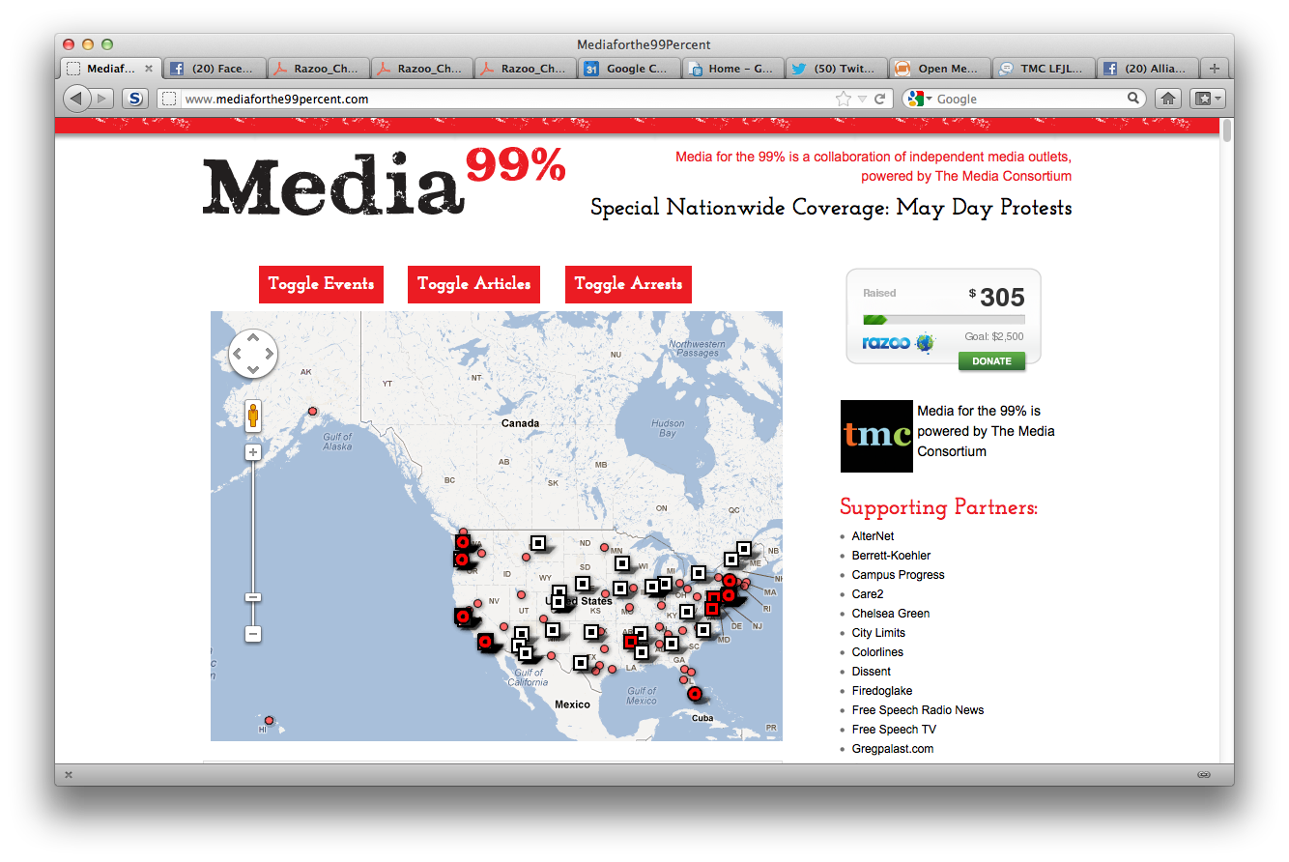

Slide 4
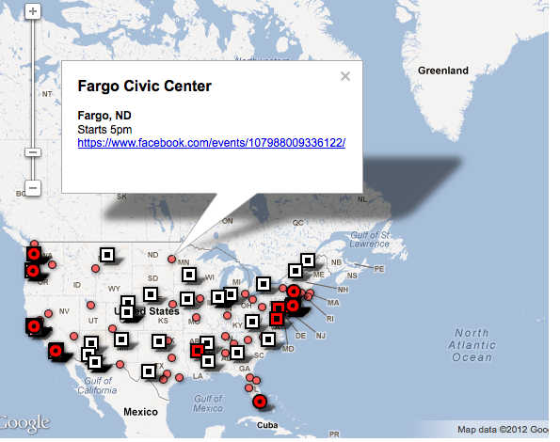

Slide 6
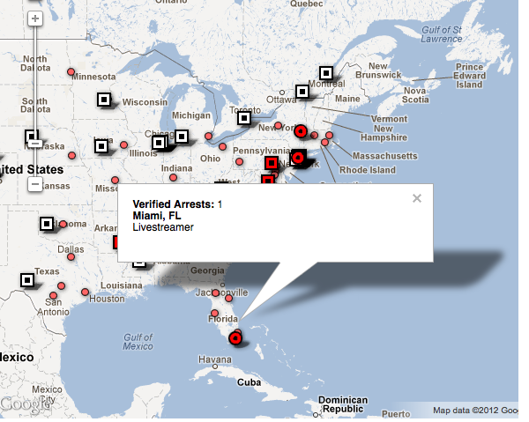

Slide 8
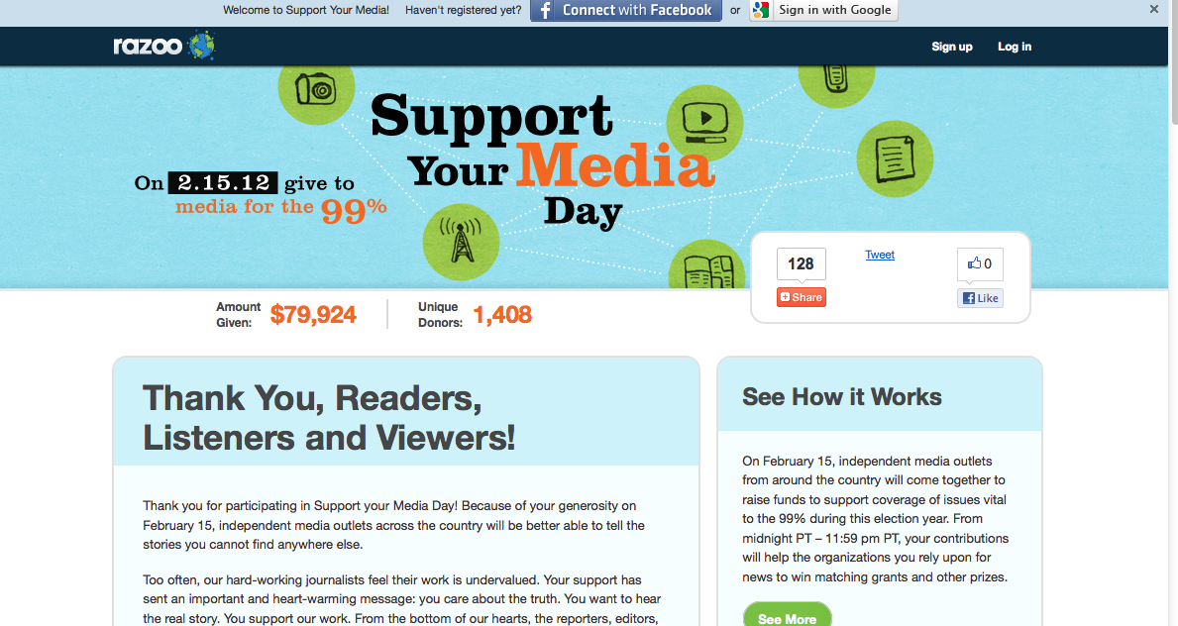

Slide 9
Benefits and costs of collaboration?
-Benefit: Collaboration represents real journalists (classic), real news rather than just citizen journalists
Citizen journalists can learn from them and stories can get amplified
-Barriers: Workload, establishing connections, restrictions on equipment
-Benefit: Local students get excited about working with larger outlets, sourcing/sharing content, extending concept of cable news model of arrangement with cable companies to this collaboration—create entire new model of funding
-Benefit: Collaboration has worked between Uptake and TMC before, Uptake partners with local and regional newspapers to feed content, especially video. Start by giving it away for free and move on to charging
-Brooklyn stories do not get covered as much because of level of news stories coming out of 5 boroughs
Potential for connecting public television with independent radio like Pacifica, possibility for accelerating

