Slide 1
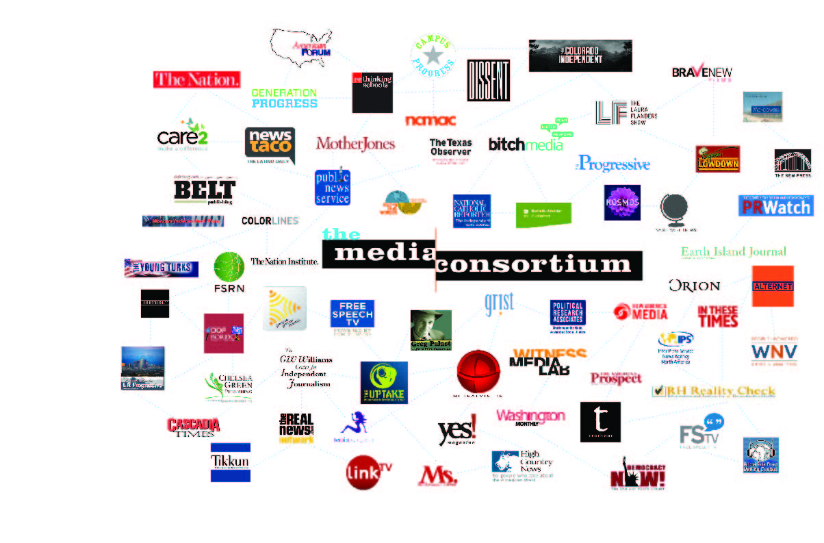
The Media Consortium
Notes:
My name is Jo Ellen Green Kaiser. I’m the Executive Director of the Media Consortium. We’re a national network of 80 independent progressive news outlets. Our mission is to support and grow the impact of the independent news sector.

Slide 2
Every story produces an effect put gif here
Notes:
What do we mean by impact? A news story may bore or delight us, confuse, inform, or educate us. In the world of progressive news, we want to do more than inform and delight: we want our stories to make a difference. By educating the public about social injustice and racial inequity, by investigating dark money and government surveillance, by providing solutions to global warming and childhood education, we hope to influence the public conversation.

Slide 3
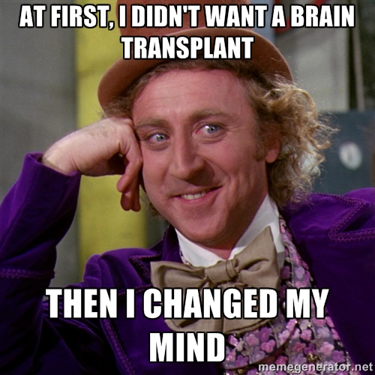
Notes:
We are all familiar with stories that had a large and visible impact. Mother Jones toppled the Mitt Romney campaign by publishing his private 47% speech. The Chicago Reporter’s investigations on police violence are changing attitudes and rules about police violence in Chicago.
Those changes, what Lindsay Green Barber calls ‘Macro” events, can be easily measured. But her rubric includes two other types of stories, those that shift public debate and stories that change an individual’s beliefs? How do we measure how we change minds?

Slide 4
Typical “Impact” Measures
Reach—number of users
Views—number of page views (text)
Time spent--reading/ listening/ watching
Clicks—on ads but also content links
Social Media Shares
Notes:
An entire field—metrics--has sprung up to measure how news media affects audiences. Yet, as you can see from this list, most of these metrics were originally built for advertisers to measure impressions. They provide measures of quantity, but not of quality. Online we can now find out which people are consuming our content, how long they spend with us and how many they are; but these measurements don’t tell us how the content affects the end-user. The only really new approaches to impact seemed to be coming from academia, so we turned that way.

Slide 5





Notes:
We also chose to run a scientific experiment because we thought it would be more persuasive. Almost all of our members have a strong point of view which, as you can see from the feministing logo, they are not unwilling to express. In the past, we’ve had trouble convincing even our allies that our outlets influence public conversations. To prove these progressive outlets have real impact, we felt it necessary for the proof to come from outside the outlets themselves. That’s why we turned to an academic, Prof. Gary King.

Slide 6
Every story produces an [a]ffect
Notes:
Return to this video: https://www.youtube.com/watch?v=l2g4h-ia_8w: What we really want to know is whether our story influences how someone thinks. If Sue thinks that climate change is “natural” we want to use fact-based information to change that belief. If Bob believes people choose to be trans, we want to educate him about the lived experience of a transgendered person. To measure affect, we turned to sentiment analysis, a method for tracking the public’s attitude towards a particular topic.

Slide 7
sen·ti·ment a·nal·y·sis
noun: sentiment analysis
the process of computationally identifying and categorizing opinions expressed in a piece of text, especially in order to determine whether the writer's attitude towards a particular topic, product, etc., is positive, negative, or neutral.
Notes:
We partnered with Prof. Gary King, who has advanced beyond sentiment analysis. His research team can choose any set of categories and accurately estimate the percent of social media posts within each category. The set of categories can be about sentiment, topic, people, or anything else.

Slide 8
35 Experiments
Topic Areas:
Reproductive health (5)
Education (4) Immigration (6)
Racial Justice (7)
Economic Inequality (6)
Climate Justice (7)
Notes:
The experimental areas where chosen largely to reflect what outlets were already doing. The twist was that outlets had to agree to co-publish their content on a date chosen by the research group. That was not an easy ask to make. We actually set up 42 experiments, but in 7 cases the outlets could not keep to the reseearchers’ protocol.

Slide 9

400 MILLION Tweets/day
Notes:
For our experiment, Prof. King measured whether sentiment on Twitter about a particular topic changed after a set of stories ran. We used Twitter as our social media base in part in part because Twitter users are fairly similar to consumers of progressive news media, but also because Prof. King had access to the entire Twitter firehose of 400 million tweets/day. For each experimental instance, Prof. King would measure sentiment on Twitter about immigrants before we ran a set of stories, published on a random date picked by researchers, and then after we ran a set of stories.

Slide 10

Notes:
As we went about setting up this project, we worried that the ripples from our outlets would be present, but too small to measure. But, using the theory of collective impact, we theorized that multiple small outlets publishing simultaneously would create an effect greater than the sum of their parts. So we set up our experiment to measure the change in sentiment when multiple small outlets worked collectively to co-publish one or more stories.

Slide 11
36 Outlets Involved
Alternet, American Prospect, Berrett-Koehler, Bitch, Cascadia Times, Care2, Chicago Reporter, City Limits, Colorado Independent, Colorlines, Defending Dissent, Dissent, Earth Island Journal, feministing, Feetin2worlds, FSRN, Generation Progress, Grist, High Country News, In These Times, LA Progressive, Making Contact, Ms. Magazine, The Nation, National Catholic Reporter, New America Media, PeoplePowerMedia, The Progressive, PR Watch, Public News Service, Reimagine, Rethinking Schools, Rewire, Tikkun, Truthout, Yes! magazine
Notes:
We are proud that 36 of our outlets participated. Kudos are due to our Director of Special Projects Manolia Charlotin who was able to convince these outlets to work together. So what did we find?

Slide 13
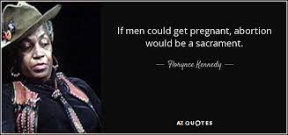
Notes:
But that chart is not easy to translate into real life, so let’s look at an example. A few years back, the Christian right decided to use the Black Lives Matter movement to attack abortion. In The Blaze, Matt Walsh argued that the war against black people is real but is not happening out on the streets, but in abortion clinics. While police killings of black men were justified, he claimed, black folks should look instead at all the potential black lives being aborted. This meme was taken up by sites like blackdignity.com, protectingblacklife.org etc.

Slide 14
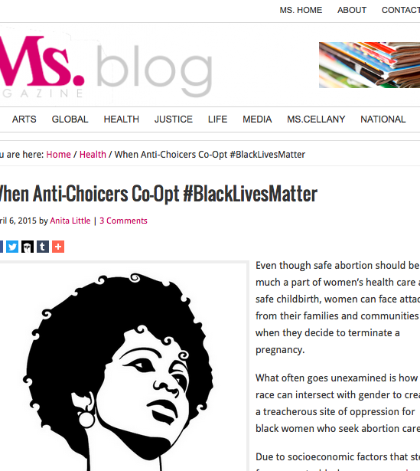
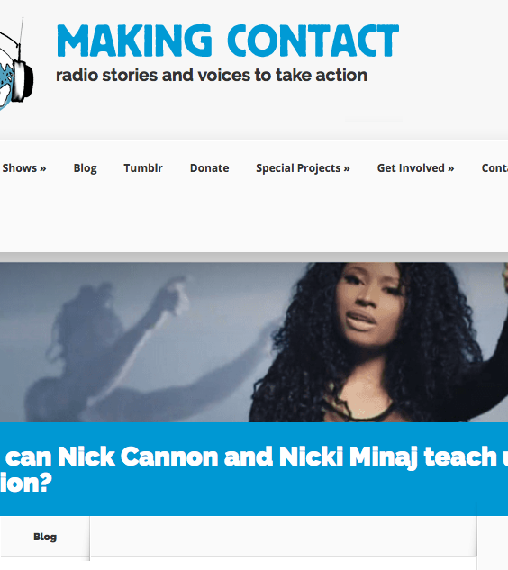
Two Davids vs. a Goliath
Notes:
Could two relatively small outlets make a difference? Could they change sentiment around abortion especially in the context of black lives? The answer was yes! On April 6, Ms. Magazine published a digital story by Anita Little titled “When Anti-Choicers Coopt #Black Lives Matter.” The same day, Making Contact Radio Project’s Jaszmin Lopez published a radio story on black singer Nicki Minaj’s song “Autobiography"

Slide 15
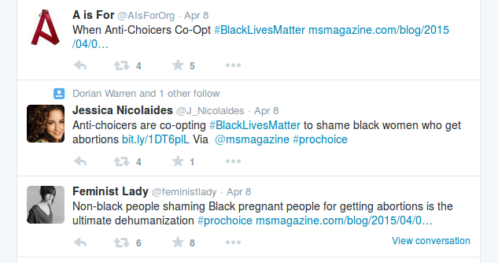
Notes:
Here are some of the tweets researchers found—these reference the Ms. magazine story directly. However the researcher’s system would have piced up the “Feminist Lady” tweet even if she hadn’t used the hashtag we were pushing or linked to the Ms. story. Juts having “black people” and “abortions” in her tweet would have been enough.

Slide 16
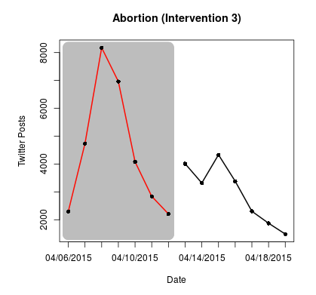
Notes:
The effect of these two stories was remarkable. The number of twitter posts that contained positive opinions on abortion almost doubled that week. People were influenced by what they read and heard.

Slide 17
Our Experiment
=>
Proves that small outlets have a measurable influence on conversations
Notes:
Making Contact and Ms. Magazine both do great reporting and have very engaged audiences. By quantitative measures they are not that big. But clearly when they co-published content, these outlets had a measurable influence on conversations.

Slide 18
Now What? Let’s Keep Going!
Scientifically-validated research method with baseline results
Research team able and willing to continue project
36 outlets trained to use the experimental protocol (plus more interested in it)
TMC Staffer Manolia Charlotin experienced in bringing fractious outlets to the experiment
Notes:
We have built the infrastructure to test a whole range of assumptions about how progressive news creates influence. The hard work of setting up the research is behind us. From now on, we can quickly test any number of questions we might have. So let’s do it!

Slide 19
Questions we’d like to test:
Our theory of collective impact.
What is the relationship between influence and conventional metrics like audience size?
Do smaller outlets working together have as much influence as one bigger outlet?
Which is more effective: collaborative storytelling (journalists working together) or collective storytelling (journalists working apart but publishing together)?

Slide 20
Questions we’d like to ask:
Can we expand the influence we have by changing how we distribute stories?
Video, radio, digital, mobile—does the platform make a difference?
Can we better increase influence if we publish many stories over a long period of time or a burst of stories in a short period of time?

Slide 21
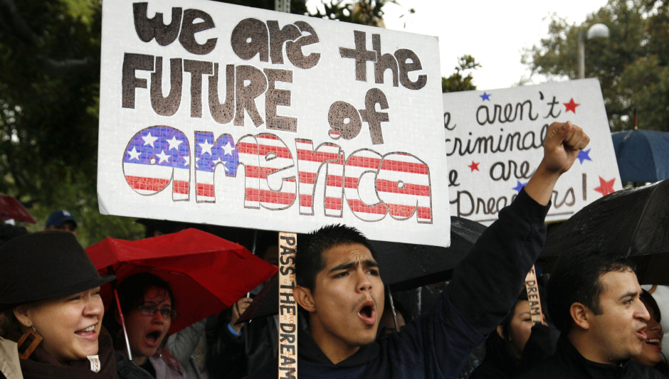
A sample project
Notes:
We propose a project on immigrant citizen and voter suppression: how immigrants are prevented from naturalizing, prevented from obtaining citizenship, and then face roadblocks to voting. Our goal is to fight back against the nativism and xenophobia of the current electoral cycle—we want to influence the public conversation about immigration. This project poses a great opportunity for our research:

Slide 22
Researchers have already done baseline research on immigration as a topic
TMC already has developed a core of outlets that have worked together on immigration stories and can follow the research protocol
TMC outlets asked TMC staff to put together a project on immigration—we already have buy-in from member outlets so it will be easy to bring more outlets into our program
Several foundations have expressed interest in supporting this project if we can find them a funding partner.

Slide 23
Thank you

Slide 24
Notes:
End of presentation.

Slide 25
Q & A: Timeline
  Development of project; funding; recruitment of researchers and experimental subjects
  Development of project: planning the experiment; communicating w/ test subjects
  Testing the experimental protocols; communicating with test subjects
  Running the experiment (April 1, 2015 – April 1, 2016)
  Communicating about experiment; starting next phase of project.

Slide 26
Q & A: Similar Projects
Harmony Institute
  Measure social change via social media sentiment, polling, press coverage of key terms, and political discourse via the Congressional Record
  Objects measured: documentary films
Participant Index
  Measure social change via social media keyword volume changes, audience opinion data (survey), and viewership information
  Objects measured: video and film
Media Impact Project
  Combines data from social, email, web, membership and event activity to create before/after measurements for individual stories, for stories from the same outlet, and between stories from different outlets
  Objects measured: news stories on all platforms

Slide 27
Q & A: Our Assumptions
“Impact” is used here to mean how much a particular news story influences an individual’s thoughts and actions
Sentiment analysis is the best way to measure influence
The twitter audience offers an accurate representation of digital news audiences
Smaller outlets have the most influence when the work together (the theory of collective impact)

