Slide 1
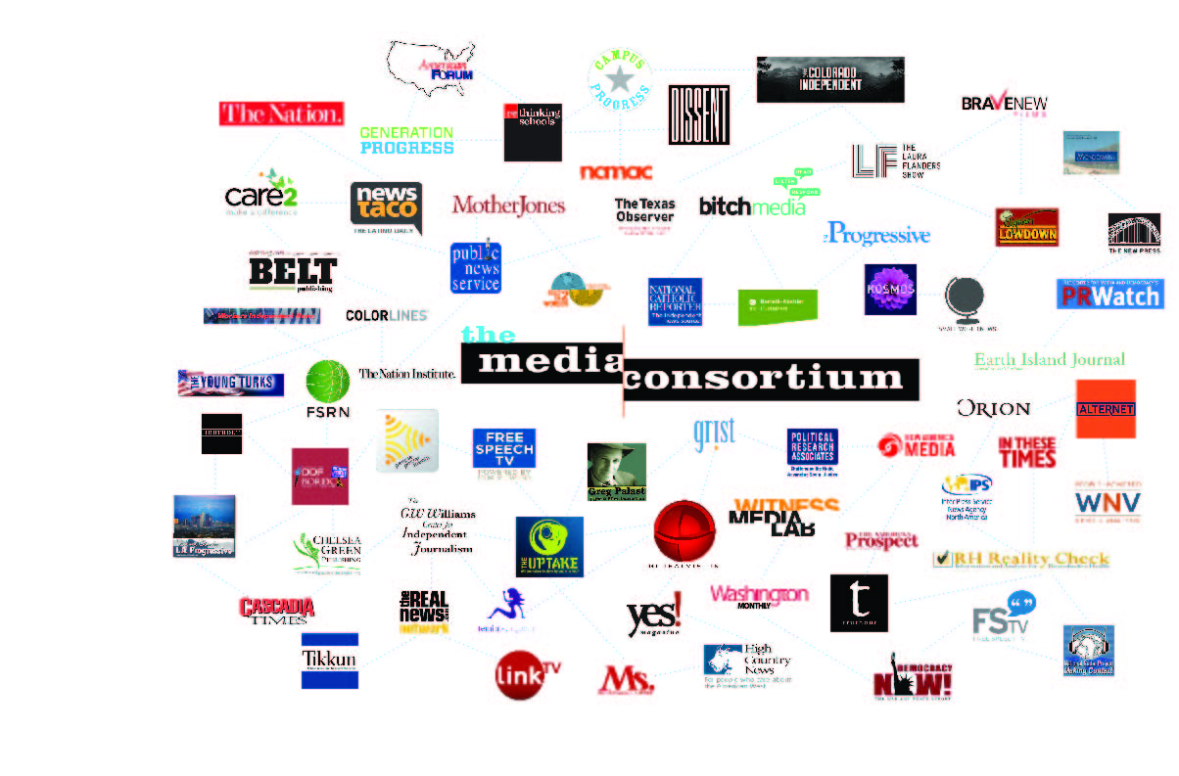
The Media Consortium
Notes:
My name is Jo Ellen Green Kaiser. I’m the Executive Director of the Media Consortium. We’re a national network of 80 independent progressive news outlets. Our mission is to support and grow the impact of the independent news sector.

Slide 2

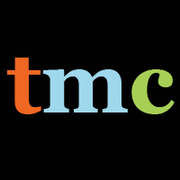
Impact
Notes:
We idealize and hope for--a massive splash that will change everything all at once (like spotlight, or mother jones' 47% video).
But it is impossible to plan for and create those kind of splashes. They are a combination of great journalism, great pr, and a lot of luck.

Slide 3

Every story produces an effect
Notes:
And while those big events make sudden changes, the progressive movement is focused on long-term change. Think about our biggest issues--climate change; economic justice; racial justice; gender justice. These issues have particular instances, like the keystone pipeline or the $15 minimum wage or keeping abortion clinics open, and all of those are important. But what we really need to do is create long-term culture change so that we don't have to have these particular fights anymore.
The right has been very good at this kind of slow long-term culture change. Look at their anti-government efforts. They started out by influencing individuals to believe that the government is corrupt; now, they've become so successful that the electorate is kicking out their establishment candidates in favor of Trump, who really comes from outside of the government.

Slide 4

Every story produces an [a]ffect
Notes:
These kind of culture shifts happen slowly and almost invisibly. To make change, however, we need to make these little ripples visible. We need to understand the ways that progressives--and progressive media in particular--do influence individuals and cultural thinking in order to increase that influence and bring change faster.

Slide 5
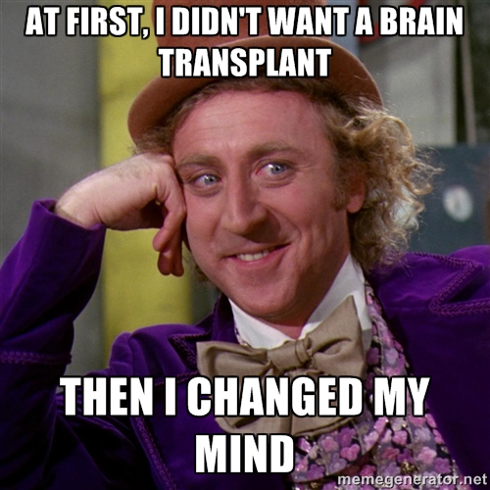
Notes:
That is what our project is designed to do. The first question we had to ask was whether we could actually see influence created by progressive media. A whole literature says that there is no way to measure that influence--that the effect is zero. But we know in our gut that isn't true. Many of us are in this room because progressive media changed our ways of thinking.
We also needed a way to be sure that the method we chose to look at influence did not come from the outlets themselves. The move from print to digital showed how much outlets exaggerated their readership. We needed an outsider.

Slide 6
sen·ti·ment a·nal·y·sis
noun: sentiment analysis
the process of computationally identifying and categorizing opinions expressed in a piece of text, especially in order to determine whether the writer's attitude towards a particular topic, product, etc., is positive, negative, or neutral.
Notes:
That;s what led us to Gary King and his team at Harvard. Gary was sure he could make visible whatever influence our outlets may have on the public, and he is a highly esteemed academic with no reason to kowtow to progressive media.
You've heard about his methods before. I can review them in detail if you like--and we also have Gary on skype with us today. But let me bottom line this for you.
The project is a success. Gary's method showed that our outlets do have a measurable influence on conversations.

Slide 7
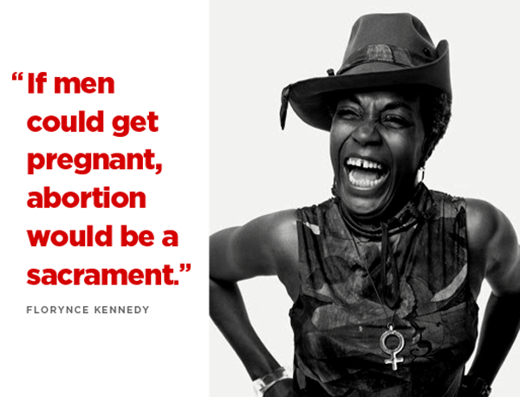
Notes:
But that chart is not easy to translate into real life, so let’s look at an example. A few years back, the Christian right decided to use the Black Lives Matter movement to attack abortion. In The Blaze, Matt Walsh argued that the war against black people is real but is not happening out on the streets, but in abortion clinics. While police killings of black men were justified, he claimed, black folks should look instead at all the potential black lives being aborted. This meme was taken up by sites like blackdignity.com, protectingblacklife.org etc.

Slide 8
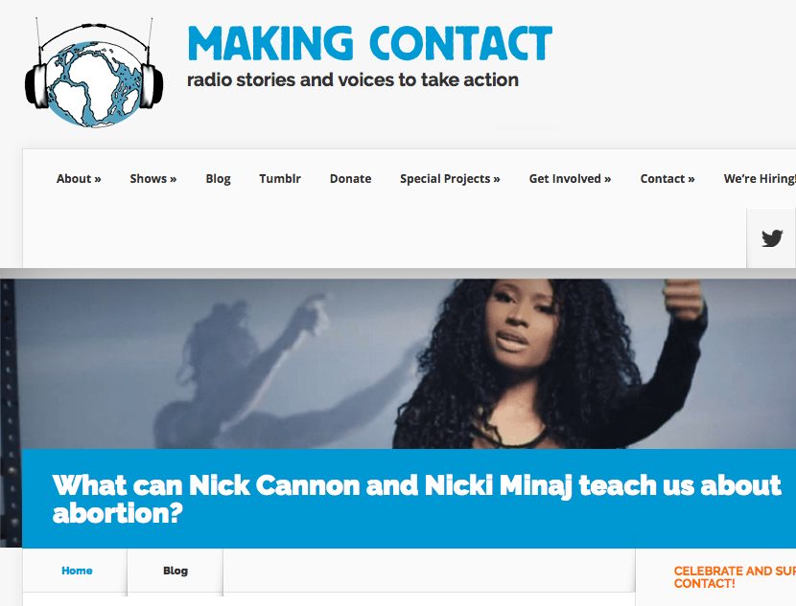
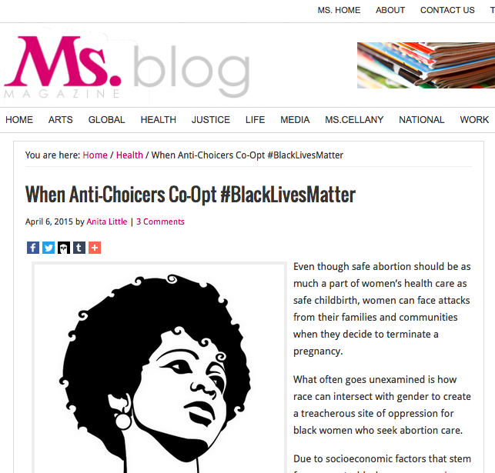
Two Davids vs. a Goliath
Notes:
Could two relatively small outlets make a difference? Could they change sentiment around abortion especially in the context of black lives? The answer was yes! On April 6, Ms. Magazine published a digital story by Anita Little titled “When Anti-Choicers Coopt #Black Lives Matter.” The same day, Making Contact Radio Project’s Jaszmin Lopez published a radio story on black singer Nicki Minaj’s song “Autobiography"

Slide 9
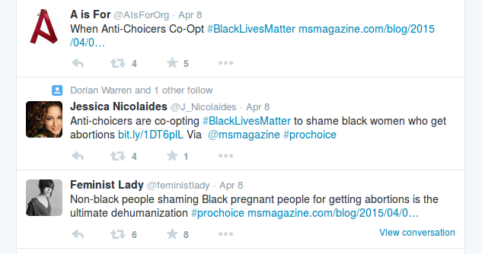
Notes:
Here are some of the tweets researchers found—these reference the Ms. magazine story directly. However the researcher’s system would have piced up the “Feminist Lady” tweet even if she hadn’t used the hashtag we were pushing or linked to the Ms. story. Juts having “black people” and “abortions” in her tweet would have been enough.

Slide 10
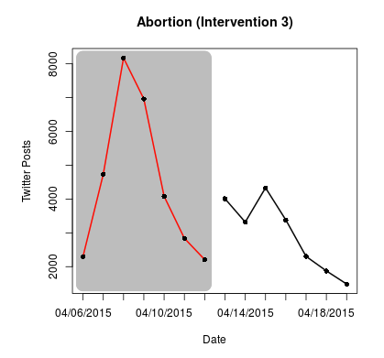
Notes:
The effect of these two stories was remarkable. The number of twitter posts that contained positive opinions on abortion almost doubled that week. People were influenced by what they read and heard.

Slide 11
Our Experiment
=>
Proves that small outlets have a measurable influence on conversations
Notes:
Making Contact and Ms. Magazine both do great reporting and have very engaged audiences. By quantitative measures they are not that big. But clearly when they co-published content, these outlets had a measurable influence on conversations.
I can't stress enough how important this is. Your funding has made possible the first-ever proof--scientific proof--that small progressive media outlets do have a real and measurable influence on public conversations.
Also look at the reverse. We now have evidence that if progressive media did not exist, we would see a lot less conversation about the issues we care most about, from climate change to abortion to immigration reform.
But the best is yet to come. Now that we have a way to measure this influence, we can start doing the real work of growing it.

Slide 12
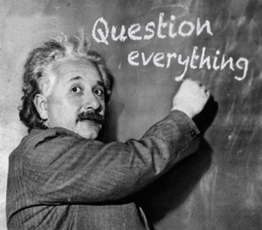
Notes:
We have so many questions we can ask. [instead of slides with questions, maybe an image?]
And we have tee'd up an experiment that will answer some of those questions quickly, while being very relevant for this election cycle.

Slide 13
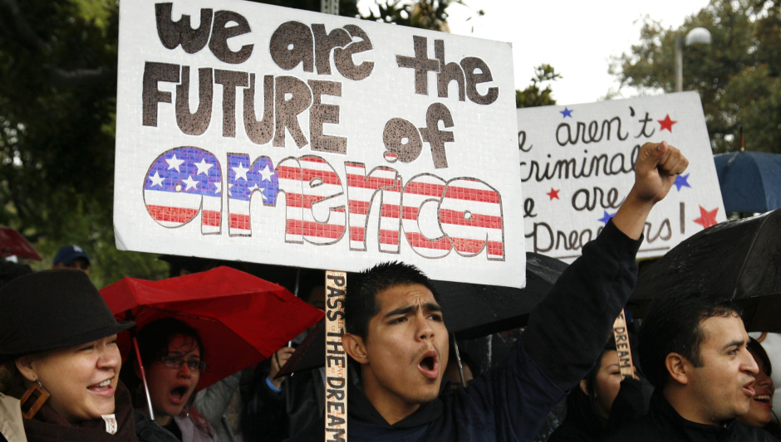
An opportunity
Notes:
Next month, the Media Consortium will launch a project on Immigrant Voter and Citizen Suppression. This project is designed to counter the nativism and xenophobia we are hearing during this electoral campaign. We need to push back with a counter narrative that will influence how Americans think about immigrants. Our focus will be on immigrants that are eligible to become citizens but face barriers to citizenship, and who are citizens but face barriers to voting. The project is designed to intersect with the Black Lives Matter movement's focus on voting rights.

Slide 14
Groundwork
Researchers have already done baseline research on immigration as a topic
TMC has already developed a core of outlets that have worked together on immigration stories and can follow the research protocol
TMC outlets asked TMC staff to put together a project on immigration—we already have buy-in from member outlets so it will be easy to bring more outlets into our program
Several foundations have expressed interest in supporting this project if we can find them a funding partner.
Notes:
Our member outlets asked us to put this project together at our annual meeting in February. We will do it. But here's our offer to you: if you are willing to continue to fund Gary's work and to fund the work of our project manager, we will be able to use this project to assess the best ways to grow our influence. We will be able, for example, to ask a big outlet like Mother Jones to publish a story one week, and then ask a few smaller outlets to publish on the same topic in a following week, and track which makes the more significant impact. We will be able to run a story on radio one week, and in text the next week, to see whether the platform makes a difference.

Slide 15
Notes:
We can do this kind of A/B testing now because you have created an infrastructure and a protocol for that testing.

Slide 16

Thank you
Notes:
Over the past twenty years, we have seen that the progressive movement can achieve real and lasting results. The gay rights movement's hard, slow work led to a culture that now embraces gay marriage. The environmental movement has a ways to go, but look at the number of electric cars on the road, and the boom in solar and wind power! The road to racial justice is long, but the Black Lives Matter movement is no sudden splash but the work of generations of civil rights' activists on the ground and in media.
Your support for this metrics project has been and continues to be critical to create the influence we seek. Thank you for your support.

Slide 17
Q & A
Notes:
End of presentation.

Slide 18
Q & A: Timeline
  Development of project; funding; recruitment of researchers and experimental subjects
  Development of project: planning the experiment; communicating w/ test subjects
  Testing the experimental protocols; communicating with test subjects
  Running the experiment (April 1, 2015 – April 1, 2016)
  Communicating about experiment; starting next phase of project.

Slide 19
Q & A: Similar Projects
Harmony Institute
  Measure social change via social media sentiment, polling, press coverage of key terms, and political discourse via the Congressional Record
  Objects measured: documentary films
Participant Index
  Measure social change via social media keyword volume changes, audience opinion data (survey), and viewership information
  Objects measured: video and film
Media Impact Project
  Combines data from social, email, web, membership and event activity to create before/after measurements for individual stories, for stories from the same outlet, and between stories from different outlets
  Objects measured: news stories on all platforms

Slide 20
Q & A: Our Assumptions
“Impact” is used here to mean how much a particular news story influences an individual’s thoughts and actions
Sentiment analysis is the best way to measure influence
The twitter audience offers an accurate representation of digital news audiences
Smaller outlets have the most influence when the work together (the theory of collective impact)

