Slide 1
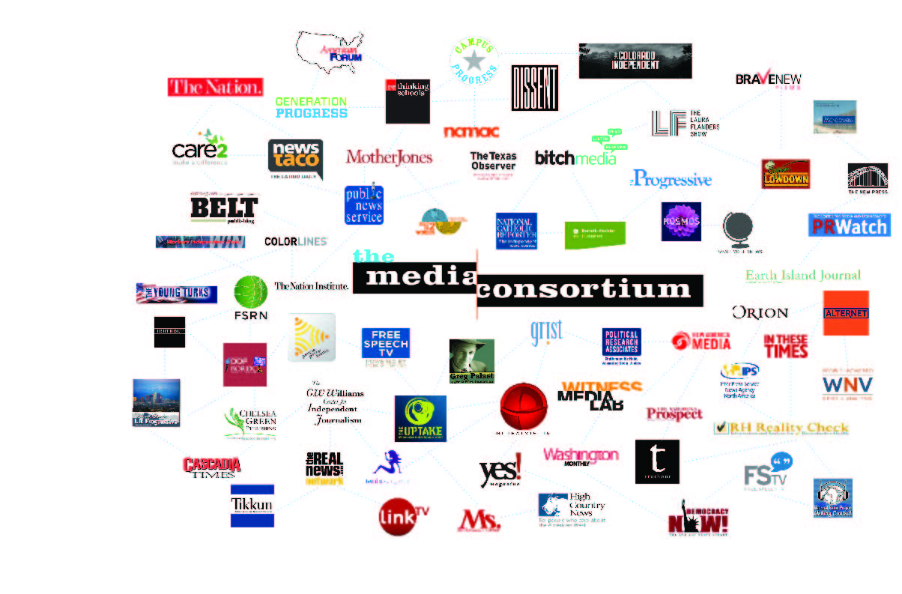
The Media Consortium
Notes:
My name is Jo Ellen Green Kaiser. I’m the Executive Director of the Media Consortium. We’re a national network of 80 independent progressive news outlets. Our mission is to support and grow the impact of the independent news sector.

