Slide 1
The Media Consortium
Mapping Our Future

Slide 2
Who Are We?
We are a Network of Independent Progressive Media Organizations

Slide 3
What Value Do We Currently Provide Our Stakeholders?
We facilitate relationship-building within the network

Slide 4
What Value Do We Hope to Provide (and sometimes achieve)?
We aspire to grow the impact of individual members’ work and of the independent, progressive media sector as a whole.

Slide 5
Examples of Success:
Wisconsin Protests
Joint reporting
Coordinated publishing
Cross promotion
=
Changed conversations
Mainstream media covered event
Protesters felt heard
Labor became a renewed focus of national attention
Occupy May Day
Joint reporting
Coordinated publishing
Cross promotion
=
Changed conversations
Mainstream media changed type of coverage
Protesters found a national media forum
Social media recognition of widespread nature of event
Furthered 99% meme

Slide 6
What Don’t We Do?
We don’t lobby on behalf of the sector
(that is done by Free Press, CMJ, NAMAC, and others)

Slide 7
What Else Don’t We Do?
We don’t offer business and technology training or services
(compare to ONA, INN, AAN)

Slide 8
Guess What?
Members won’t pay enough in dues to sustain our organization because our value to members is based on wants (mission, impact) , rather than needs (business services, technology skills)

Slide 9
At current levels of member support, TMC could remain an informal peer network with an annual meeting
It can not remain an organization focused on impact, nor can it sustain a full-time staff

Slide 10
What Are Our Options?
Downsize (become an informal peer network w/ no director)
Add Business Services, Tools, and Skills (competing directly with INN, ONA, MPA, etc)
Locate partners who value our impact goals (and are willing to provide financial support to realize them)

Slide 11
Let’s Take a Closer Look at #3
Who Values the Impact Created by our Content?
Who Values the Continuation of our Sector?
Progressive/Left Political Parties
Foundations and Major Donors
Nonprofit Organizations helped by our Sector
Other Independent Progressive Media

Slide 12
We Can Dismiss a Couple of These
Political Parties:
While most of us identify as progressive, the vast majority of outlets in the Media Consortium are non-partisan
NonProfit Organizations
They love us, but we are a want for them, not a need. They have other priorities for their funds.

Slide 13
So, What About Funders?
What Won’t Work: Ask for infrastructure support
What Funders Tell Us Will Work:
Choose 3 issues a year (abortion, fracking, etc)
Collaborate on those issues + prove impact
Question:
Will this just take away money that would have been spent on TMC members?

Slide 14
What about other organizations in our sector? Will they support us?
There are a number of other associations for independent news media:
NFCB—community radio
ACM—community TV
NAMAC—community media/film
INN—investigative news outlets
LION—hyperlocal outlets
AAN—alternative news media

Slide 15
AAN offers a Partnership
Who is AAN? They are Alt Weeklies
How are they like us?
Alt “weeklies” are becoming 24/7 digital
They are increasing the quantity and quality of their content
They are looking at hybrid biz models
They are fiercely independent and “alternative”

Slide 16
What AAN Wants
Access to our editorial collaborations
Chance to learn more about the donor model
Chance to learn more about producing regular, high-quality digital content
Increased numbers (our 70 + their 130 will lead to more $$ from sponsors for meetings)
Some of the prestige of our outlets (they struggle with reputation issues)

Slide 17
What AAN Offers
Shared Membership and Technology Staff
A presence in DC, where they are based
Shared conferences (esp their digital connect)
Ad Sharing and Content Syndication platforms
Our own 501c3 designation

Slide 18
Up for Negotiation
Will TMC dues stay the same if we partner with AAN?
Will TMC members be charged for AAN conferences or will that be included in dues?
Will AAN cover some of the cost of TMC staff?
And more

Slide 19
To Sum UP
We Must Choose a New Direction:
Downsize: become a self-run peer network
Add Biz & Tech Services : fulfill stakeholder needs so you will pay more
Become Issue-Based: appeal to funders by focusing on 3 issue areas per year
Partner with AAN: take advantage of an opportunity to join forces w/ a like org

Slide 20
What Direction Should We Take?
YOU DECIDE

Slide 21
The Media Consortium
Strategic Planning
Small Group (Saturday)
Large Group (Sunday)

Slide 22
Why We Are Here
The Problem:
TMC is not currently financially sustainable as an organization.
The Question:
What strategic direction will lead to financial sustainability while supporting our shared values?

Slide 23
Overall Strategy
Formal and organized facilitation strategy
Dotmocracy
Focused approach to discuss strategic alternatives
Small Group Breakout Sessions (Saturday)
Small Group + Large Group Call To Action (Sunday)

Slide 24
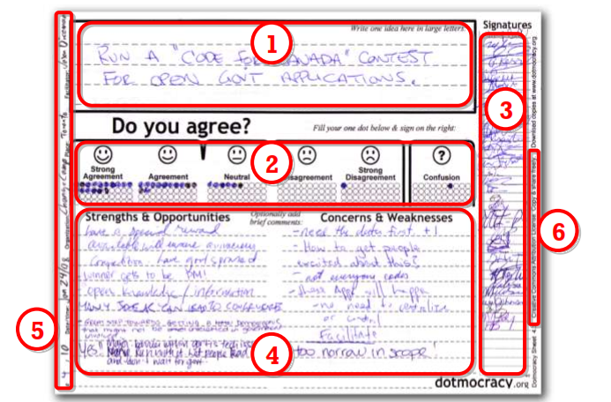
Dotmocracy
“A simple method for recognizing points of agreement among a large number of people”
- Jason Diceman

Slide 25
Dotmocracy Procedure
Each group is provided x7 Dotmocracy sheets
Peer to Peer Network - Business Services
Issue Driven (Funder Directed) - x3 Blanks
Partner w/AAN
Small group vote to identify discussion topic
Identify pro/cons & opportunities
Vote for next topic to discuss
This will either be one of the strategic directions previously identified, or a new idea discovered during group discussion
When all topics are exhausted or time runs out, complete the Dotmocracy sheets
Data will be analyzed and presented on Sunday
Sunday is a combination of small group, large group & decisions

Slide 26
Colored Pens
Funding Partners = Blue Pens
Allies = Black Pens
Members = Red Pens

